Slide 1
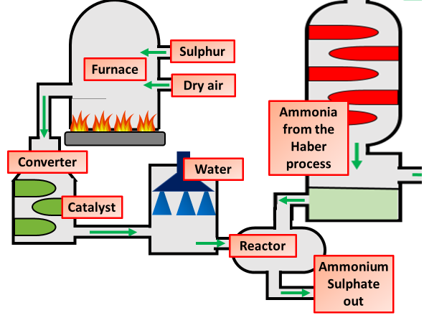
Ammonium Sulphate Question
Specification Link:
Using Resources:
Highlight key words in the information below:
Fertilisers may contain nitrogen, phosphorus and potassium compounds. Ammonia is manufactured by the Haber process and can be used to make ammonium sulfate, which can be used as a fertiliser.
The industrial production of ammonium sulfate happens on a much larger scale than its production in the lab. A fertiliser factory often begins with the raw materials needed to make ammonia and sulfuric acid, rather than buying these two reactants from elsewhere.
Ammonium sulfate and urea are made from ammonia. These compounds are used by farmers. The diagram shows the stages to make ammonium sulfate
Using ammonia solution, describe how you would make the fertiliser ammonium sulphate.
__________________________________________________________________________________________________________________________________________________________________________________________________________________________________________________________________________________________________________________________________________________________________________________________________________________________
Give two examples from the diagram of the efficient use of energy and raw materials.
____________________________________________________________________________________________________________________________________________________________________
What are the raw materials to make ammonium sulphate?
________________________________________________________________________________
The equation for the production of ammonium sulphate is shown below:
2NH₃(aq) + H₂SO₄(aq) →(NH₄)₂SO₄(aq)
Complete the table below
The lab preparation of ammonium sulfate is a 'batch' process. A small amount of product is made slowly at any one time, and the apparatus cleaned ready to make another batch. The industrial production of ammonium sulfate is a 'continuous' process. The product is made quickly all the time, as long as raw materials are provided.
Question | Answer
How many hydrogens are there in the formula of ammonium sulphate?
What is the name of the substance with the formula NH₃?
What is the name of the substance with the formula H₂SO₄?
What are the differences between a continuous & batch process
__________________________________________________________________________________________________________________________________________________________________________________________________________________
Describe how the equipment to the left could be used to measure the rate of photosynthesis:
_______________________________________________________________________________________________________________________________________________________________________________________________________________________________________________________________

