Slide 1
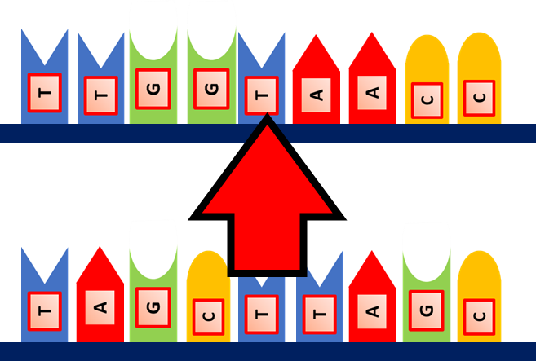
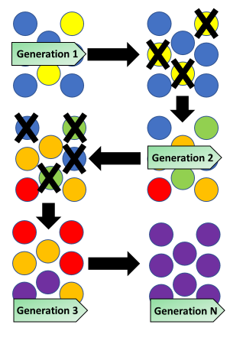
Antibiotics
Specification Link:
Infection & Response
Highlight key words in the question below:
What do antibiotics do to bacteria?
______________________________________________________________________________________
Antibiotics are substances that slow down or stop the growth of bacteria. They are commonly prescribed medicines, examples include penicillin and amoxicillin. These can be taken to cure the disease by killing the pathogen, but only cure bacterial diseases and not viral ones.
Antibiotics damage the bacterial cells but do not damage the host cells. They have the ability to cure some bacterial diseases that would have previously killed many people. Since their introduction, they have had a large influence on the world's health and death rate.
Different bacteria cause different diseases. One antibiotic may only work against one type of bacteria, or a few types. This means that a range of different antibiotics is needed for the treatment of the whole range of bacterial diseases.
What is an example of an antibiotic?
___________________________________________
Why don’t antibiotics work on viruses?
______________________________________________________________________________________
What effect have antibiotics had on the Earth’s death rate?
______________________________________________________________________________________
Why are different antibiotics needed?
______________________________________________________________________________________
A Mutation occurs when a DNA gene is damaged or changed in such a way as to alter the genetic message carried by that gene. A Mutagen is an agent of substance that can bring about a permanent alteration to the physical composition of a DNA gene such that the genetic message is changed.
What is a mutation?
_______________________________________________________________________________________________________________________________________________________________
Using the diagram to the right, explain how bacteria become resistant to antibiotics:
______________________________________________________________________________________________________________________________________________________________________________________________________________________________________________________________________________________________________________________________
How can we stop antibiotic resistant bacteria from evolving?
__________________________________________________________________________________________________________

Slide 2

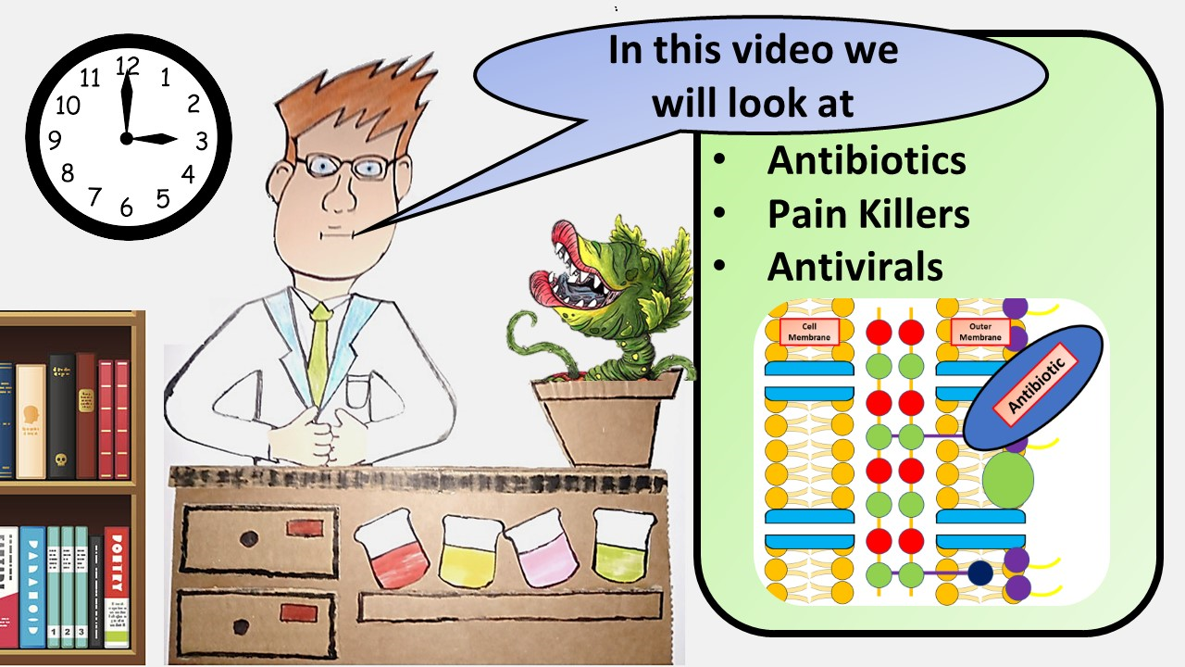


Click here to access my youtube videos
Resources that this activity would work well with
Lesson on TES
Lesson on TPT
Follow me on social media to stay in touch
Keep up to date with my new content:

