Slide 1
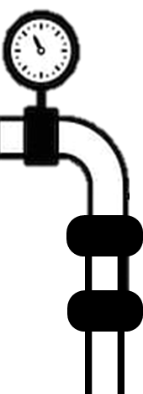
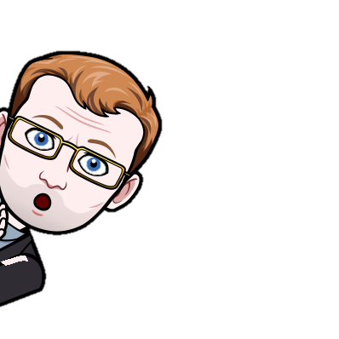
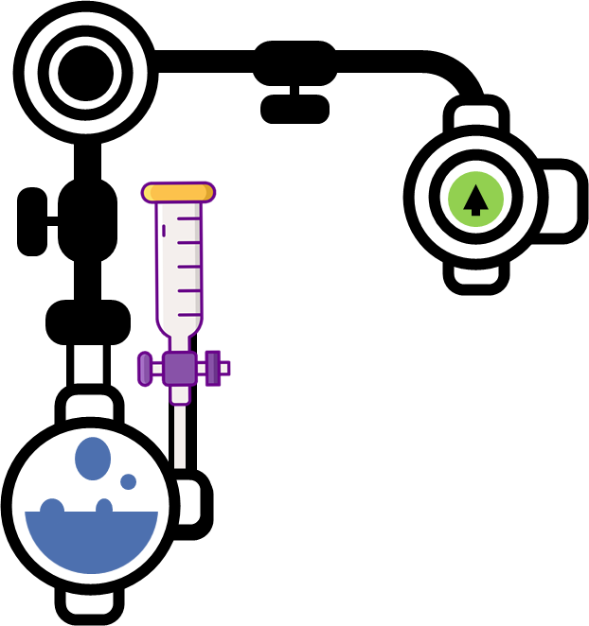
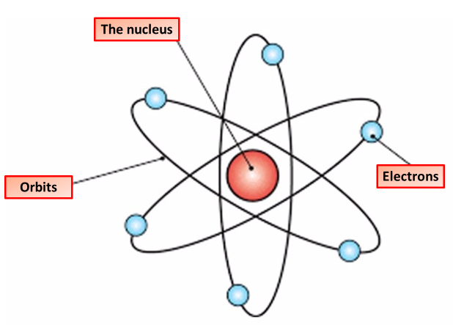
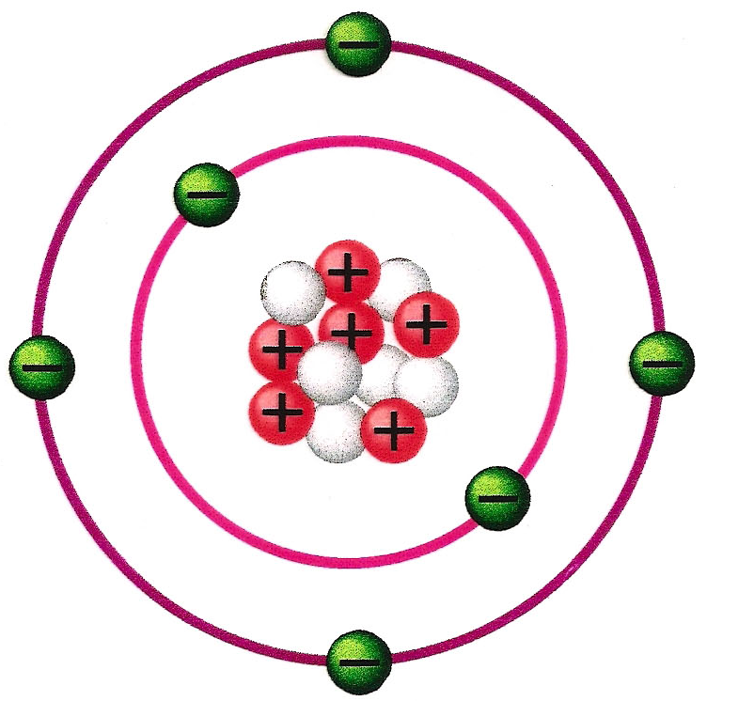
Atoms, Compounds & Mixtures
An atom a fundamental piece of matter. An atom itself is made up of three tiny kinds of particles called subatomic particles: protons, neutrons, and electrons. The protons and the neutrons make up the centre of the atom called the nucleus, and the electrons fly around above the nucleus in a small cloud.
The periodic table is a chart showing all the elements arranged in order of increasing atomic number. The vertical columns in the periodic table are called groups. Each group contains elements that have similar properties .
Atoms consist of electrons surrounding a nucleus that contains protons and neutrons.
Electrons are contained in shells around the nucleus. The number of electrons is the same as the number of protons. The have a -1 charge
The Nucleus is the centre of the atom and is made up of protons and neutrons. The nucleus has a positive charge
Neutrons are found in the nucleus of the atom, has a mass of 1 and no charge
The electronic structure of an atom is a description of how the electrons are arranged. It can be shown as numbers or as a diagram. Electron configuration diagram for lithium. Take lithium for example. The diagram shows each energy shell as a circle around the nucleus, each electron is represented by a dot.
Protons are found in the nucleus of the atom, has a mass of 1 and a charge of +1
Atoms the same number of electrons as it’s atomic number
The first shell can hold 2 electrons
All other shells can hold 8 electrons
Electrons are drawn in pairs
Only move onto the next shell once the shell is full
A mixture contains two or more substances. that have not reacted chemically with each other. A mixture is made of little bits of each substance mixed together. A mixture can be separated by physical methods, a compound can not.
A chemical compound is a chemical substance composed of many identical molecules composed of atoms from more than one element held together by chemical bonds.
Crystallisation is used to produce solid crystals from a solution. When the solution is warmed, some of solvent evaporates leaving crystals behind.
Paper chromatography is used to separate mixtures of soluble substances. These are often coloured substances such as food colourings, inks, dyes or plant pigments.
Simple distillation works because the dissolved solute has a much higher boiling point than the solvent. When the solution is heated, solvent vapour leaves the solution. It moves away and is cooled and condensed. The remaining solution becomes more concentrated as the amount of solvent in it decreases.

Slide 2
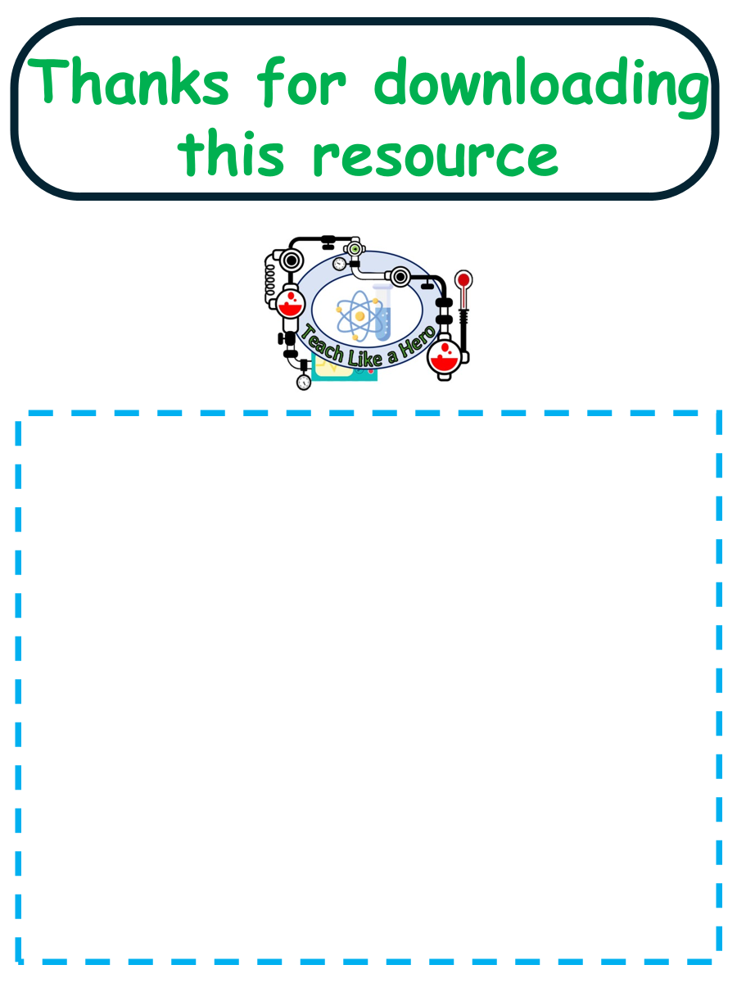
Click here to access my atoms youtube videos
Resources that this activity would work well with
Lesson on TES
Lessons on TPT
Follow me on social media to stay in touch
Keep up to date with my new content:

