Slide 1

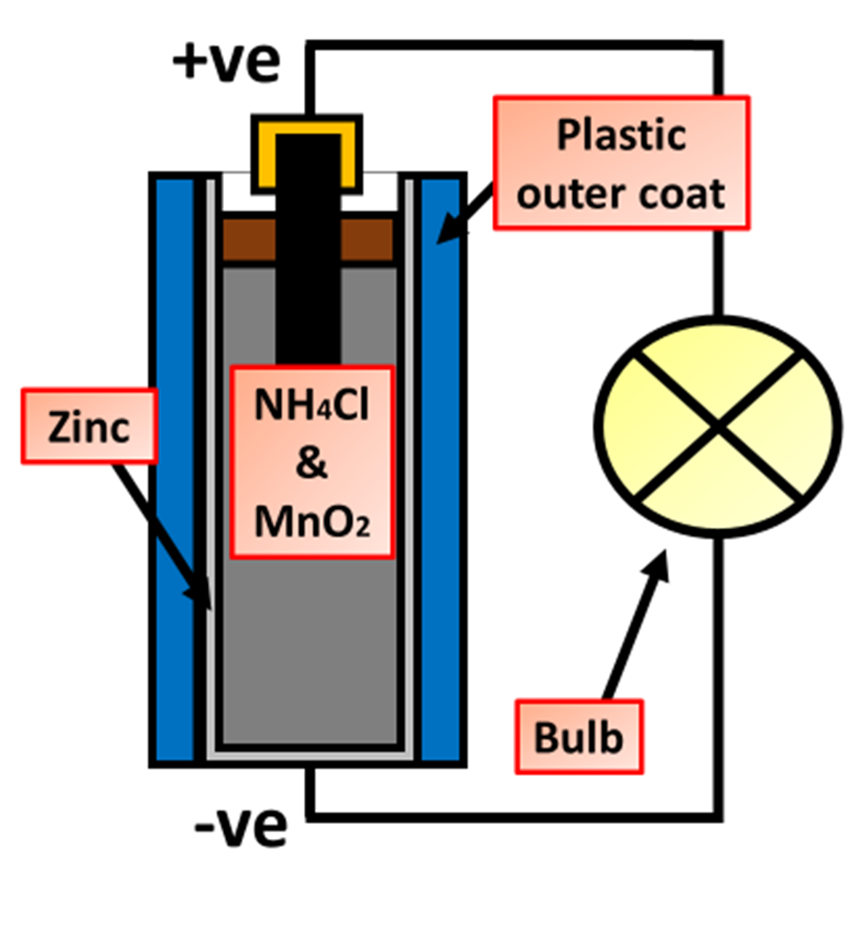
Batteries Article
Batteries are devices that store and provide electrical energy through chemical reactions. They consist of two electrodes—a positive cathode and a negative anode—separated by an electrolyte, which allows ions to move between the electrodes. When a battery is connected to a circuit, a chemical reaction occurs between the electrodes and the electrolyte, causing electrons to flow from the anode to the cathode through the external circuit, creating an electric current that powers devices.
The development of batteries began in the late 18th century with Alessandro Volta, who created the first true battery, known as the Voltaic Pile, in 1800. It consisted of alternating discs of zinc and copper, separated by pieces of cloth soaked in saltwater. This invention paved the way for further advancements, including the development of more efficient and reliable batteries, such as the alkaline battery and the lithium-ion battery, which is widely used in modern electronic devices. Batteries have revolutionized technology by providing a portable and convenient source of power for countless applications.
Questions
What is a battery?
What are the electrodes called in a battery?
What creates current from a battery?
Who developed the first battery?
What liquid was used in the first batteries?

