Slide 1

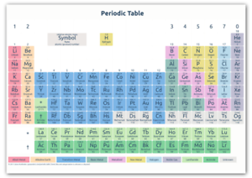
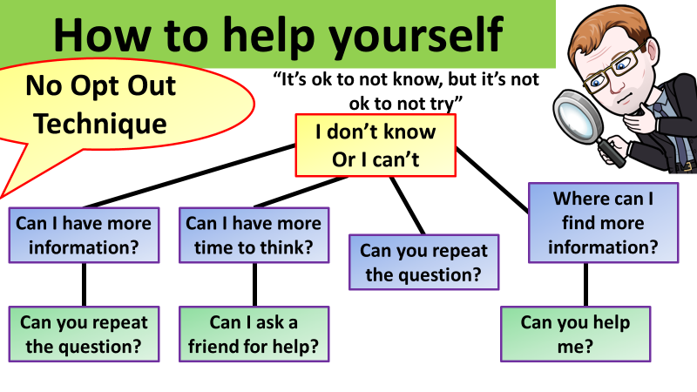


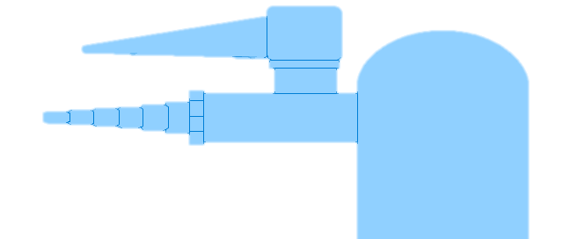

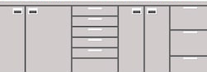

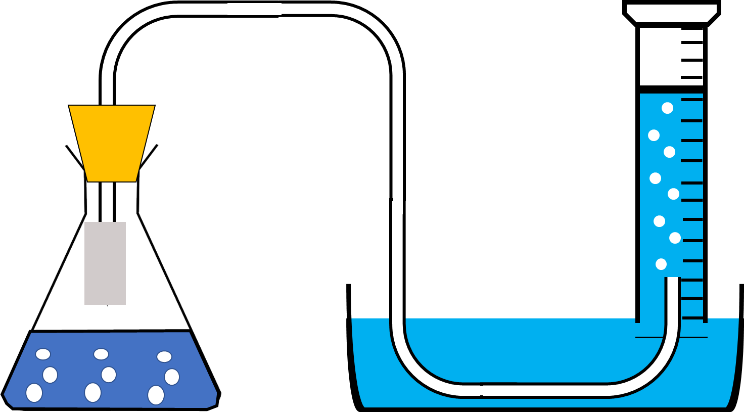
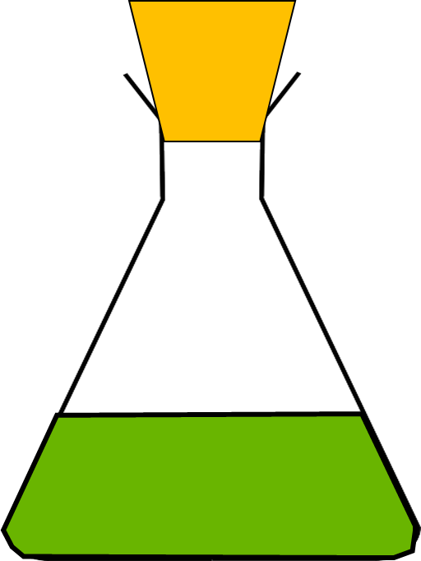


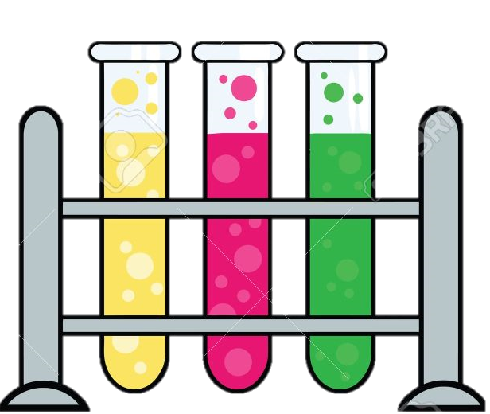
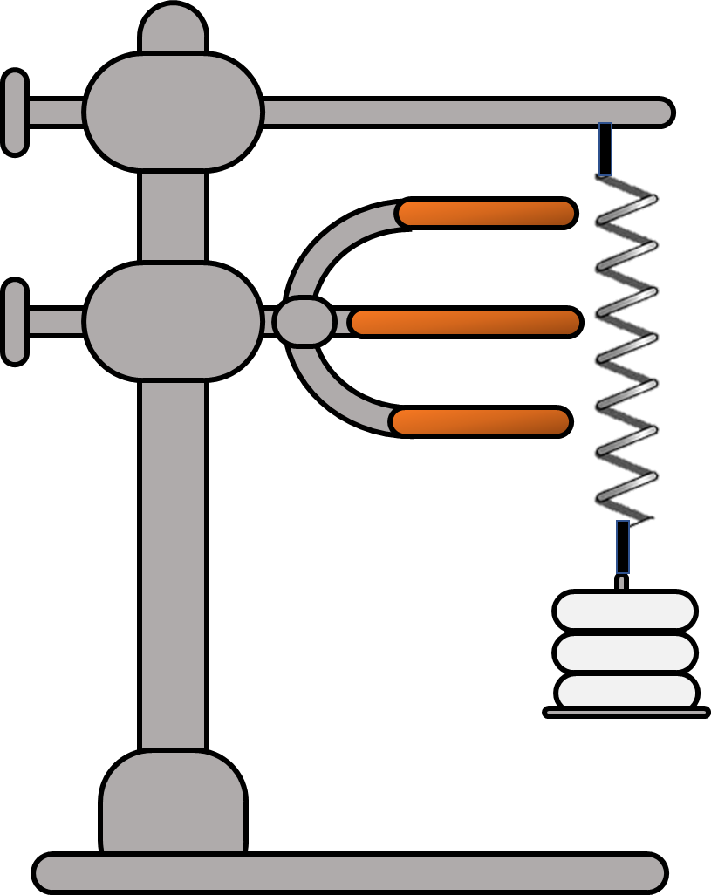
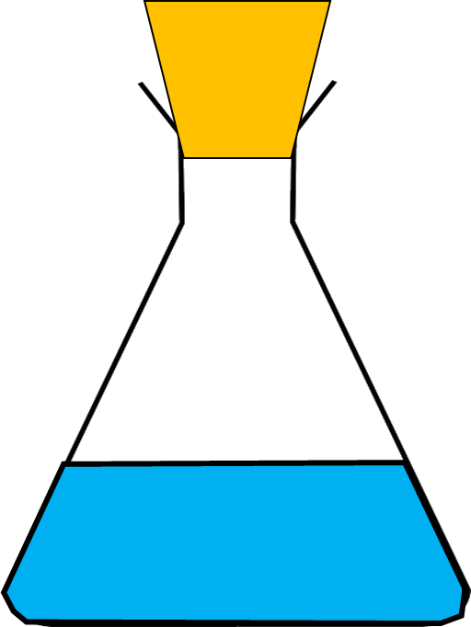
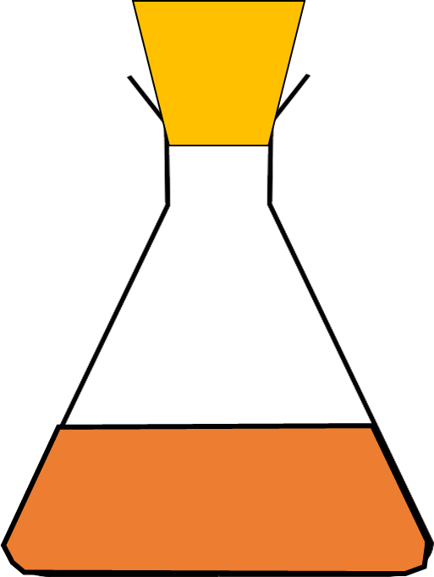
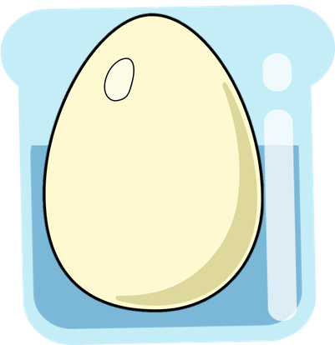
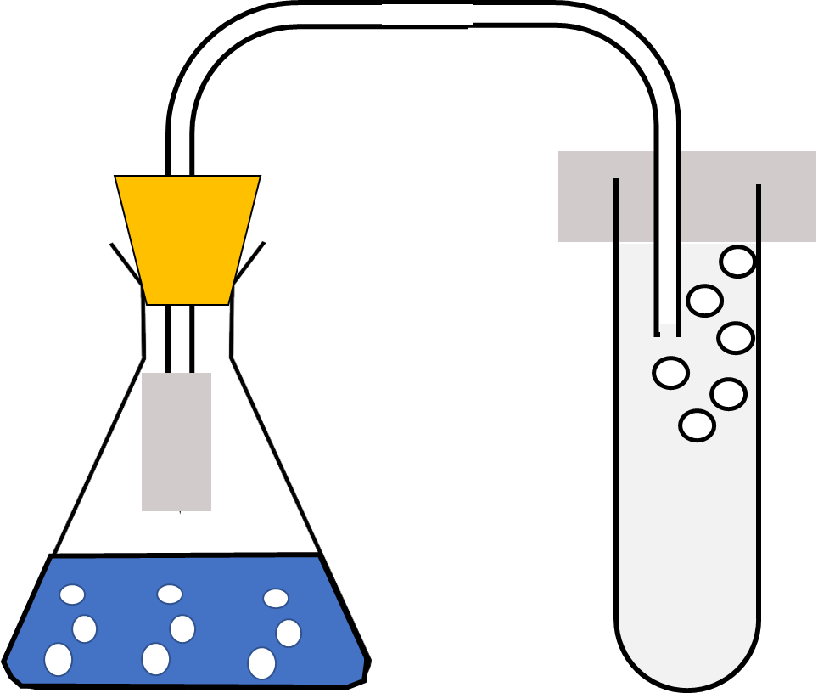


Biology Required Practical's Revision

Slide 2
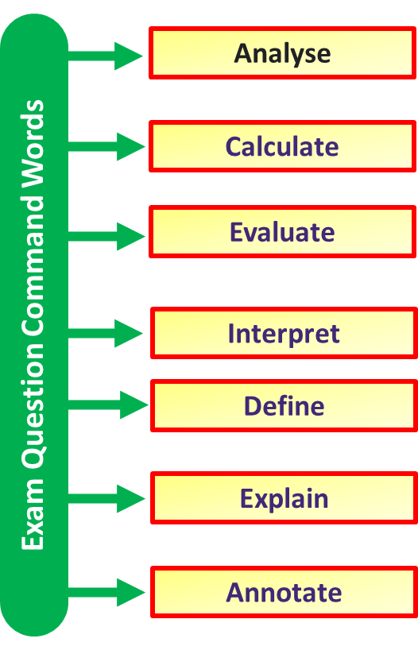
Improving Exam Technique
Key Idea
Read the question
Reread the question
Specification Link:
Science Revision
Method 1: Know the meaning of command words
Command words are the words and phrases used in exams and other assessment tasks that tell you how they should answer the question.
State – Give a simple answer such as a correct term or name.
Describe – Give detail about what happens, where is happens and when is happens. If it is “describe a graph”, give numbers and data from the graph.
Explain – Give detail about how and why it happens. Use specific key terminology within the topic/subject.
Suggest – Come up with an idea based on what you have learnt
Notes:
Print off enough boards for students to use them in pairs

Slide 3
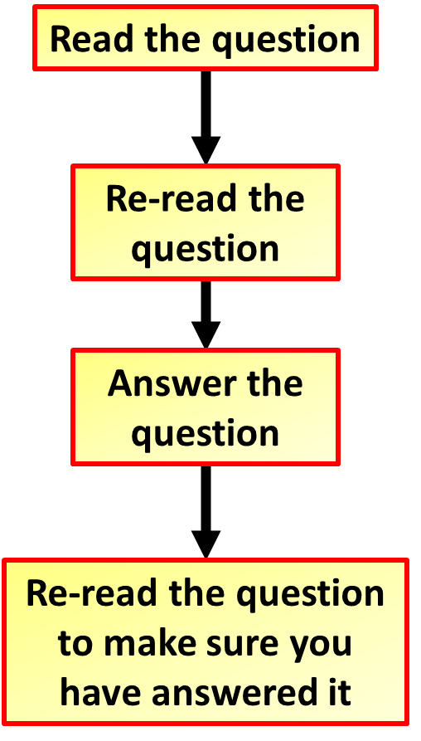
Improving Exam Technique
Key Idea
Read the question
Reread the question
Specification Link:
Science Revision
Method 2: Read the question thoroughly
Read the directions and questions more than once, if necessary. Underline key words. You don't want to re-answer a question
Box – Firstly, students box the command word. This highlights what type of answer the examiner is looking for.
Underline – Then they underline key words, this help jog your memory of the topic.
Glance – Finally they glance over the question again to gain any more information thus allowing you to analyse the question thoroughly and depict what they examiner is asking.
Notes:
Print off enough boards for students to use them in pairs

Slide 4
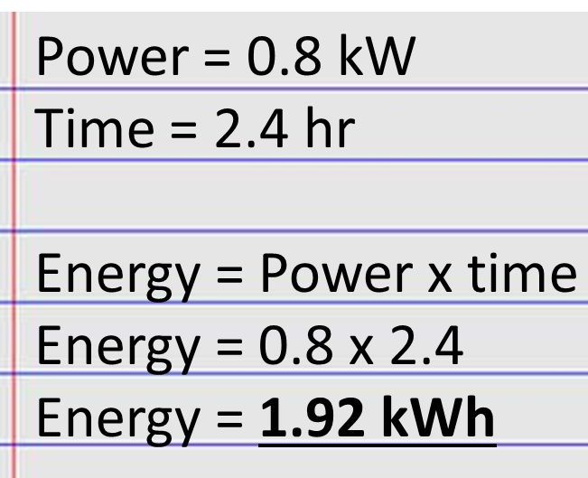
Improving Exam Technique
Key Idea
Read the question
Reread the question
Specification Link:
Science Revision
Method 3: Don’t miss out on equation question marks
Lots of easy marks are missed in exams when it comes to answering questions that involve equations. Take your time when answering the and remember the following:
Write down the equation you are going to use. If the “standard” form of the equation (e.g. F=ma) needs to be rearranged (e.g. a=F/m) then write down both forms, in case you rearrange the equation incorrectly.
Substitute the quantities from the question into your formula and carry out the calculation.
Write down the answer and don’t forget to use the correct unit.
Notes:
Print off enough boards for students to use them in pairs

Slide 5
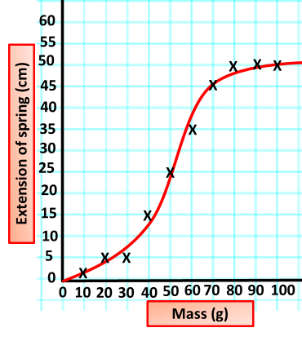
Improving Exam Technique
Key Idea
Read the question
Reread the question
Specification Link:
Science Revision
Method 4: Don’t rush graph questions
When drawing a graph make sure you use the majority of the grid space available.
Always think about the features of the graph: what do the axis intercepts, the gradient of the line and the area underneath the line mean
Label each axis with the name of the quantity and its unit
In general:
The independent variable goes on the x-axis
The dependent variable goes on the y-axis
Notes:
Print off enough boards for students to use them in pairs

Slide 6
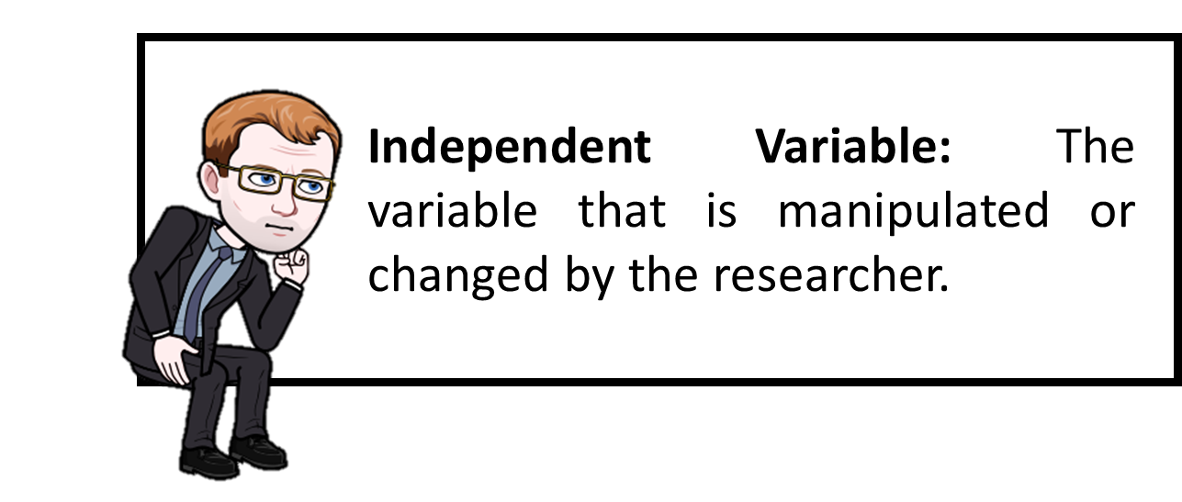
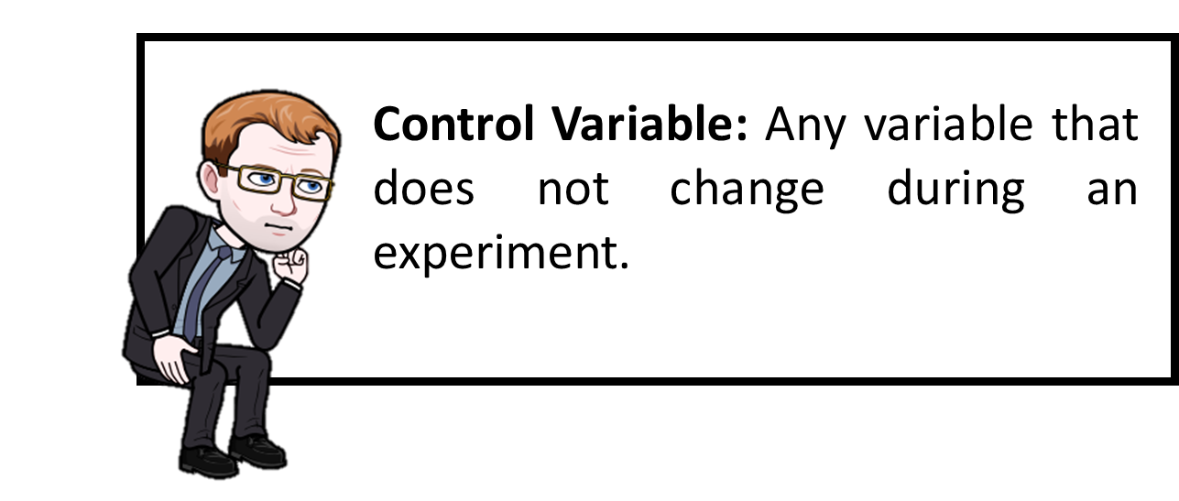
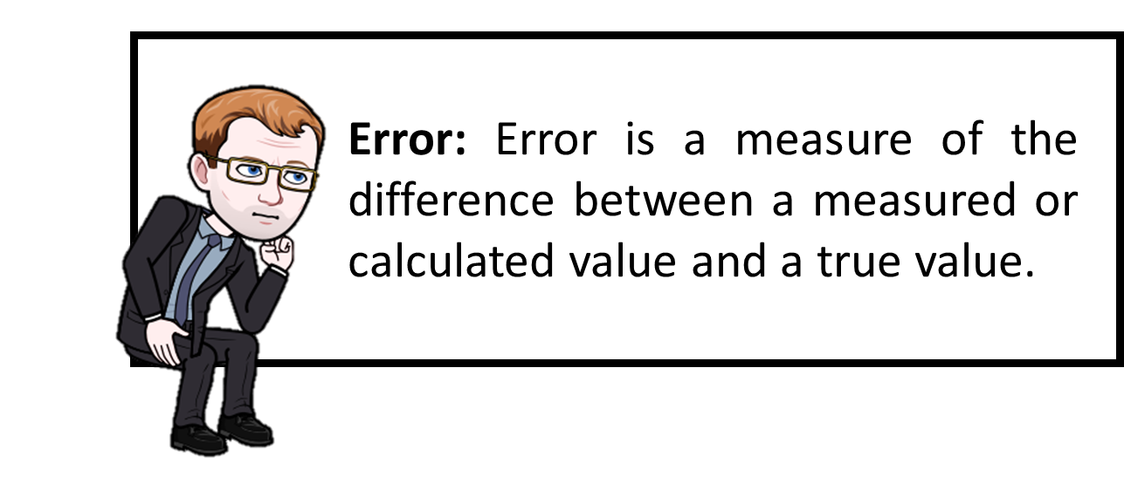
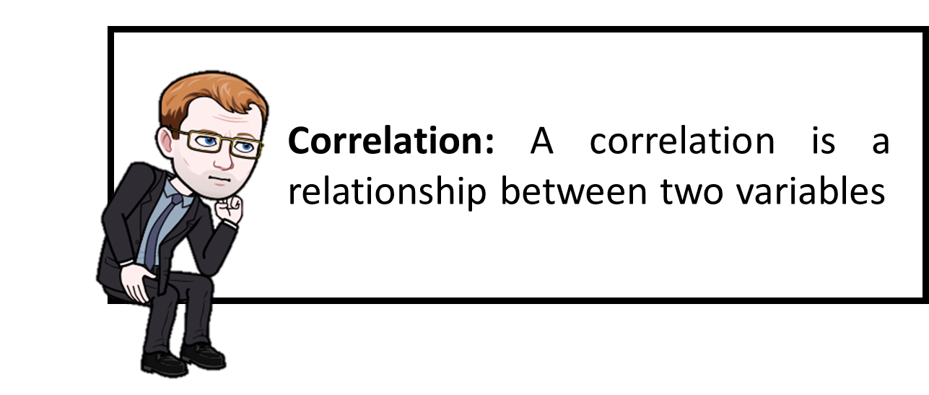
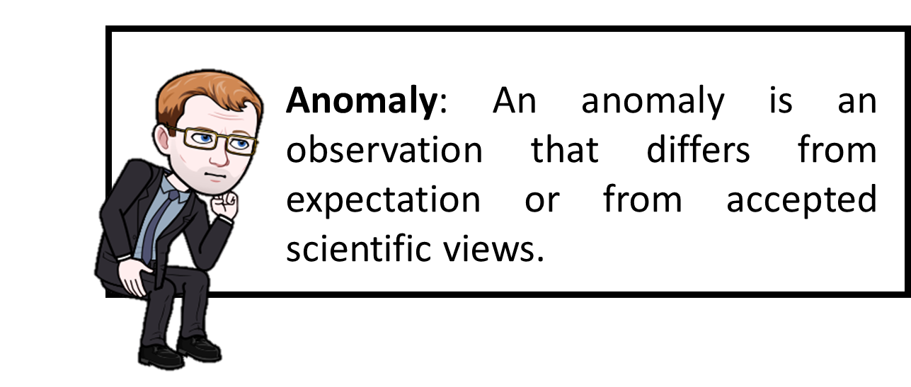
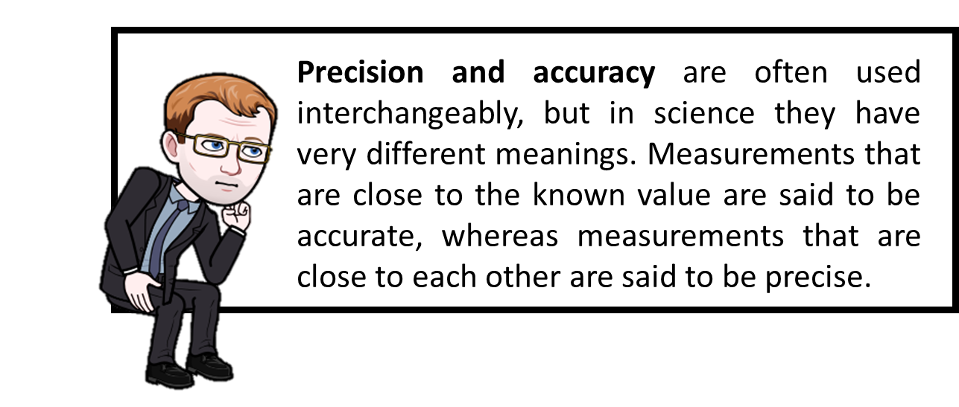
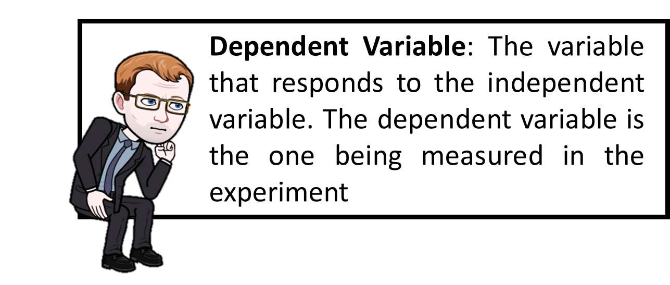
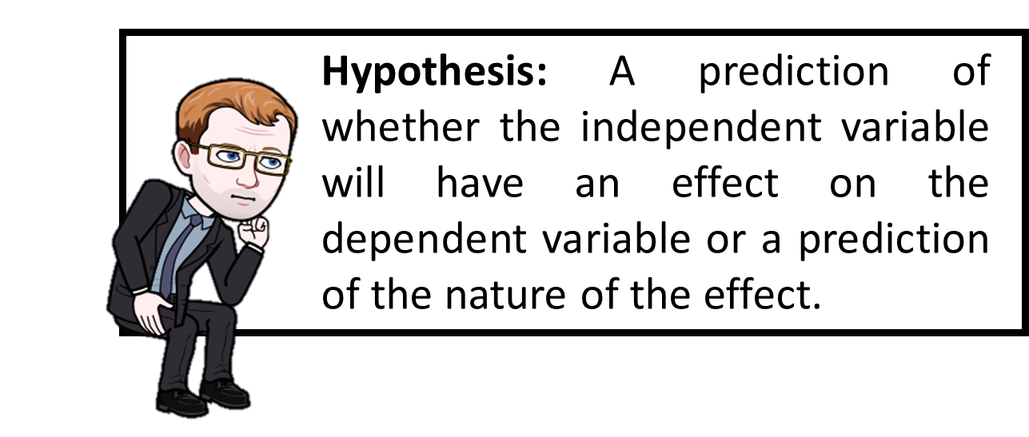
When we are looking at practical activities in Science it’s important to use some key words

Slide 7

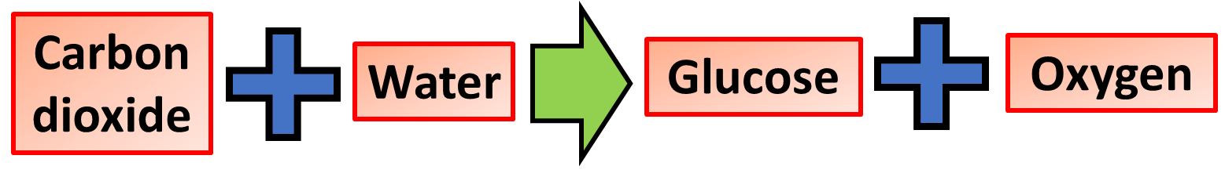
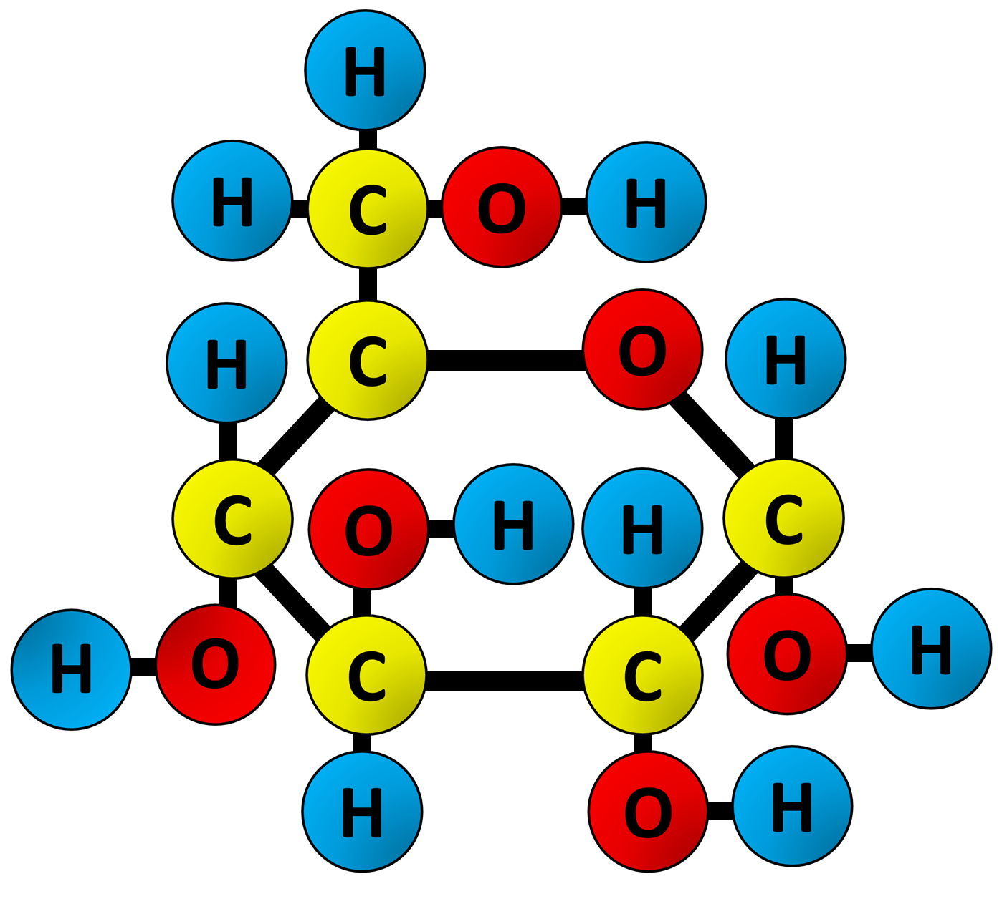
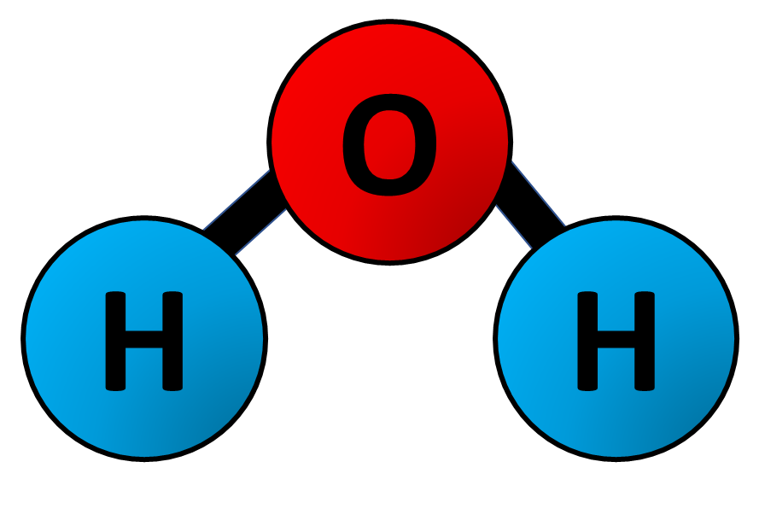

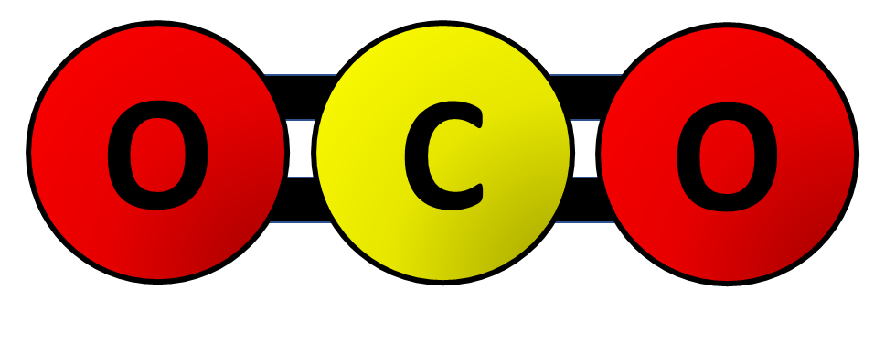
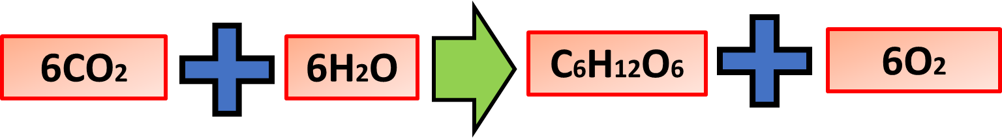
Limiting Factors
Key Words:
Water
Carbon dioxide
Temperature
Light
Specification Link:
4.4.1.1 Photosynthesis reaction
What is a limiting factor?
Introduction
Photosynthesis is a chemical reaction that takes place inside a plant, producing food for the plant to survive. Carbon dioxide, water and light are all needed for photosynthesis to take place. Photosynthesis happens in the leaves of a plant.
In a process like photosynthesis which is affected by more than one factor, its rate is limited by the factor which is closest to its minimum value
So at any point in time if one of the three factors is in low supply, this factor will be the limiting factor
Only a change to the limiting factor will increase or decrease the rate of photosynthesis. Changing the other two will have no effect.

Slide 8
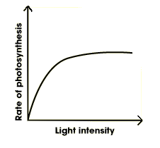
Limiting Factors
Key Words:
Water
Carbon dioxide
Temperature
Light
Specification Link:
4.4.1.1 Photosynthesis reaction
What is a limiting factor?
Light
Without enough light, a plant cannot photosynthesise very quickly, even if there is plenty of water and carbon dioxide. Increasing the light intensity will boost the speed of photosynthesis.
In a process like photosynthesis which is affected by more than one factor, its rate is limited by the factor which is closest to its minimum value
So at any point in time if one of the three factors is in low supply, this factor will be the limiting factor
Describe the change in the rate of photosynthesis
A
Only a change to the limiting factor will increase or decrease the rate of photosynthesis. Changing the other two will have no effect.
Is there any way that the rate of photosynthesis can be artificially increased?
B

Slide 9
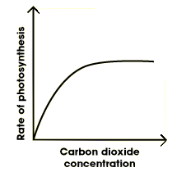
Limiting Factors
Key Words:
Water
Carbon dioxide
Temperature
Light
Specification Link:
4.4.1.1 Photosynthesis reaction
What is a limiting factor?
Carbon dioxide
Sometimes photosynthesis is limited by the concentration of carbon dioxide in the air. Even if there is plenty of light, a plant cannot photosynthesise if there is insufficient carbon dioxide
In a process like photosynthesis which is affected by more than one factor, its rate is limited by the factor which is closest to its minimum value
So at any point in time if one of the three factors is in low supply, this factor will be the limiting factor
Describe the change in the rate of photosynthesis
A
Only a change to the limiting factor will increase or decrease the rate of photosynthesis. Changing the other two will have no effect.
Is there any way that the rate of photosynthesis can be artificially increased?
B

Slide 10
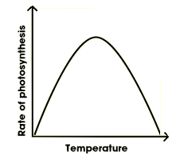
Limiting Factors
Key Words:
Water
Carbon dioxide
Temperature
Light
Specification Link:
4.4.1.1 Photosynthesis reaction
What is a limiting factor?
Temperature
If it gets too cold, the rate of photosynthesis will decrease. Plants cannot photosynthesise if it gets too hot. If the temperature gets too hot the enzymes that carry out photosynthesis become denatured so no longer work.
In a process like photosynthesis which is affected by more than one factor, its rate is limited by the factor which is closest to its minimum value
So at any point in time if one of the three factors is in low supply, this factor will be the limiting factor
Describe the change in the rate of photosynthesis
A
Only a change to the limiting factor will increase or decrease the rate of photosynthesis. Changing the other two will have no effect.
What causes the rate of photosynthesis to go down to 0
B

Slide 11
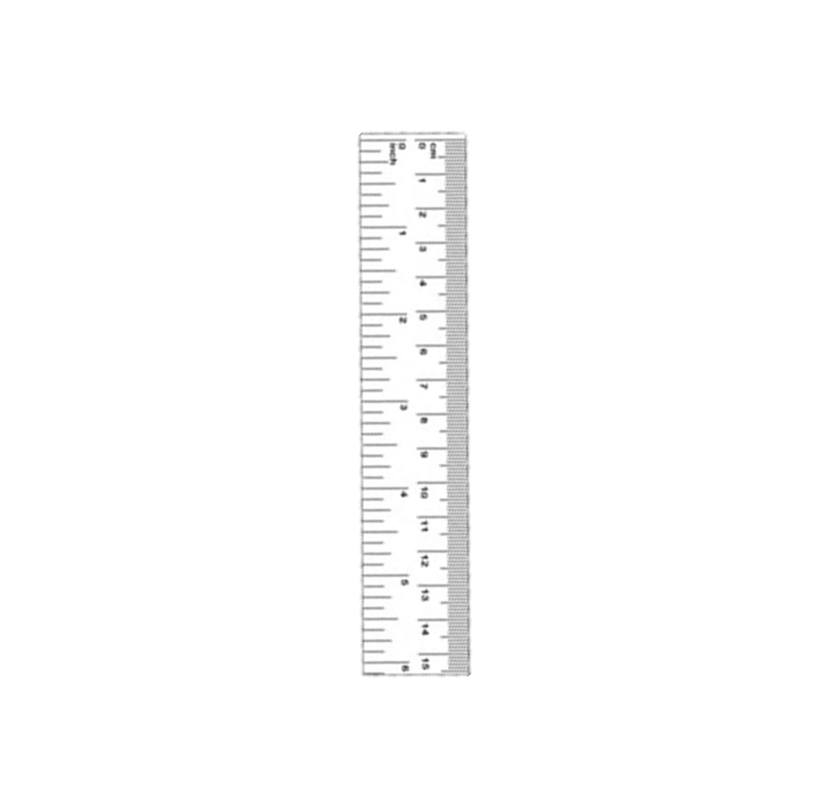
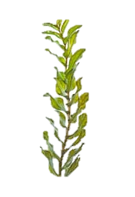
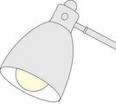

Photosynthesis Required Practical
Specification Link:
Chemical Analysis: 4.8.1.3
Lamp: decreases light intensity as you move it further away
Pond weed: Underwater plants are used as we can either count the number of bubbles or measure the volume of oxygen
Calcium carbonate: Ensures that carbon dioxide isn’t a limiting factor
Ruler: Measures length in mm

Slide 12
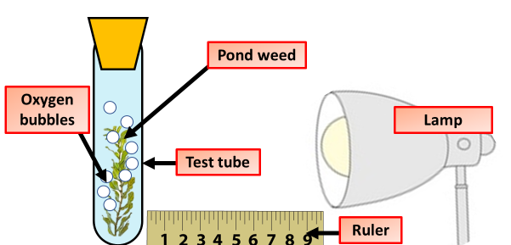
Limiting Factors
Key Words:
Water
Carbon dioxide
Temperature
Light
Specification Link:
4.4.1.1 Photosynthesis reaction
Method:
Set up a test tube rack containing a boiling tube at a distance of 10 cm away from the light source
Fill the boiling tube with the sodium hydrogen carbonate solution.
Put the piece of pondweed into the boiling tube with the cut end at the top. Gently push the pondweed down with the glass rod.
Leave the boiling tube for 5 minutes.
Start the stop watch and count the number of bubbles produced in one minute.
Repeat the count twice more. Then use the data to calculate the mean number of bubbles per minute.
Repeat steps 1‒7 with the test tube rack and boiling tube at distances of 20 cm, 30 cm and 40 cm from the light source.
Measuring the rate of photosynthesis
Measuring photosynthesis via the production of oxygen. Oxygen can be measured by counting bubbles evolved from pondweed, or by using the apparatus to measure the amount of gas evolved over a period of time.

Slide 13

Answering GCSE Biology Practical Exam Questions
A student is asked to investigate the effect of light intensity on photosynthesis in pondweed. Some of the equipment they were provided with is shown below:
a boiling tube
freshly cut 10 cm piece of pondweed
a light source
a ruler
a test tube rack
a stop watch
0.2% solution of sodium hydrogen carbonate solution
a glass rod.
Describe how they could carry out this investigation. You may wish to draw a diagram to show how the equipment can be set up.

Slide 14
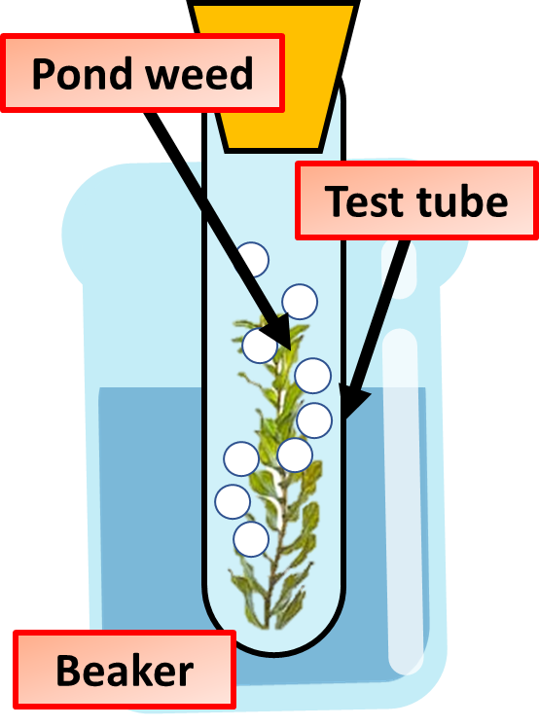
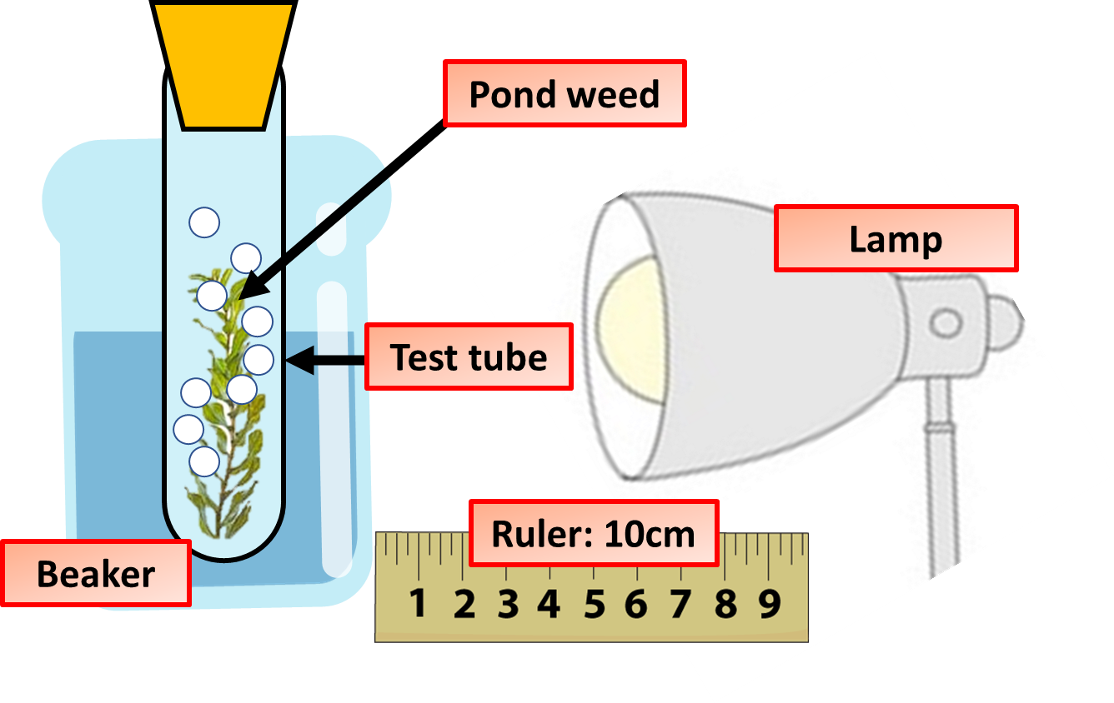
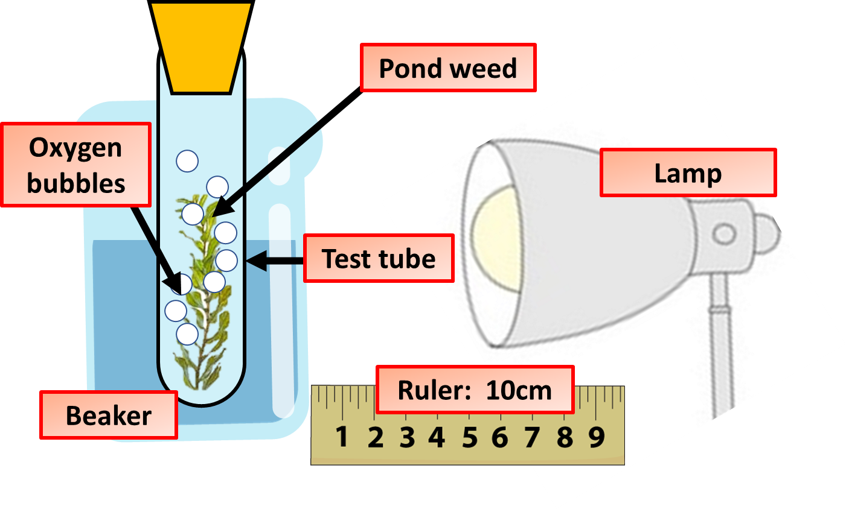

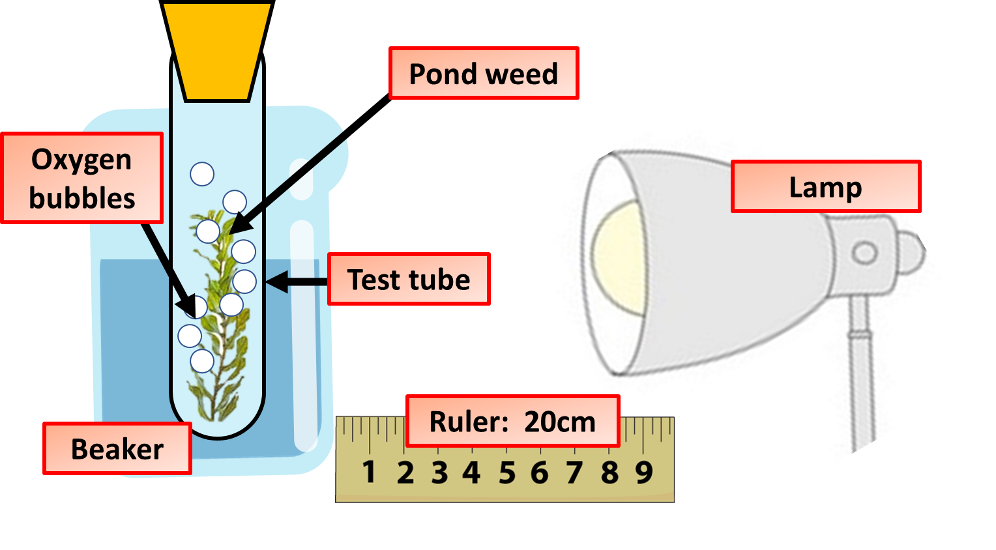
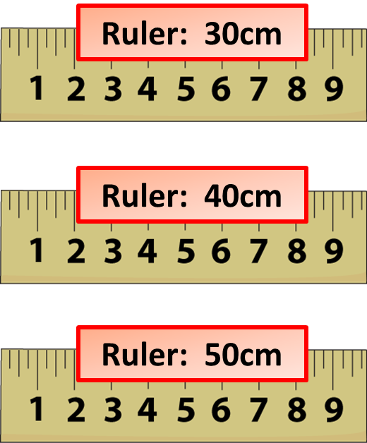
Photosynthesis Investigation Method
Specification Link:
4.4.1.1 Photosynthesis reaction
Task
In pairs, construct a method to look at how light intensity affects the rate of photosynthesis
Notes:
Print off enough games for students to use them in pairs
After students have finished ask them the questions at random to ensure they’ve picked up the correct answers

Slide 15
Answering GCSE Biology Practical Exam Questions
A student is asked to investigate the effect of light intensity on photosynthesis in pondweed. Describe how they could carry out this investigation. You may wish to draw a diagram to show how the equipment can be set up.
Set up a test tube rack containing a boiling tube at a distance of 10 cm away from the light source
Fill the boiling tube with the sodium hydrogen carbonate solution.
Put the piece of pondweed into the boiling tube with the cut end at the top. Gently push the pondweed down with the glass rod.
Leave the boiling tube for 5 minutes.
Start the stop watch and count the number of bubbles produced in one minute.
Repeat the count twice more. Then use the data to calculate the mean number of bubbles per minute.
Repeat steps 1‒7 with the test tube rack and boiling tube at distances of 20 cm, 30 cm and
40 cm from the light source.

Slide 16
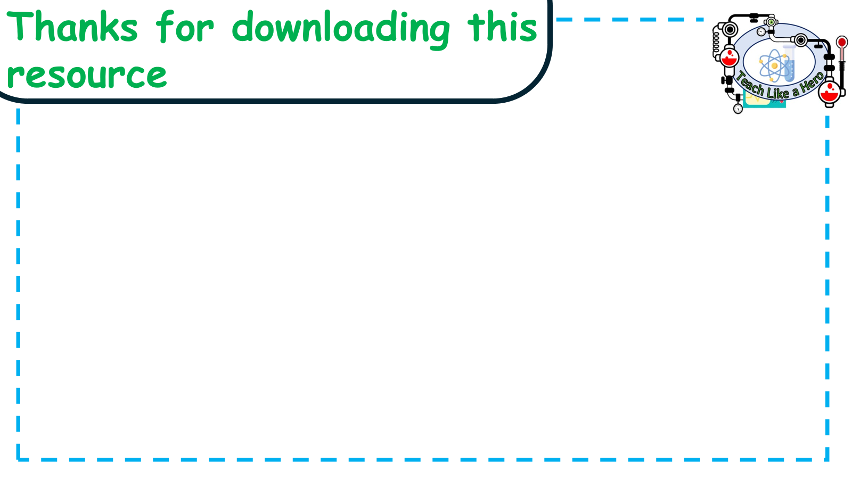
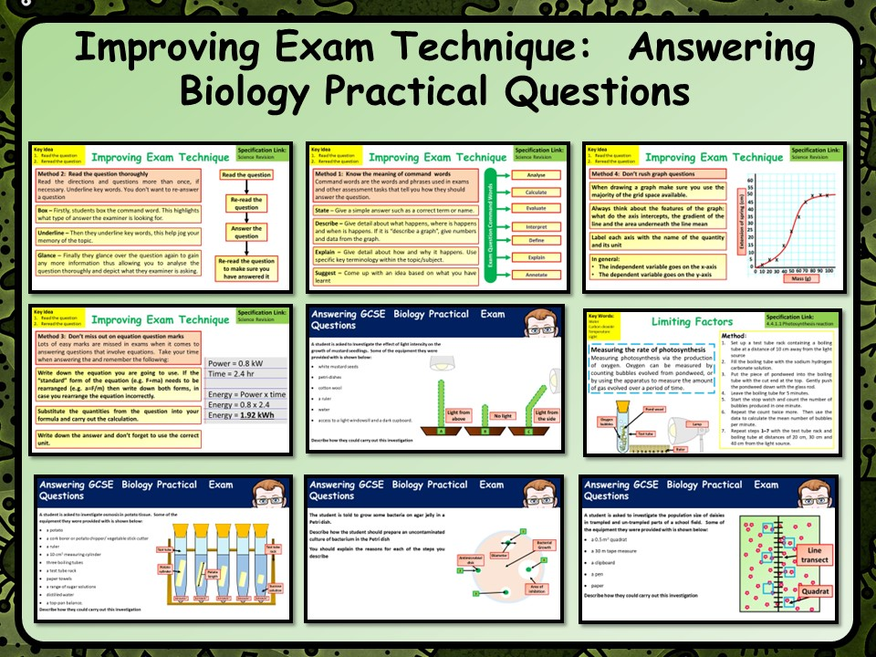
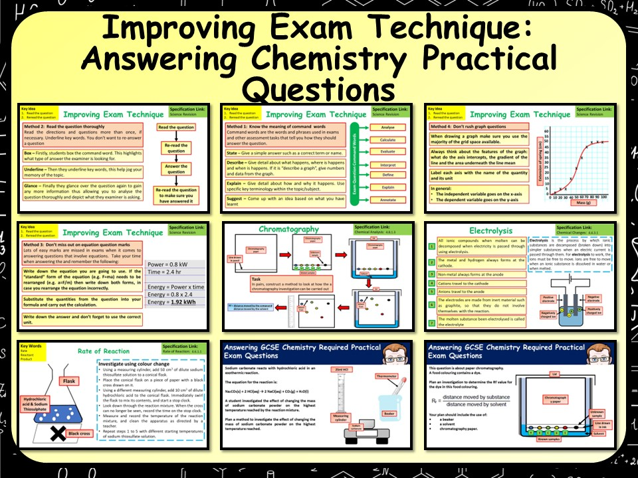
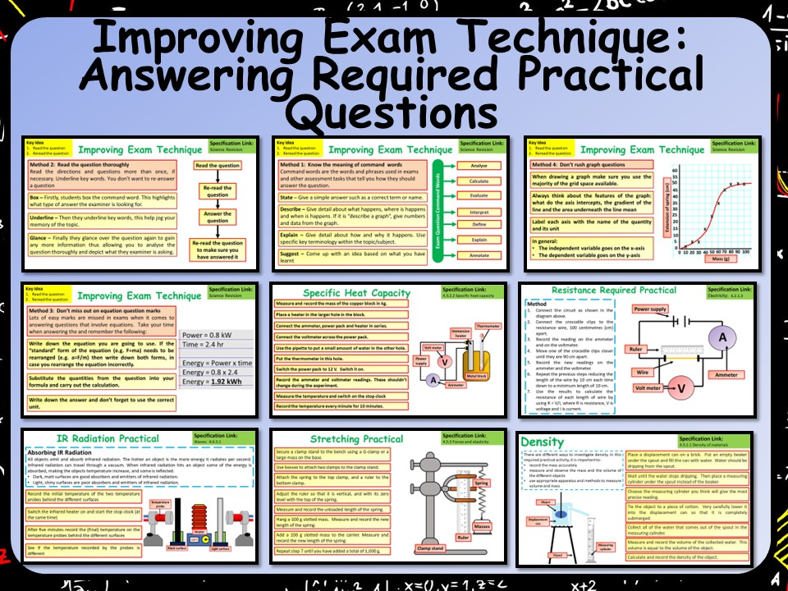


Click on the links below for full lessons looking at revising required practical's with students
Biology required practical's
Chemistry required practical's
Physics required practical's
Follow me on social media to stay in touch
Keep up to date with my new content:

