Slide 1
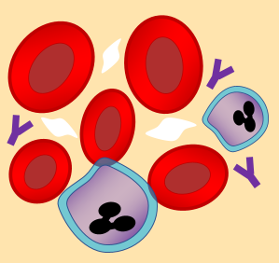
Blood & the Immune System
Specification Link:
Infection & Response
Blood is a complex liquid tissue. It transports oxygen, dissolved substances and heat around the body. It is also involved in the body’s immune response.
What is the role of red blood cells?
______________________________________________________________________________________
What is the role of white blood cells?
______________________________________________________________________________________
What is the role blood plasma?
______________________________________________________________________________________
What is the role of platelets?
______________________________________________________________________________________
White blood cells are part of the immune system. White blood cells help the body to defend itself against pathogens.
Describe how pathogens cause infections and describe how the immune system defends the body against these pathogens..
___________________________________________________________________________________________________________________________________________________________________________________________________________________________________________________________________________________________________________________________________________________________________________________________________________________________________________________________________________________________________________________________________________________________________________________________________________________________________________________________________________________________________________________________________________________________________________________________________________________________________________________
Antibodies attach to antigens. Antigens are substances found on the surface of cells, including bacteria and other pathogens. Different antibodies attach to different antigens. In this way, the body’s immune system can recognise foreign antigens – antigens that are not normally produced by the body, but by pathogens instead.
Antibodies can neutralise toxins produced by pathogens. They can also cause the destruction of pathogens by:
causing bacteria to burst open and die
labelling the pathogen so that it is recognised more easily by phagocytes
sticking pathogens together in clumps so that they can be engulfed by phagocytes more easily
What do antibodies attach to?
_________________________________________
What is an example of a pathogen?
_________________________________________
How can antibodies neutralize pathogens?
______________________________________________________________________________________________________________________________________________________________________________________________________________________________________________________

Slide 2

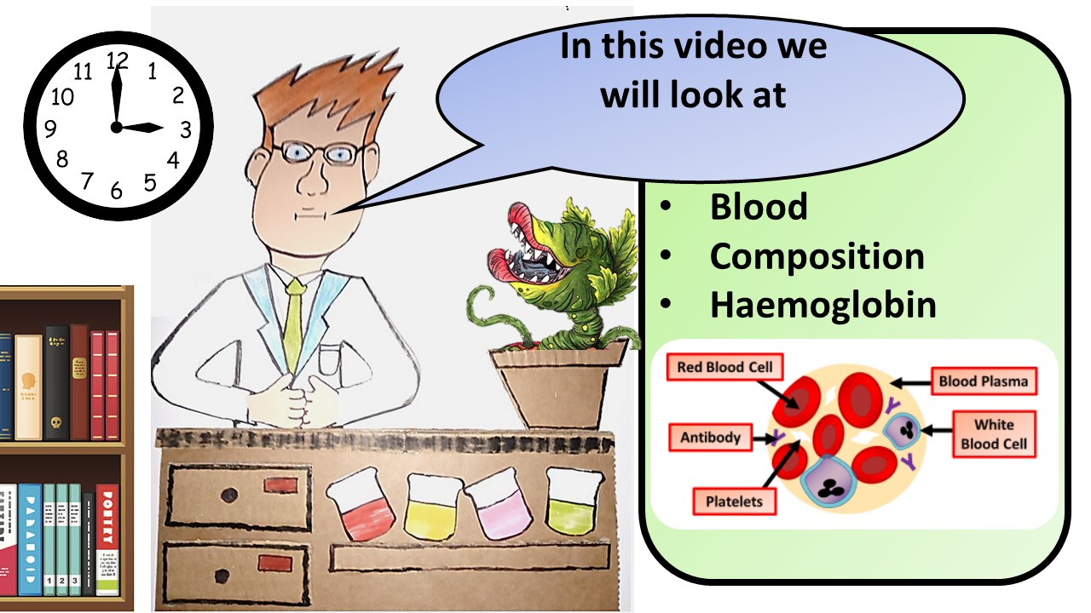


Click here to access my youtube videos
Resources that this activity would work well with
Lesson on TES
Lesson on TPT
Follow me on social media to stay in touch
Keep up to date with my new content:

