Slide 1
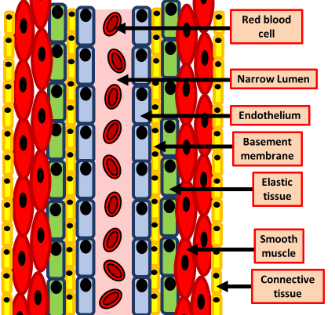
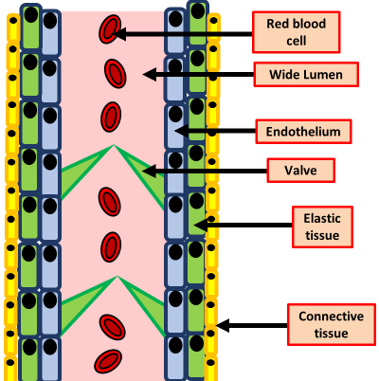
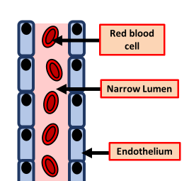
Blood Vessels
Specification Link:
Biological organisation
Highlight key words in the question below:
Arteries carry oxygenated blood away from the heart to the tissues, except for pulmonary arteries, which carry blood to the lungs for oxygenation (usually veins carry deoxygenated blood to the heart but the pulmonary veins carry oxygenated blood as well).
Describe how the structure of an artery is adapted to it’s function
__________________________________________________________________________________________________________________________________________________________________________________________________________________________________________________________________
Veins are an important part of our circulatory system. They are responsible for returning deoxygenated blood back to the heart after arteries carry blood out. The vena cava is the largest vein in the body. Veins have much thinner walls than arteries
Describe how the structure of a vein is adapted to it’s function
________________________________________________________________________________________________________________________________________________________________________________________________________________________________________________________________________________________________________________________________________________________________________________
The blood capillaries are where the important functions of the circulation take place: the exchange of material between circulation and cells. Capillaries are the smallest of the body’s blood vessels. They are only one cell thick, and they are the sites of the transfer of oxygen and other nutrients from the bloodstream to other tissues in the bod
Describe how the structure of a capillary is adapted to it’s function
____________________________________________________________________________________________________________________________________________________________________________________________________________________________________

Slide 2
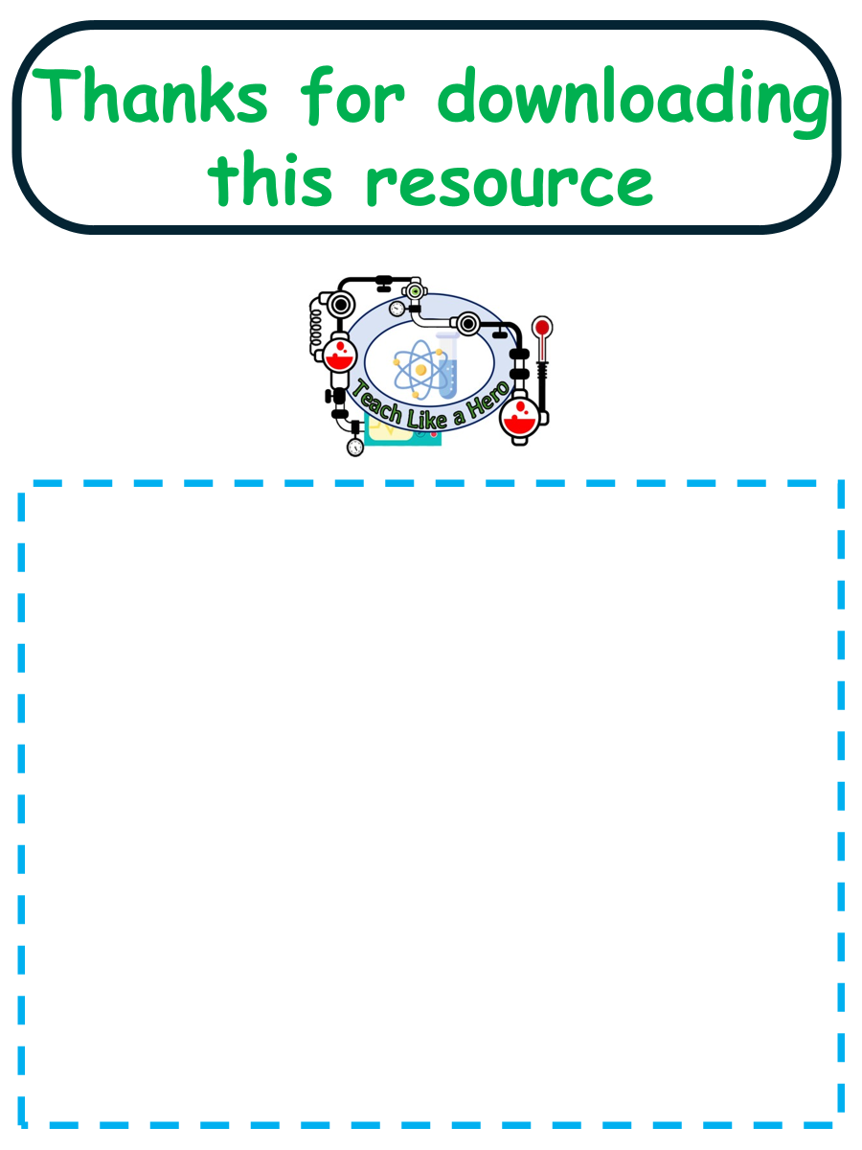
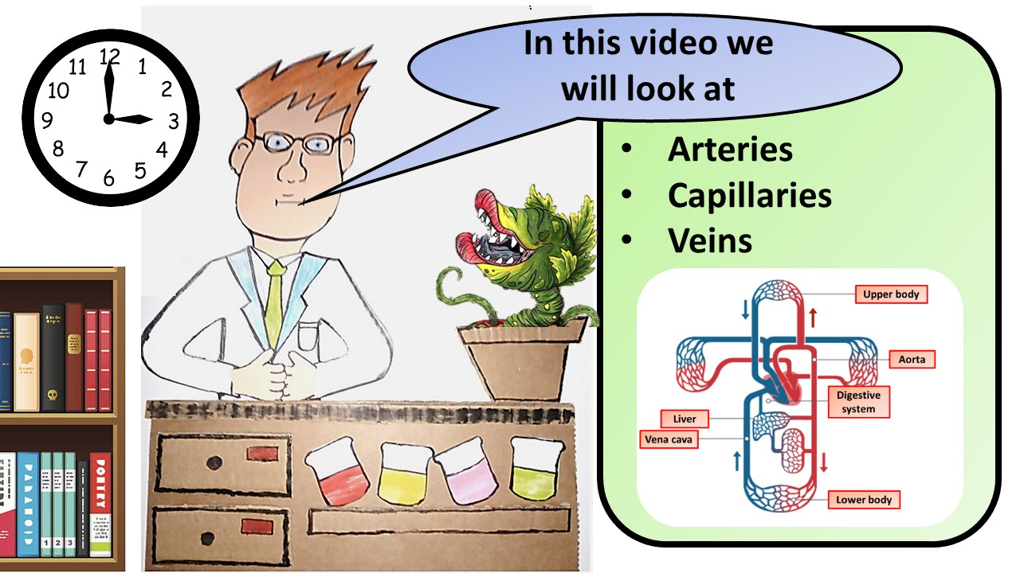


Click here to access my youtube videos
Resources that this activity would work well with
Lesson on TES
Lesson on TPT
Follow me on social media to stay in touch
Keep up to date with my new content:

