Slide 1

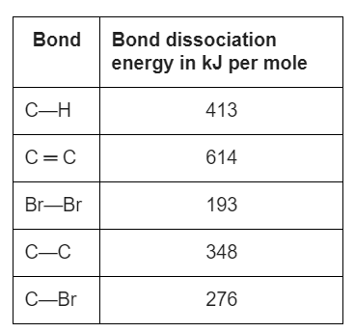
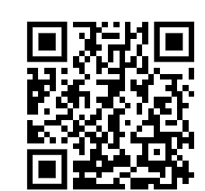
Bond Energy Calculation
The equation for the reaction can be represented as:
Use the bond dissociation energies in the table to calculate the enthalpy change (∆H) for this reaction.
Calculate the energy of bonds broken
Calculate the energy of bonds made
Answer
Calculate overall change in energy
Link to answer video

Slide 2
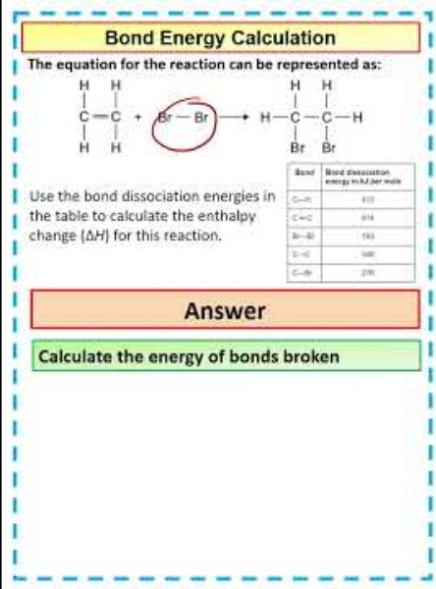
Bond Energy Calculation

