Slide 1
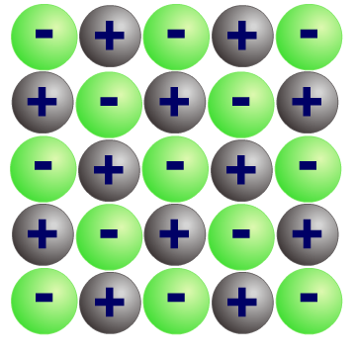
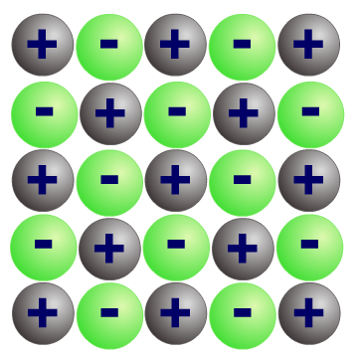
Bonding Notes
There are four types of bonds or interactions: ionic, covalent, hydrogen bonds, and van der Waals interactions. Ionic and covalent bonds are strong interactions that require a larger energy input to break apart.
Hydrogen bonds are a strong type of dipole-dipole interaction. As a Rule of Thumb, they are weaker than covalent and ionic ("intramolecular") bonds", but stronger than most dipole-dipole interactions. There are two requirements for hydrogen bonding.
Ionic Bonding: Positive and negative ions form when a metal reacts with a non-metal, by transferring electrons. The oppositely charged ions are strongly attracted to each other, forming ionic bonds. An ionic lattice is held together by strong electrostatic forces of attraction between the oppositely charged ions. The forces act in all directions in the lattice. This is called ionic bonding. An example is sodium iodine:
Oppositely charges ions attract each other
Each sodium ion is surrounded by iodide ions and vice versa
Sodium iodide has a high melting point because it has lots of bonds
It will dissolve in water and will then be able to conduct electricity because the ions can move
It is brittle because if a single layer is moved just one atom across alike ions will be next to each other and similar charges repel
Covalent Bonding
A covalent bond is a shared pair of electrons. Covalent bonding results in the formation of molecules or giant structures. Substances with small molecules have low melting and boiling points and do not conduct electricity. Giant covalent substances have very high melting points.
A covalent bond is formed when two atoms share a pair of electrons. Covalent bonding occurs in most non-metal elements, and in compounds formed between non-metals.
These shared electrons are found in the outer shells of the atoms. Each atom contributes one electron to the shared pair of electrons.
Giant covalent structures contain very many atoms , each joined to adjacent atoms by covalent bonds . The atoms are usually arranged into giant regular lattices - extremely strong structures because of the many bonds involved.
Metals form giant structures in which electrons in the outer shells of the metal atoms are free to move. The metallic bond is the force of attraction between these free electrons and metal ions. Metallic bonds are strong, so metals can maintain a regular structure and usually have high melting and boiling points.
Metallic Bonding
In metals, the electrons leave the outer shells of metal atoms, forming positive metal ions and a 'sea' of delocalised electrons.
Metals are solids at room temperature, so the structure of a solid metal consists of closely packed metal ions.
These ions are arranged in a regular way to form a metallic lattice structure. The lattice has layers of metal ions.

Slide 2
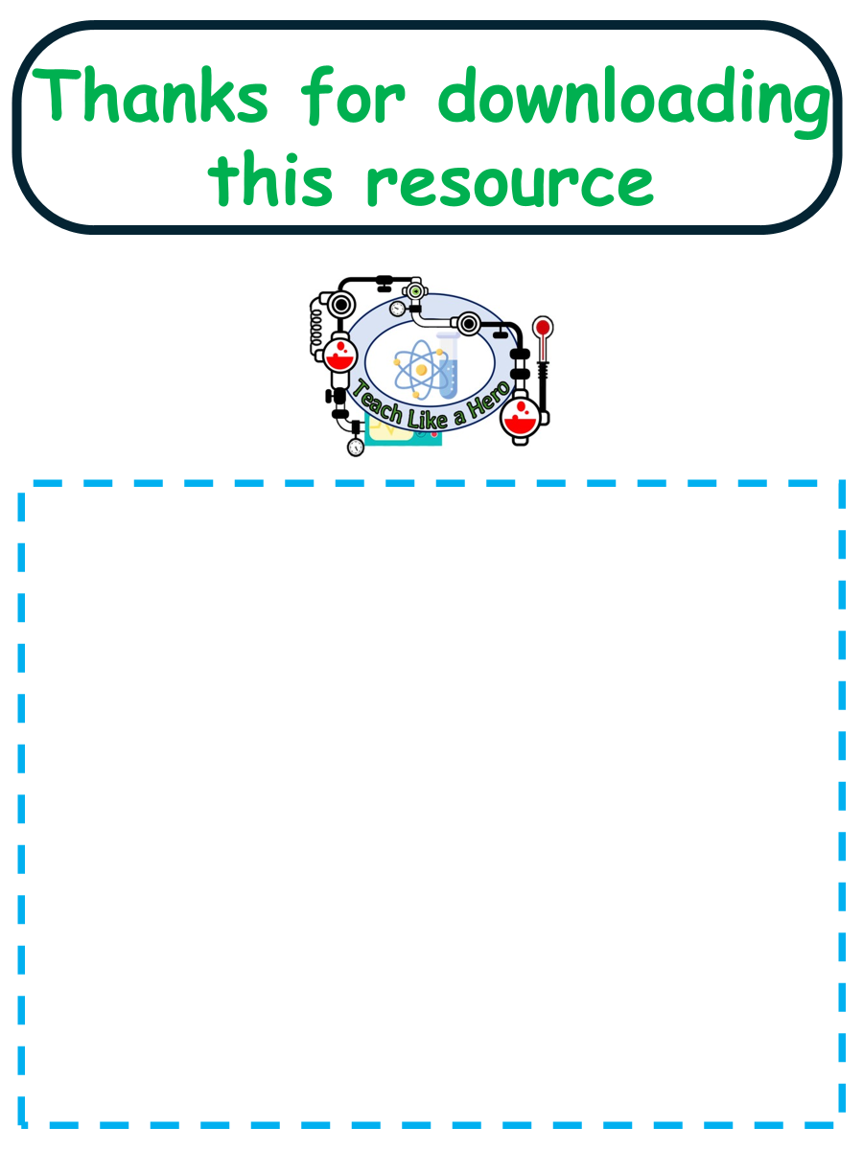
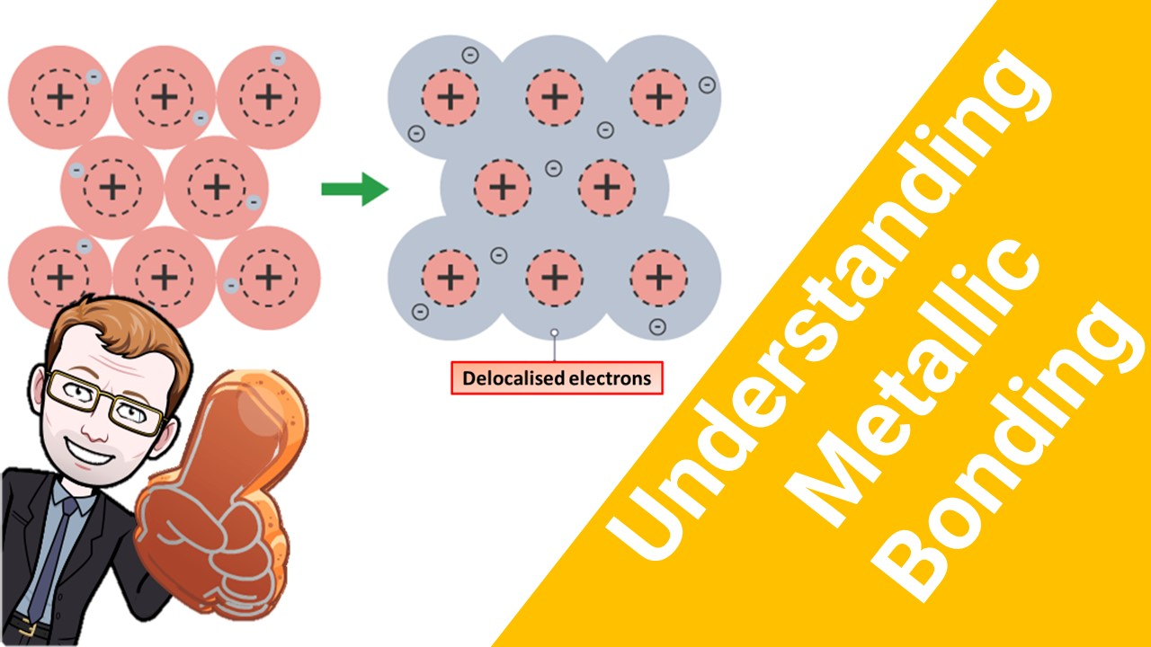
Click here to access my bonding youtube videos
Resources that this activity would work well with
Lesson on TES
Lessons on TPT
Follow me on social media to stay in touch
Keep up to date with my new content:

