Slide 1

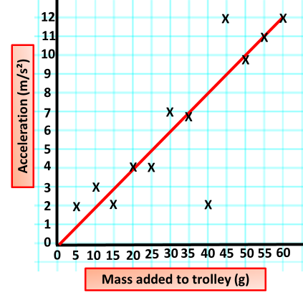
Calculating Force
Specification Link:
Physics Equation Practice
Introduction
A force causes an object to undergo a specific change. Unbalanced forces cause changes in speed, shape or direction. Gravitational forces act between masses. Friction opposes motion.
Remember the three-step process:
Write down the equation you are going to use.
Substitute the quantities from the question into your formula and carry out the calculation.
Write down the answer and don't forget to use the correct unit.
Example
A car has a mass of 1,000 kg. What force must the car’s engine supply to cause an acceleration of 2 m/s²?
force = mass x acceleration
= 1,000 x 2
= 2,000 N
A car has a mass of 73 kg. What force must the car’s engine supply to cause an acceleration of 4 m/s²?
__________________________________
A golf club is in contact with the golf ball for 0.2s and exerts a force of 1500 N on the golf ball. The golf ball accelerates at 4m/s². What is the mass of the golf ball?
_______________________________________________________________________________________________________________________________________________________________________________________________________________________
A car has a mass of 18 kg. What force must the car’s engine supply to cause an acceleration of 27 m/s²?
__________________________________
Looking at results:
What is the trend in the results?
___________________________________________________________________________________________________
What are the results showing?
____________________________________________________________________________________________________________________________________
Is there any anomalous results?
___________________________________________________________________________________________________
What is the interval in the mass added?
__________________________________________________________________

