Slide 1

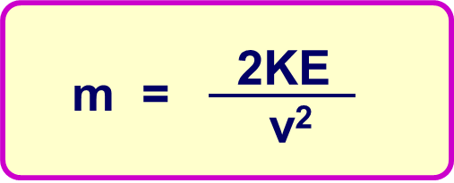
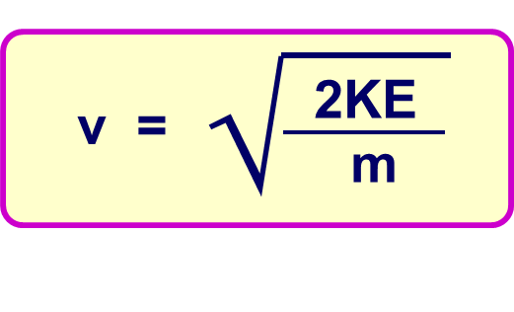
Calculating Kinetic Energy
Specification Link:
Physics Equation Practice
Introduction
When work is done the energy is transferred from one type to another. ... Kinetic energy is the energy an object possesses by virtue of its movement. The amount of kinetic energy possessed by a moving object depends on the mass of the object and its speed .
Remember the three-step process:
Write down the equation you are going to use.
Substitute the quantities from the question into your formula and carry out the calculation.
Write down the answer and don't forget to use the correct unit.
Example
A car with a mass of 1,500 kg travels at a velocity of 20 m/s. What is the KE?
kinetic energy = ½ x mass x velocity²
= ½ x 1,500 x 20²
= 300,000 J = 300 kJ
A car with a mass of 730kg travels at a velocity of 10 m/s. What is the KE?
____________________________________________________________________________________________________________________________________________________________
A car with a mass of 1560kg travels at a velocity of 35 m/s. What is the KE?
____________________________________________________________________________________________________________________________________________________________
Calculate mass
Calculate velocity
6Bus travelling through town, with a mass of 5040kg and kinetic energy of 493900J.
________________________________________________________________________________
Automatic door closing 0.2m/s, with a kinetic energy of 1.6J.
________________________________________________________________________________
Bird flying towards its nest with a mass of 0.25kg and a kinetic energy of 40.5J.
________________________________________________________________________________
Wind turbine blade with a kinetic energy of 104040J, turning at 6m/s.
________________________________________________________________________________
A Wii remote flung from a hand through a TV, with a kinetic energy of 1.44J and a mass of 4.5kg
________________________________________________________________________________
Aeroplane travelling at 75m/s with a kinetic energy of 843700J.
________________________________________________________________________________

