Slide 1
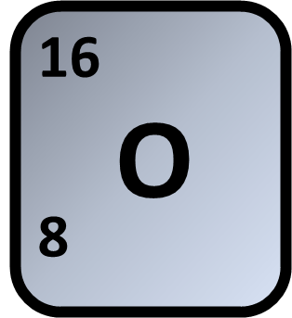
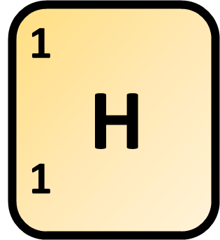

Calculating Relative Formula Mass
The sum of the relative formula masses (M_{r}) of the reactants (3 H₂ + RO₃) is 150
Calculate the relative atomic mass (A_{r}) of R.
Answer
Mass of oxygen
Mass of hydrogen
Calculate the mass of R
Link to answer video

