Slide 1
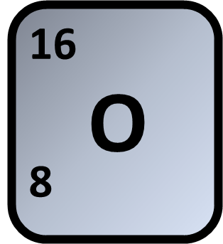
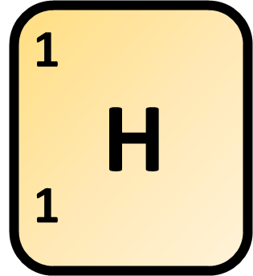
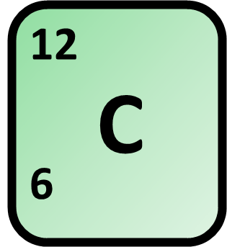

Calculating Relative Formula Mass
Calculate the relative formula mass (M_{r}) of carbonic acid (H₂CO₃)
Mass of oxygen
Mass of hydrogen
Answer
Mass of carbon
Total mass of compound
Link to answer video

