Slide 1
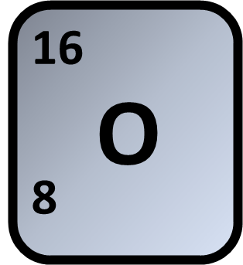
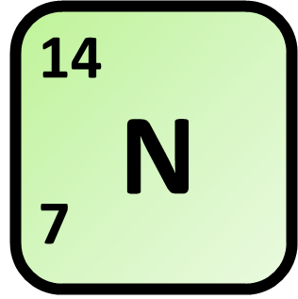
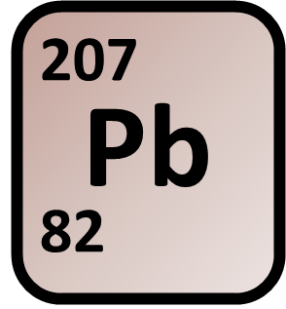
Calculating Relative Formula Mass
Calculate the relative formula mass (M_{r}) of lead nitrate Pb(NO₃)₂
Mass of Oxygen
Mass of Nitrogen
Answer
Mass of Lead
Calculate total mass
Link to answer video

