Slide 1
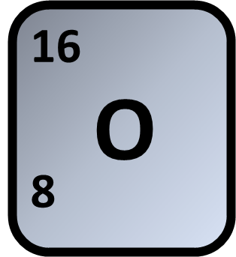
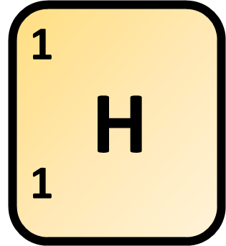
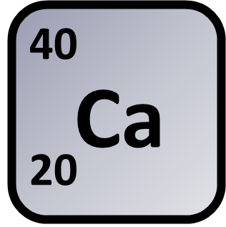

Calculating Relative Formula Mass
Calculate the formula mass (Mr), of the compound calcium hydroxide, Ca (OH)₂
Answer
Mass of oxygen
Mass of hydrogen
Mass of calcium
Calculate total mass
Link to answer video

