Slide 1
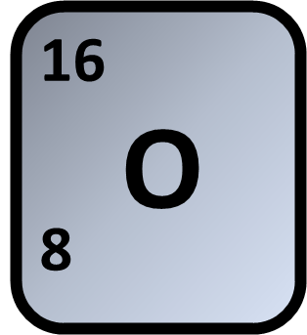
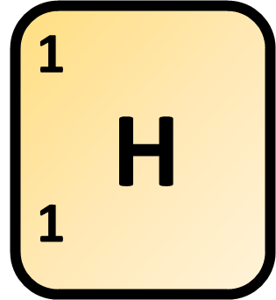
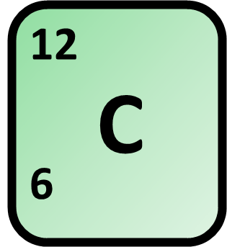
Calculating Relative Formula Mass
Calculate the relative formula mass (M_{r}) of carbonic acid (H₂CO₃)
Answer
Mass of oxygen
Mass of hydrogen
Mass of carbon
Total mass of compound

