Slide 1

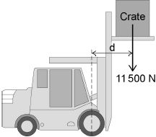
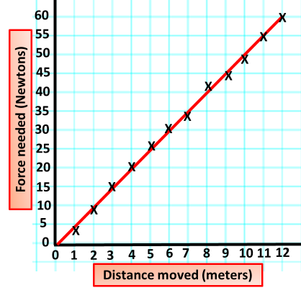
Calculating Work Done
Specification Link:
Physics Equation Practice
Introduction
When a force causes a body to move, work is being done on the object by the force. Work is the measure of energy transfer when a force (F) moves an object through a distance (d). So when work is done, energy has been transferred from one energy store to another, and so: energy transferred = work done.
Remember the three-step process:
Write down the equation you are going to use.
Substitute the quantities from the question into your formula and carry out the calculation.
Write down the answer and don't forget to use the correct unit.
Example
What is the work done when a cyclist peddles a bicycle with a force of 1,000 N moving it 250 m?
work done = force x distance moved
= 1,000 x 250
= 250,000 J = 250 kJ
The diagram below shows a fork-lift truck lifting a heavy crate.. The crate weighs 11 500 N and is lifted vertically 2.60 m. Calculate the work done to lift the crate.
______________________________________________________________________________________________________________________________________________________________
A cyclist used the brakes to slow down and stop the bicycle. A constant braking force of 140 N stopped the bicycle in a distance of 24 m. Calculate the work done by the braking force to stop the bicycle. Give the unit.
____________________________________________________________________________________________________________________________
An object is moved a distance of 8 meters. Using the graph calculate the work done.
________________________________________________________________________________________________________________
An object is moved a distance of 12 meters. Using the graph calculate the work done.
________________________________________________________________________________________________________________
The camper van’s engine provides a constant force of 2kN. How much work has been done if it travels 200 metres?
__________________________________________________________
Each person pulls with a force of
50 N and the other team moves
2.5 m towards them. How much work has been done?
______________________________________________________
This crazy person is bog snorkelling! Over a distance of 10 m she transferred 1200 J. What was the force she needed to do this?
__________________________________________________

