Slide 1

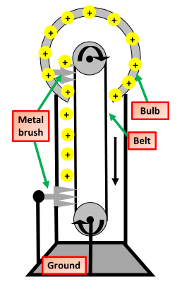

Calculating Charge
Specification Link:
Physics Equation Practice
Introduction
Electrons are negatively charged particles and they transfer energy through wires as electricity. Charge is a property of a body which experiences a force in an electric field. Charge is measured in coulombs (C).
Remember the three-step process:
Write down the equation you are going to use.
Substitute the quantities from the question into your formula and carry out the calculation.
Write down the answer and don't forget to use the correct unit.
Example
How much charge flows with a current of 40A for 30s?
Charge flow = Current X Time
Charge flow = 40A X 30s
= 1200C
How much charge flows with a current of 80A for 60s?
________________________________________________________
Charge flows through the completed circuit and a reading is shown on both the ammeter and the voltmeter. In 10 seconds, 20 coulombs of charge flows through the circuit. Calculate the current reading shown on the ammeter. _________________________________________________________________________________________________________________________________________________________________________________
How much charge flows with a current of 45A for 6s?
________________________________________________________
The 230 volt mains electricity supply causes a current of 11 amps to flow through the cable. Calculate the amount of charge that flows through the cable when the cable is switched on for 2 hours and give the unit. _________________________________________________________________________________________________________________________________________________________________________________
How much charge flows with a current of 55A for 23s?
________________________________________________________
When the potential difference between the Van de Graaff generator and the earthed sphere is 60 kV, a spark jumps between the metal dome and the earthed sphere. The spark transfers 0.000025 coulombs of charge to the earthed sphere. Calculate the energy transferred by the spark. _________________________________________________________________________________________________________________________________________________________________________________
When the potential difference between the Van de Graaff generator and the earthed sphere is 80 kV, a spark jumps between the metal dome and the earthed sphere. The spark transfers 0.000065 coulombs of charge to the earthed sphere. Calculate the energy transferred by the spark. _________________________________________________________________________________________________________________________________________________________________________________

