Slide 1
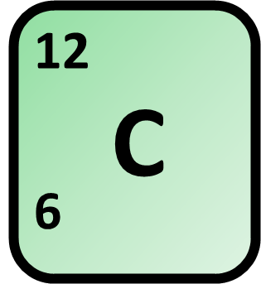
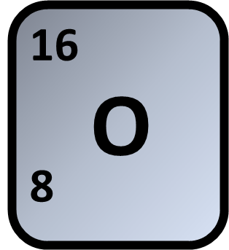
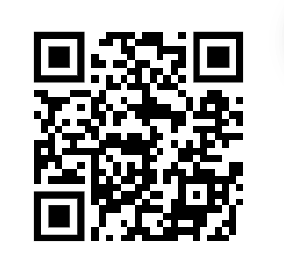
Calculating Moles
A 0.050 mol sample of a hydrocarbon was burned in excess oxygen. The products were 3.60 g of water and 6.60 g of carbon dioxide.
Calculate the number of moles of carbon dioxide produced.
Moles = mass / molar mass
RFM of carbon dioxide
Answer
Calculate the number of Moles:
Link to answer video

Slide 2




Click here to access my moles youtube videos
Resources that this activity would work well with
Lesson on TES
Moles Calculation Révision Questions on TES
Follow me on social media to stay in touch
Keep up to date with my new content:

