Slide 1

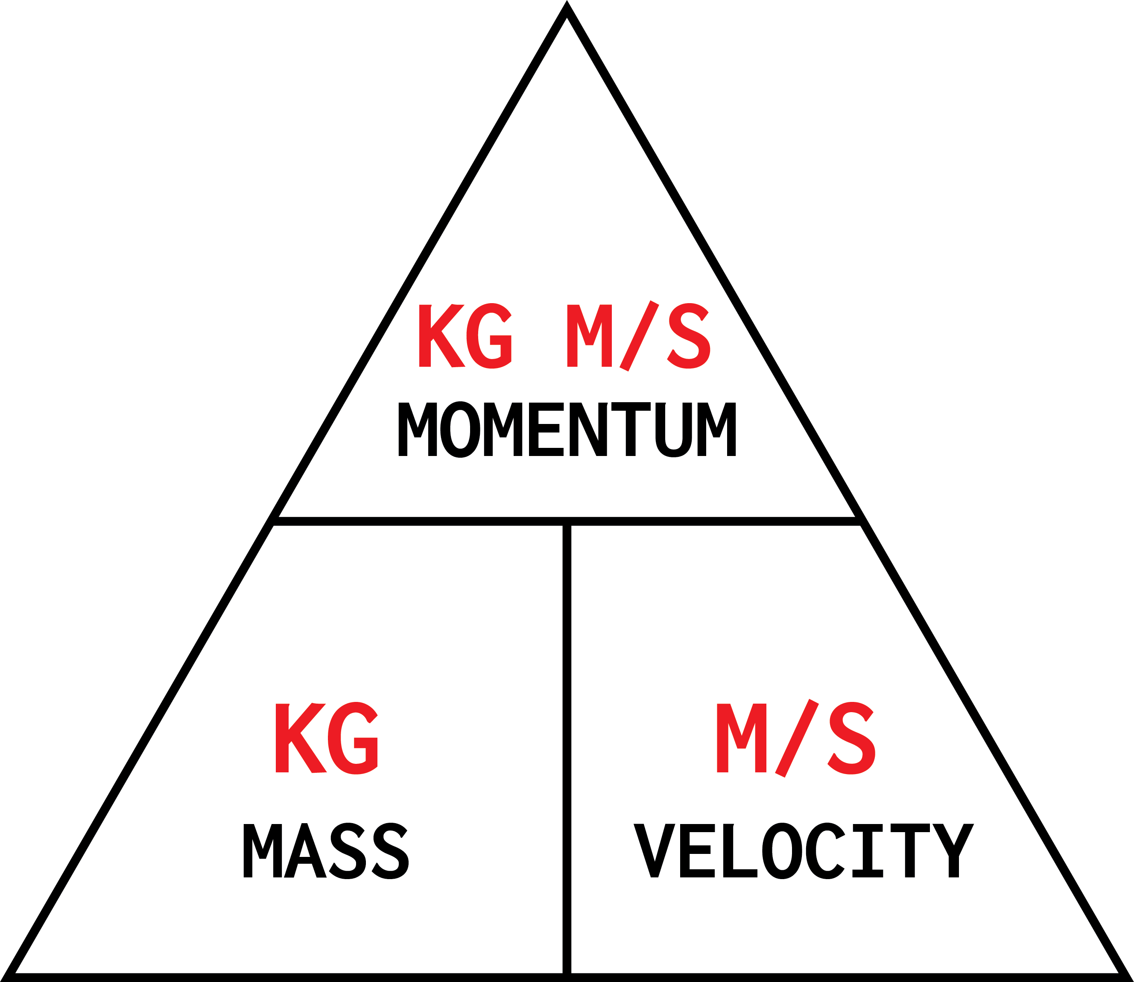
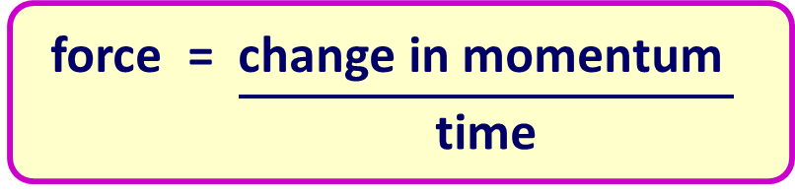
Calculating Momentum
Specification Link:
Physics Equation Practice
Introduction
Momentum is a physics term; it refers to the quantity of motion that an object has. A sports team that is on the move has the momentum. ... Momentum can be defined as "mass in motion." All objects have mass; so if an object is moving, then it has momentum - it has its mass in motion.
Remember the three-step process:
Write down the equation you are going to use.
Substitute the quantities from the question into your formula and carry out the calculation.
Write down the answer and don't forget to use the correct unit.
Example
An aircraft carrier has a mass of 1,000,000 kg and a velocity of 15 m/s. What is its momentum?
momentum = mass x velocity
= 1,000,000 x 15
= 15,000,000 kg m/s
What is the momentum with a mass of 12Kg and a velocity of 5m/s?
________________________________________________________
A gun fires the paintball forwards at a velocity of 90 m / s. The paintball has a mass of 0.0030 kg. Calculate the momentum of the paintball just after the gun is fired. ____________________________________________________________________________________________________________________________________________
What is the momentum with a mass of 6Kg and a velocity of 4m/s?
________________________________________________________
Calculate the velocity of a dog with a mass of 50 kg and with a momentum of 2 kg m/s.. ________________________________________________________________________________________
What is the force when momentum changes by 5 kg m/s in 10s?
______________________________________________________________________________________
What is the mass of a man if his velocity is 50 m/s and his momentum 2 kg m/s?
________________________________________________________________________________________
What is the force when momentum changes by 54 kg m/s in 19s?
______________________________________________________________________________________
What is the force when momentum changes by 78 kg m/s in 22s?
______________________________________________________________________________________
What is the momentum of a bike if the mass is 1000 kg and the velocity is 80 m/s?
________________________________________________________________________________________

