Slide 1

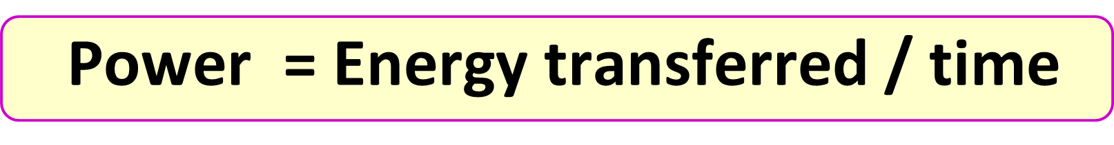
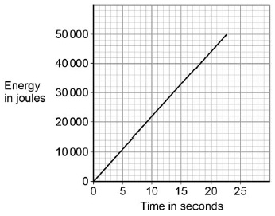

Calculating Power
Specification Link:
Physics Equation Practice
Introduction
Power is a measure of the amount of work that can be done in a given amount of time. Power equals work (J) divided by time (s). The SI unit for power is the watt (W), which equals 1 joule of work per second (J/s). Power may be measured in a unit called the horsepower
Remember the three-step process:
Write down the equation you are going to use.
Substitute the quantities from the question into your formula and carry out the calculation.
Write down the answer and don't forget to use the correct unit.
Example
What is the power when the potential difference is 5V and the current is 15A?
Power = Potential difference x Current
Power = 5V X 15A
= 75W
Figure 2 shows how the amount of energy transferred by a kettle varies with time.
Example
How much power is needed when 75J of energy is transferred in 25s?
Power = Energy transferred / time
Power = 75J / 25s
= 3W
Example
A lawnmower engine does 10 kJ of work in 10 seconds. What is the power of the engine?
power = work done / time taken
= 10,000 / 10
= 1,000 W = 1 kW
The power output of the kettle is given by the gradient of the graph. Calculate the power output of the kettle. _________________________________________________________________________________________________________________________________
Calculate the work done by the cyclist when his power output is 200 W for 1800 seconds.. ________________________________________________________________________________________
Calculate the power of an appliance when the PD is 5V and the current is 3a
________________________________________________________________________________________
The drone can fly for 25 minutes before the battery needs recharging. The power output of the battery is 65.0 W. Calculate the maximum energy stored by the battery.
________________________________________________________________________________________
Calculate the power of an appliance when the PD is 34V and the current is 12a
________________________________________________________________________________________

