Slide 1
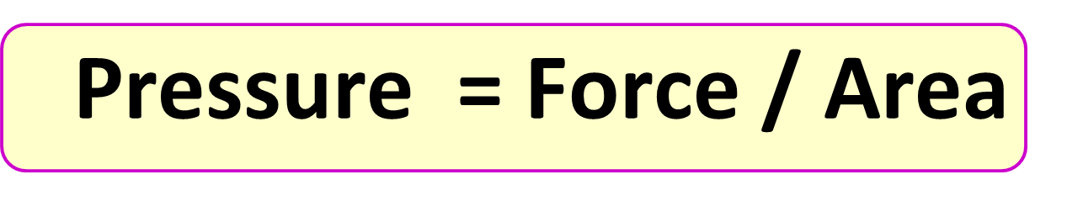
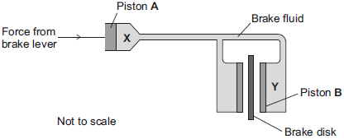
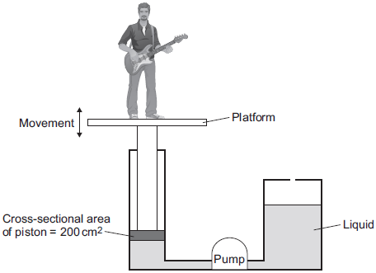
Calculating Pressure
Specification Link:
Physics Equation Practice
Introduction
Pressure means how much something is pushing on something else. It is expressed as force per unit area: P=F/A. In technology, pressure is often specified in multiples of atmospheric pressure. It can also be defined as the thrust (compressive force acting perpendicularly to the surface of a body) acting per unit area.
Remember the three-step process:
Write down the equation you are going to use.
Substitute the quantities from the question into your formula and carry out the calculation.
Write down the answer and don't forget to use the correct unit.
Example
What is the pressure when a force of 20N is applied to a 20m² area?
Pressure = Force / Area
Pressure = 20N / 20m²
= 1N/m²
What is the pressure when a force of 40N is applied to a 20m² area?
________________________________________________________
The figure below is a simplified diagram of a hydraulic brake system.
What is the pressure when a force of 200N is applied to a 50m² area?
________________________________________________________
What is the pressure when a force of 45N is applied to a 5m² area?
________________________________________________________
A force of 24 N acts on piston A. The cross-sectional area of piston A is 8 mm2. Calculate the pressure in N/mm² at position X. ________________________________________________________________________________________________________________________
The figure below shows the parts of the lifting machine used to move the platform up and down.
To move the platform upwards, the liquid must cause a force of 1800 N to act on the piston. The cross-sectional area of the piston is 200 cm². Calculate the pressure in the liquid, in N / cm2, when the platform moves. ____________________________________________________________________________________________________________________________________________________________________________________________________________________________________________________________________________________

