Slide 1
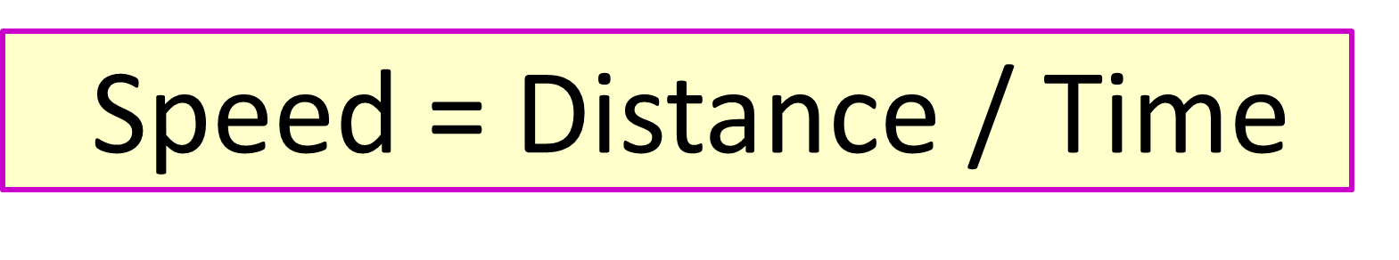
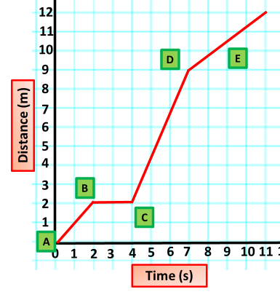
Calculating Speed
Specification Link:
Physics Equation Practice
Introduction
Distance is a measure of how far an object moves. ... Speed is the rate of change of distance - it is the distance travelled per unit time. Like distance, speed is also a scalar quantity, as it does not refer to direction.
Remember the three-step process:
Write down the equation you are going to use.
Substitute the quantities from the question into your formula and carry out the calculation.
Write down the answer and don't forget to use the correct unit.
Example
A train takes 100 seconds to travel 1,500 m. What is the speed of the train?
Speed = Distance / Time
Speed = 1500 / 100
Speed = 15 m/s
A train takes 30 seconds to travel 1,200m. What is the speed of the train?
______________________________________________________________________________________________________
A F1 car travels at 200 km/h. How far would it travel after 1.5 hours?
__________________________________________________________________________________________________________
An athlete can jog up to 8 m/s. How far could he jog after 2 minutes?
__________________________________________________________________________________________________________
A train takes 5 seconds to travel 60m. What is the speed of the train?
______________________________________________________________________________________________________
A snail travels at 12 metres per hour. How far could it travel after 1 day?
__________________________________________________________________________________________________________
What speed of an object between point A & B?
________________________________________________________________________________________________________
What speed of an object between point B & C?
________________________________________________________________________________________________________
What speed of an object between point C & D?
________________________________________________________________________________________________________

