Slide 1
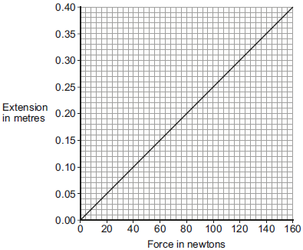
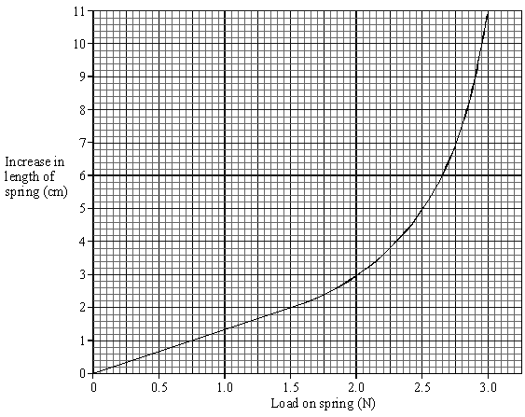
Calculating Spring Constant
Specification Link:
Physics Equation Practice
Introduction
Spring constant is a measure of the stiffness of a spring up to its limit of proportionality or elastic limit. The spring constant is different for different elastic objects. For a given spring and other elastic objects, the extension is directly proportional to the force applied.
Example
What is the force applied to a spring with a spring constant of 10N/m when it’s stretched 0.5m?
Force applied to a spring = Spring constant X extension
Force =10N/m x 0.5m
= 5N
Remember the three-step process:
Write down the equation you are going to use.
Substitute the quantities from the question into your formula and carry out the calculation.
Write down the answer and don't forget to use the correct unit.
What is the force applied to a spring with a spring constant of 12N/m when it’s stretched 0.2m?
________________________________________________________
Figure 2 shows how the extension of a single spring from the chest expander depends on the force acting on the spring.
Use data from Figure 2 to calculate the spring constant of the spring. Give the unit ________________________________________________________________________________________________________________________________________________________________________________________
What is the force applied to a spring with a spring constant of 6N/m when it’s stretched 0.3m?
________________________________________________________
What is the force applied to a spring with a spring constant of 17N/m when it’s stretched 0.9m?
________________________________________________________
The length of the spring with no load was 15 cm. Use the graph to find:
The load needed to produce an increase in length of 2 cm.
_________________________________________________________
The increase in length produced by a load of 2.3 N.
_________________________________________________________
The length of the spring when the load was 2.3 N.
_________________________________________________________

