Slide 1
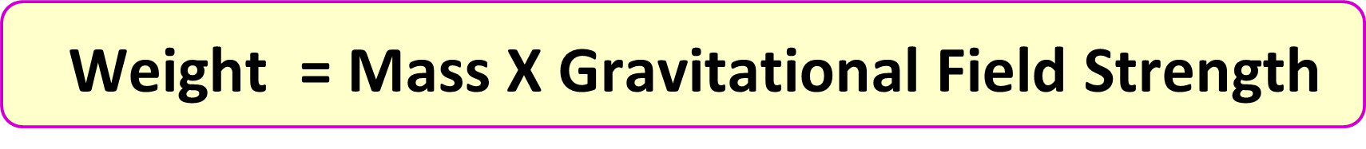
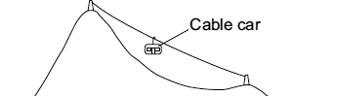
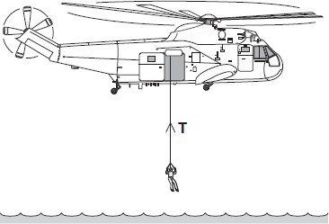

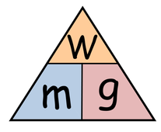
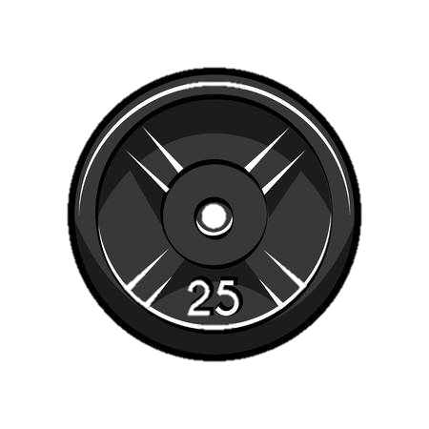
Calculating Weight
Specification Link:
Physics Equation Practice
Introduction
Mass is a measure of how much matter there is in an object, while weight is a measure of the size of the pull of gravity on the object. ... Mass is measured in kilograms (kg). Weight is a force due to the pull of gravity on an object. Weight is a force and so is measured in newtons (N).
Remember the three-step process:
Write down the equation you are going to use.
Substitute the quantities from the question into your formula and carry out the calculation.
Write down the answer and don't forget to use the correct unit.
Example
What is the weight of a stone with a mass of 100 kg with a gravitational field strength of 10N/Kg?
Weight = Mass X Gravitational Field Strength
Weight = 100 kg X 10 N/Kg
=1000 N
What is the weight of a stone with a mass of 23 kg with a gravitational field strength of 10N/Kg?
________________________________
What is the weight of a stone with a mass of 12 kg with a gravitational field strength of 7N/Kg?
________________________________
The diagram shows a cable car used to take skiers to the top of a mountain. The total mass of the cable car and skiers is 7500 kg. Calculate the weight of the cable car and skiers.
______________________________________________________________________________________________________________
The diagram shows a helicopter being used to rescue a person from the sea. The mass of the rescued person is 72 kg. Use the equation in the box to calculate the weight of the rescued person.
______________________________________________________________________________________________________________
What is the mass of an object that has a weight of 50N?
______________________________________________________________________________________
What is the mass of an object that has a weight of 86N?
______________________________________________________________________________________

