Slide 1
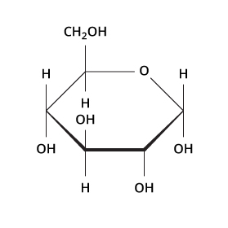
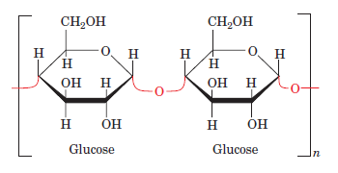
Carbohydrates Question
Specification Link:
Biological Molecules
Highlight key words in the information below:
Carbohydrates are one of the four major classes of biomolecules along with proteins, nucleic acids, and lipids. Carbohydrates are compounds that contain at least three carbon atoms, a number of hydroxyl groups, and usually an aldehyde or ketone group. They may contain phosphate, amino, or sulfate groups. First, carbohydrates serve as energy stores, fuels, and metabolic intermediates. Second, ribose and deoxyribose sugars form part of the structural framework of RNA and DNA. Third, polysaccharides are structural elements in the cell walls of bacteria and plants.
Describe the general structure of carbohydrate monomers:
________________________________________________________________________________________________________________________________________________________________
Identify three uses of carbohydrates in organisms. ________________________________________________________________________________________________________________________________________________________________________________________________________________________________________________________________________________________________________________________________
Glycosidic bonds are covalent chemical bonds that hold together a glycoside. A glycoside is simply a ring-shaped sugar molecule that is attached to another molecule. The sugar ring may be either a 5-membered ring or a 6-membered ring, and the other molecule can be - and often is - another sugar. Look at this figure showing a sucrose molecule.
A glycosidic bond forms by a condensation reaction, which means that one water molecule is produced during formation of a glycoside. The reverse reaction, the breakage of a glycosidic bond, is a hydrolysis reaction. One water molecule is used up in the reverse reaction.
Describe what a glycosidic bond is and how they are formed:
_____________________________________________________________________________________________________________________________________________________________________________________________________________________________________________________________________________________________________________________________________________________________________________________________________________________________________________
How is the structure of cellulose related to its function?
________________________________________________________________________________________________________________________________________________________________________________________________________________________________________________________________________________________________________________________________________________________________________________________________________________________________________________________

