Slide 1
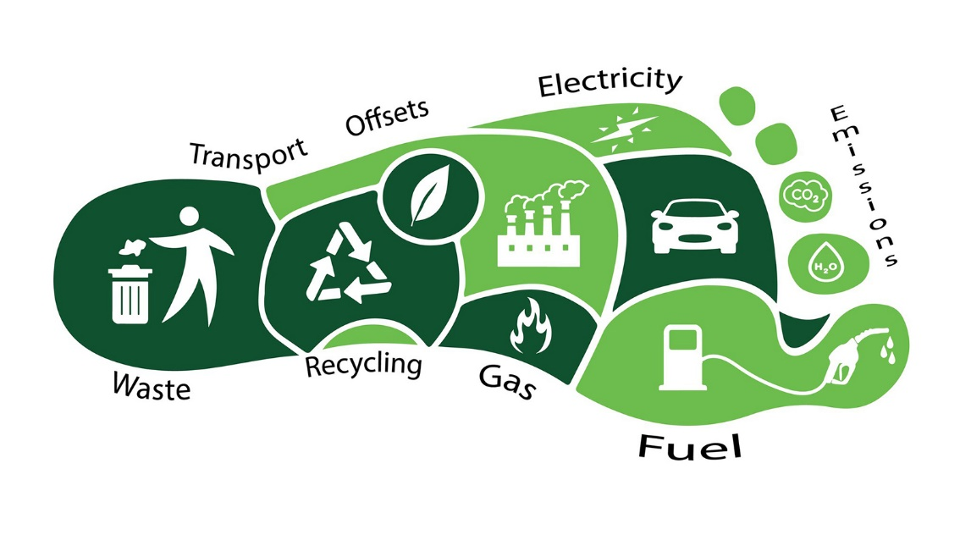
Carbon Footprint Practice Question
Climate change is a major concern to human life
Describe what a carbon footprint is and how it can be reduced
The carbon footprint of a person during one year would consist of the total amount of carbon dioxide released into the atmosphere by all of the activities they take part in
learn the 5 R's: refuse, reduce, reuse, rot, recycle
Answer
bike more and drive less
conserve water and protect our waterways
eat seasonally, locally, and more plants
switch to sustainable, clean energy
take holidays locally and don’t fly

