Slide 1
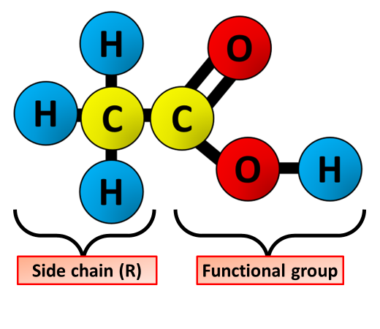
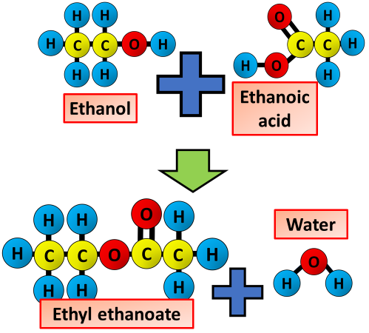
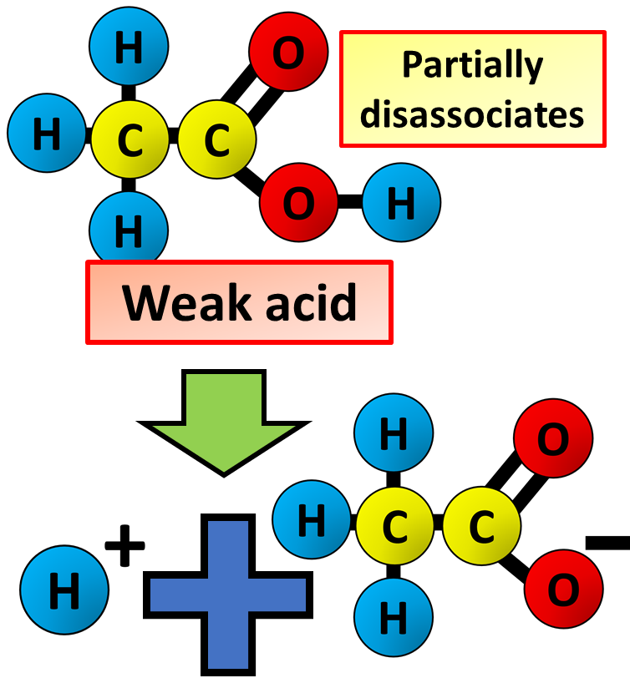
Carboxylic Acids
Specification Link:
Organic Chemistry: 4.7.2.4
The carboxylic acids are a homologous series of organic compounds.
Carboxylic acids contain the carboxyl functional group (-COOH). Carboxylic acids end in '-oic acid'.
The carboxyl group will never have a position number in a carboxylic acid, as it is always on the end of the carbon chain.
The basic rules of naming apply. Carboxylic acids take their names from their ‘parent’ alkanes. For example, ethane is the ‘parent’ alkane of ethanoic acid. Ethanoic acid has the formula CH₃COOH
What is the functional group in an acid?
____________________________________________________
Short carboxylic acids are liquids and are soluble in water. Longer carboxylic acids are solids and are less soluble in water.
The boiling point of a carboxylic acid is higher than that of the alkane with the same number of carbon atoms because the intermolecular forces are much stronger.
What do all organic acid names end with?
____________________________________________________
What organic acid would you produce from ethene?
____________________________________________________
Describe the properties of organic acids
____________________________________________________________________________________________________________________________________________________________________________________________________________________________________
Carboxylic acids can react with alcohols to make esters. Esters are organic compounds which all contain the functional group -COO-. Esters have fruity smells and can be used as solvents.
Ethanol and ethanoic acid react in the presence of a catalyst to form an ester. Name the ester made from ethanol and ethanoic acid.
_________________________________________________________
What type of chemical is used as a catalyst in this reaction?
_________________________________________________________
Weak acids, such as ethanoic acid (CH₃COOH), do not fully dissociate. In fact, about only one per cent of ethanoic acid molecules split up to form H⁺ ions and CH₃COO– ions at any one time.
Esters are used in perfumes because they smell pleasant and are volatile. What does volatile mean?
_________________________________________________
Solutions of ethanoic acid and hydrochloric acid with the same concentration have different pH values.
Explain why the solution of ethanoic acid has a higher pH than the solution of hydrochloric acid.
________________________________________________________________________________________________________________________________________________________________________________________________

Slide 2

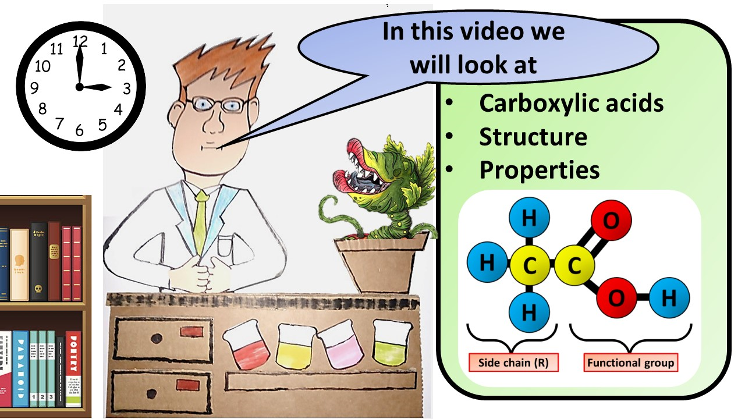


Click here to access my youtube videos
Resources that this activity would work well with
Lesson on TES
Lesson on TPT
Follow me on social media to stay in touch
Keep up to date with my new content:

