Slide 1
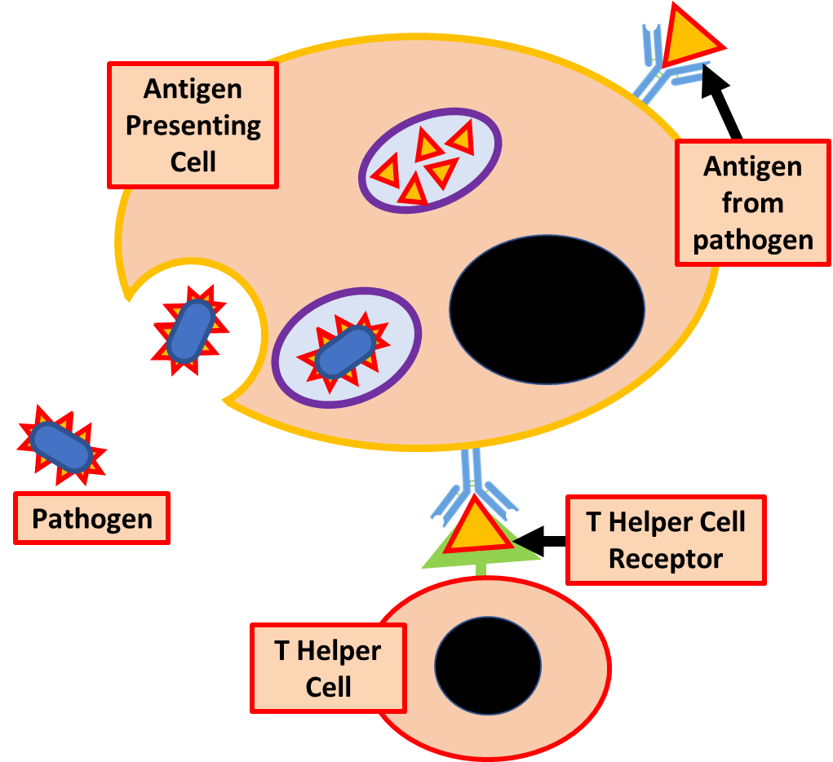
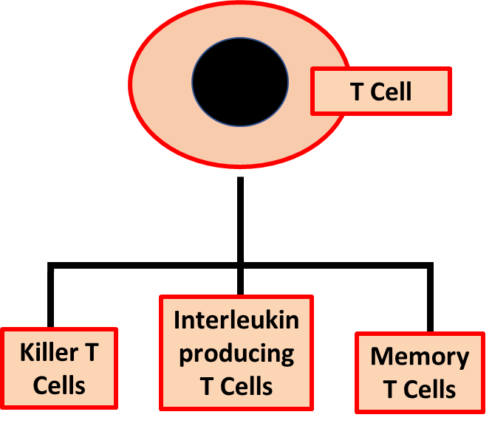
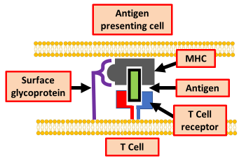
Cell Mediated Immunity Practice Question
Specification Link:
Communicable Diseases: 4.1.1
Highlight key words in the information below:
2
3
Cell-mediated immunity. Antibodies alone are often not enough to protect the body against pathogens. In these instances, the immune system uses cell-mediated immunity to destroy infected body cells. T cells are responsible for cell-mediated immunity
1
4
How are pathogenic antigens presented on antigen presenting cells?
________________________________________________________________________________________________________________________________________________________________________________________________________________________________________________________________________________________________________________________________________________________________________________________________________________
5
6
Highlight key words in the information below:
T cell receptor binding to MHC-antigen complex. T cell receptors recognise foreign antigens, then convey the message to the nucleus to induce a response. ... The antigens that TCRs bind are small peptide fragments, or epitopes, displayed by MHC molecules on the surface of cells.
A clone of identical T cells is formed, all with the correct shaped receptor. These T cells then differentiate to form 4 groups of specialised T cells. These are:
Killer T cells
Helper T cells
Suppressor T cells
Memory cells
Explain the different roles of T Cells
________________________________________________________________________________________________________________________________________________________________________________________________________________________________________________________________________________________________________________________________________________________________________________________________________________________________________________________
Explain what happens at the T Cell receptor
________________________________________________________________________________________________________________________________________________________________________________________________________________________________________________________________________________________________________________________________________________________________________

Slide 2

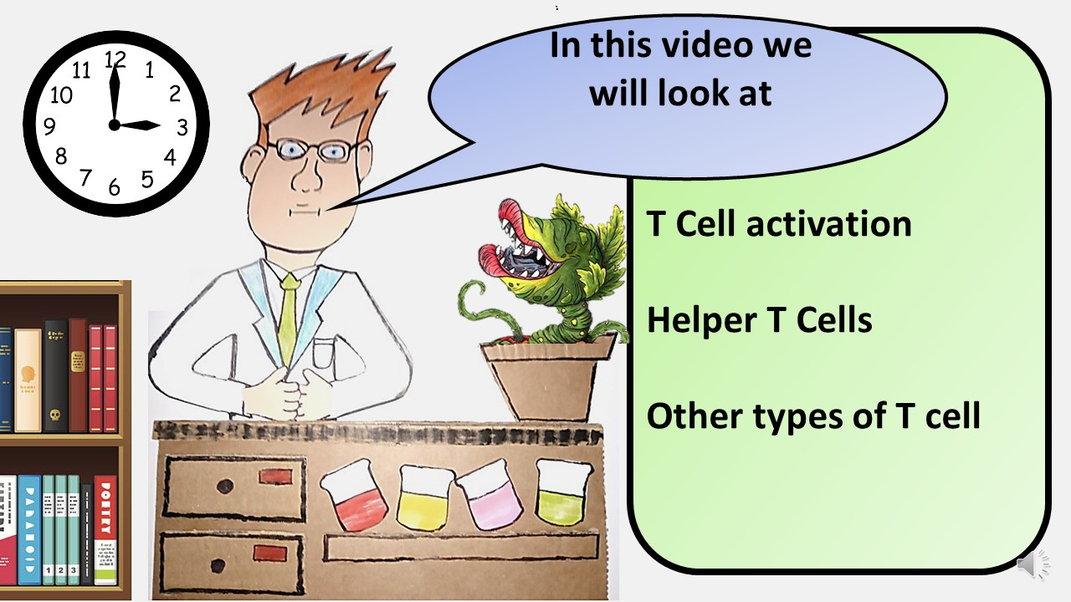


Click here to access my percentage composition youtube videos
Resources that this activity would work well with
Lesson on TES
Lesson on TPT
Follow me on social media to stay in touch
Keep up to date with my new content:

