Slide 1
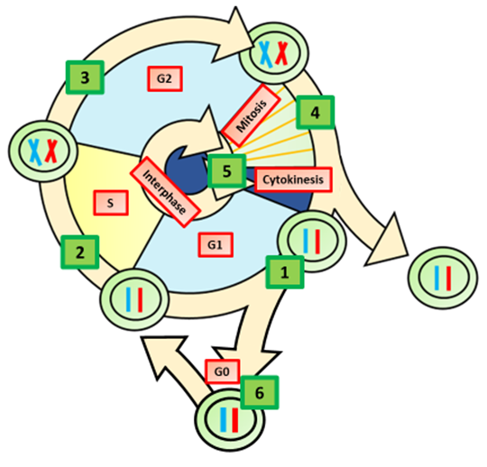
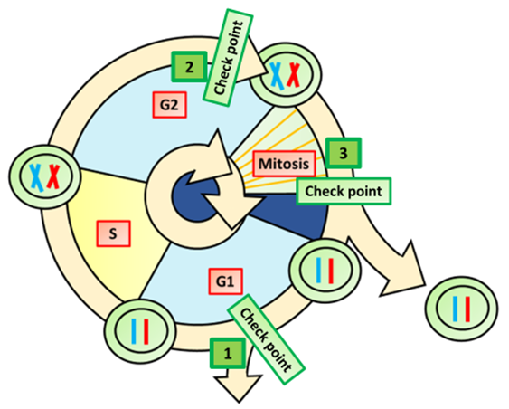
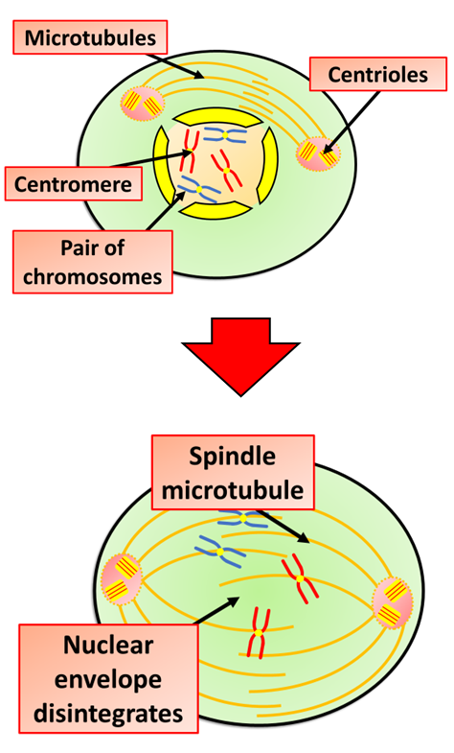
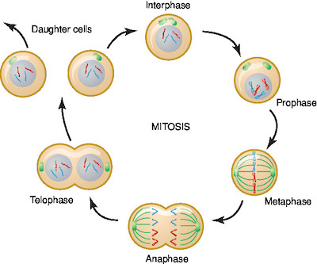
Explain what the cell cycle is
Explain how the cell cycle is controlled
Key information to include:
Explain what happens during G1
Explain what happens during S
Explain what happens during G2
Explain what happens during M
Key information to include:
What happens at each checkpoint
What is the role of CDKs
What is the role of mitotic cyclin
Summaries mitosis
Explain what happens during mitotic Prophase
Key information to include:
What is the importance of mitosis
What order do the phases happen
What role does mitosis play in asexual reproduction
Key information to include:
What happens to the chromatin
What is the role of microtubles
What happens to the nuclear membrane
What is the role of the centromeres

Slide 2
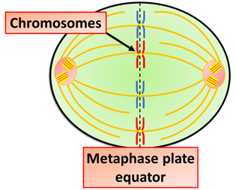
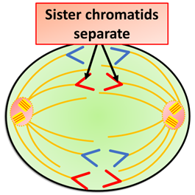
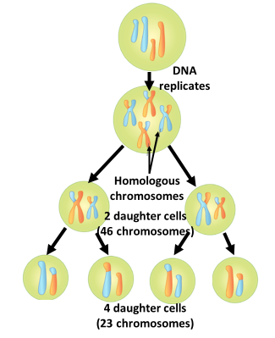
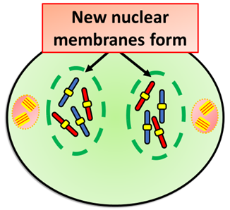
Explain what happens during mitotic Metaphase
Explain what happens during mitotic Anaphase
Key information to include:
What role is played by the spindle fibres
How are the chromosomes separated
Why do the chromosomes make V shapes
Key information to include:
What happens to the chromosomes
What is the role of the spindle fibres
What role is played by the centromeres
Explain what happens during mitotic Telophase
Summaries meiosis
Key information to include:
What happens to the chromatids
When do new nuclear membranes reform
How is the number of chromosomes maintained
What comes after this phase
Key information to include:
What is the role of meiosis
Where does meiosis happen
How does meiosis differ from mitosis
How is genetic diversity increased

Slide 3
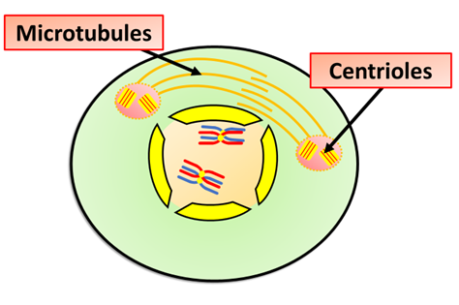
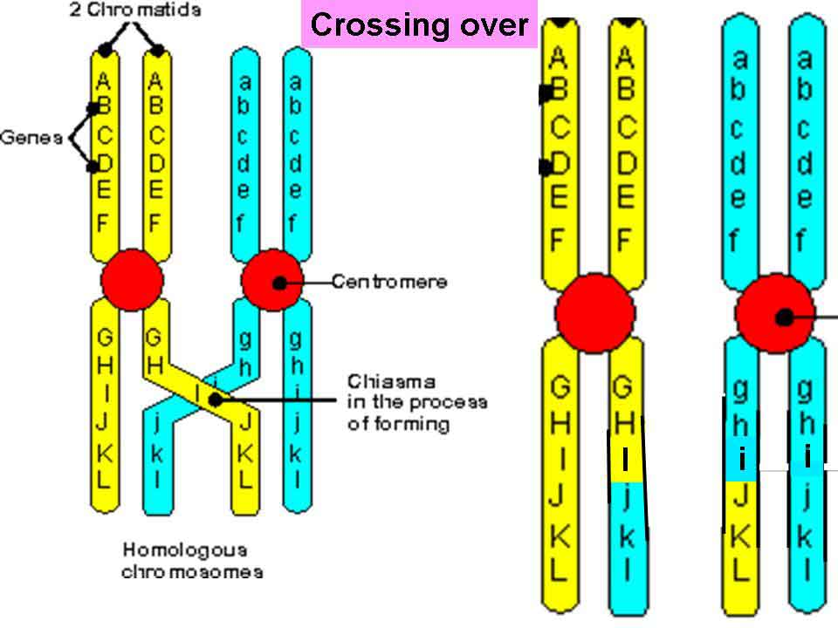
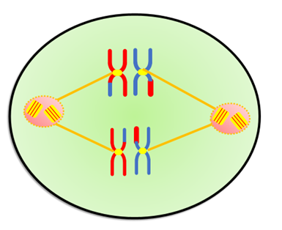
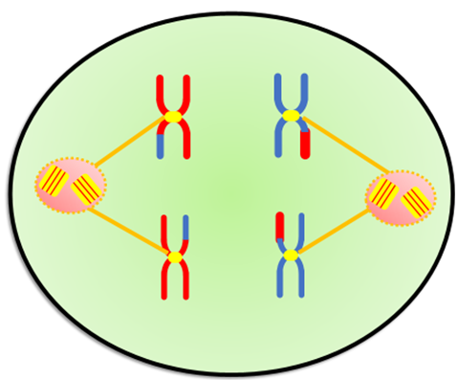
Explain what happens during meiosis Prophase 1
Explain what happens during crossing over of chromosomes
Key information to include:
How does prophase 1 differ from prophase in mitosis
What happens to chromosomes
What do the spindle fibres begin doing
Key information to include:
What are chromosomes
What are alleles
What is crossing over
At what points does crossing over occur
What is the purpose of crossing over
Explain what happens during meiosis Metaphase 1
Explain what happens during meiosis Anaphase 1
Key information to include:
How does metaphase 1 differ from metaphase in mitosis
How do chromosomes pair up
Where do the spindle fibres attach
Key information to include:
How does anaphase 1 differ from anaphase in mitosis
How are the pairs of chromosomes moved around the cell

Slide 4
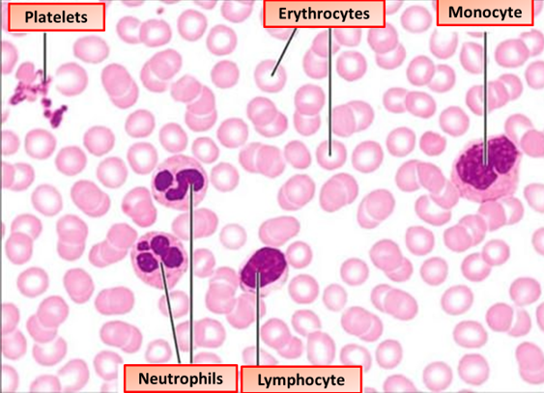
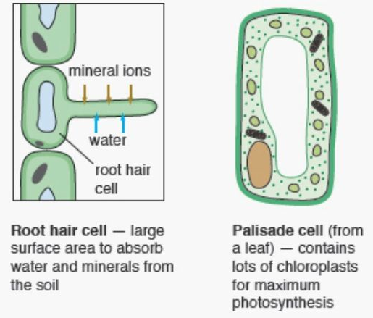
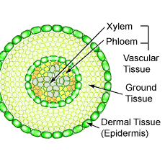
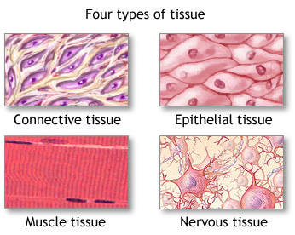
Describe specialized cells found in the blood
Describe specialized cells found in plants
Key information to include:
Erythrocytes
Platelets
Monocytes
Neutrophils
Lymphocytes
Macrophages
T cells
B cells
Key information to include:
Root hair cells
Xylem cells
Phloem cells
Palisade cells
Describe specialized cells found in animal tissues
Describe specialized cells found in plant tissues
Key information to include:
Epidermal tissue
Muscle tissue
Nervous tissue
Bone tissue
Cartilage
Connective tissue
Ciliated epithelium
Key information to include:
Epidermal tissue
Xylem tissue
Phloem tissue

Slide 5
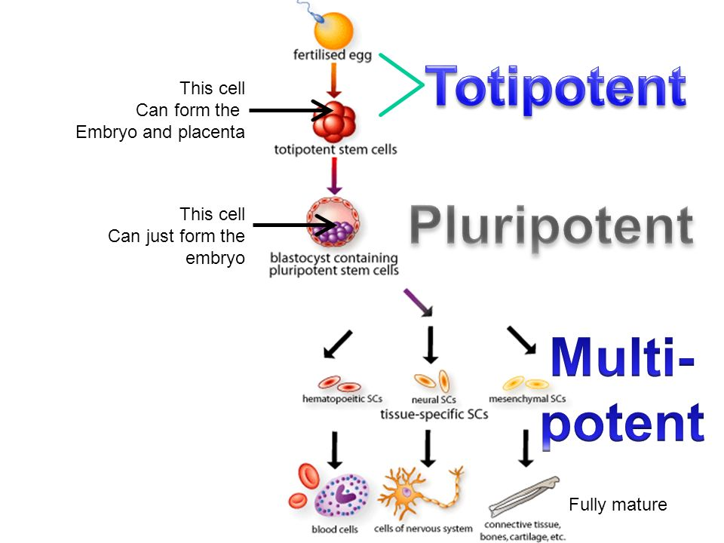
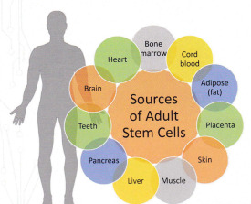
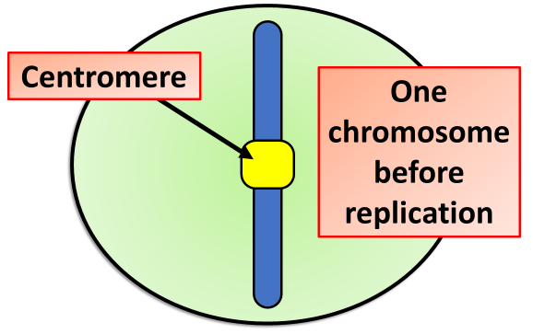
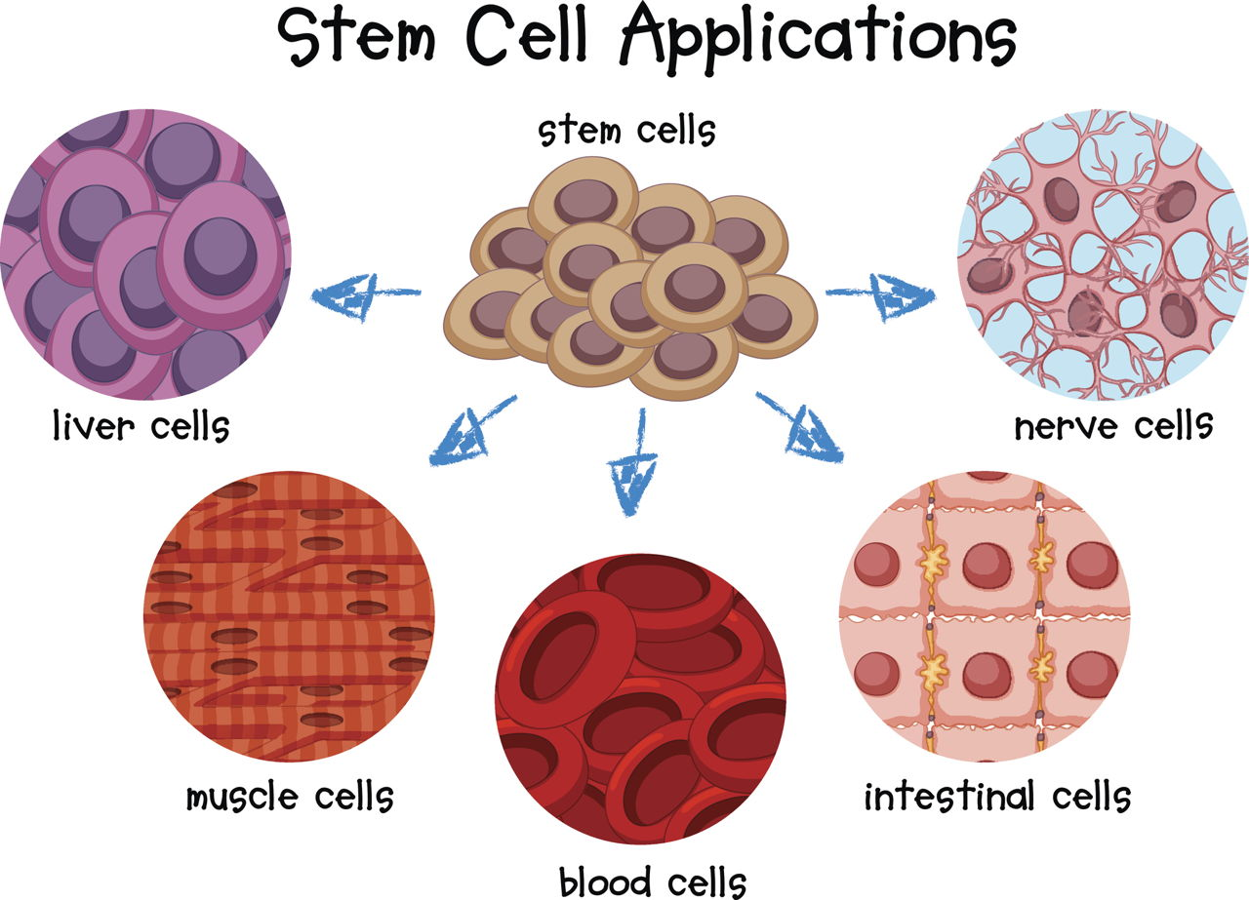
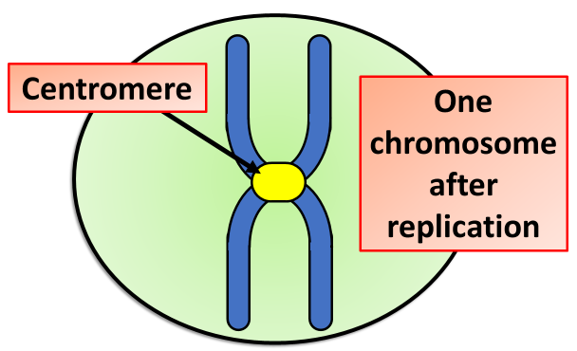
Describe stem cell potency
Describe the sources of stem cells
Key information to include:
Embryonic stem cells
Adult stem cells
Tissue stem cells
Bone marrow
Meristematic cells
Key information to include:
Totipotent
Pluripotent
Multipotent
Describe uses of stem cells
Describe what happens during chromosome replication
Key information to include:
Heart disease
Type 1 diabetes
Parkinson’s disease
Altzheimer’s disease
Macular degeneration
Birth defects
Spinal injuries
Key information to include:
How does DNA replicate
What is the role of the centromere
What are chromatids

Slide 6

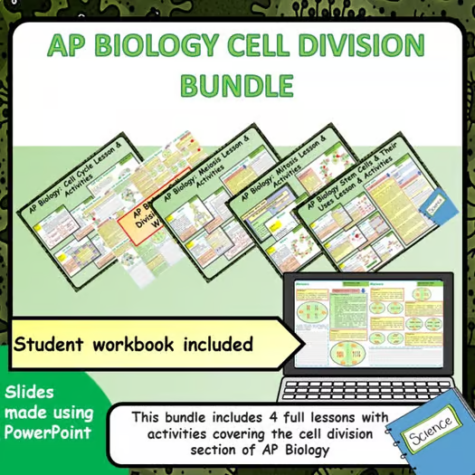


Click on the links below for lessons this resource can be used with
TPT lesson on cells
TES lessons on cells
Follow this link for a videos running that can be used with students on cells
Youtube video link
Follow me on social media to stay in touch
Keep up to date with my new content:

