Slide 1
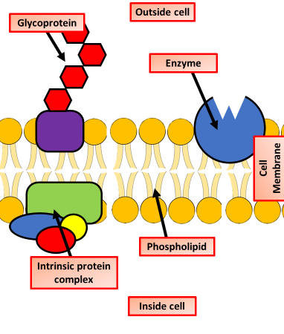
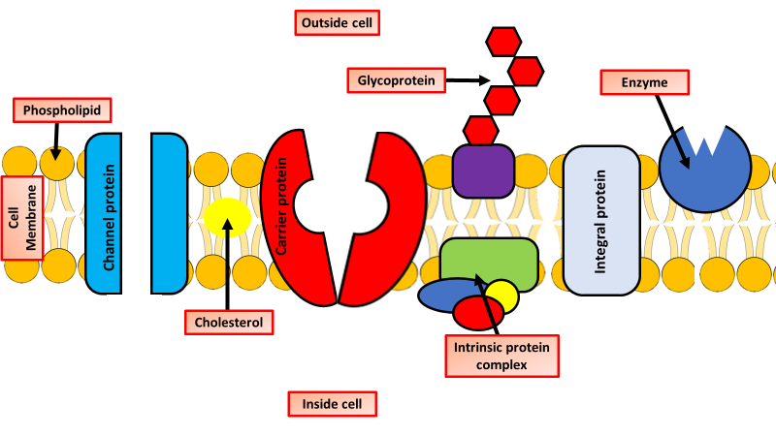
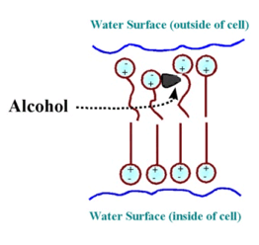
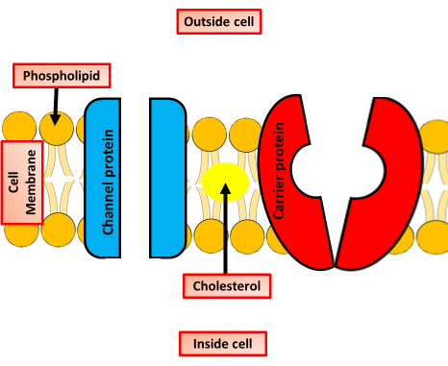
Describe the fluid mosaic
What are the roles of different membrane proteins?
Key information to include:
What a fluid mosaic is
What the components are
What is and properties of a phospholipid bilayer
Key information to include:
Glycoproteins
Intrinsic proteins
Enzymes
Channel proteins
Carrier proteins
Proton pumps
Explain the effect of temperature on membranes
Explain the effect of solvents on cell membranes
Key information to include:
What happens if the temperature is too low
What happens if the temperature is too high
What effect does temperature have on movement of molecules across it
Key information to include:
What are solvents
What effects do solvents have on membranes
What effect does alcohol have on membranes

Slide 2
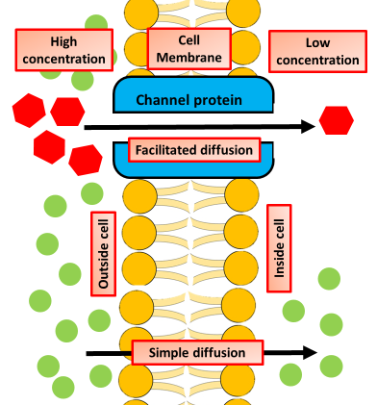
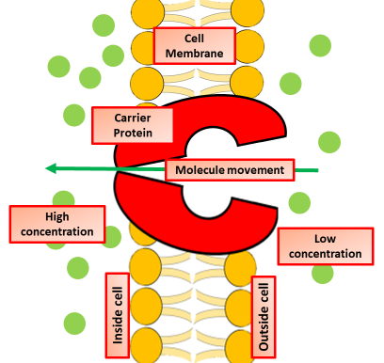
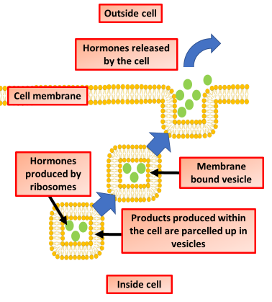
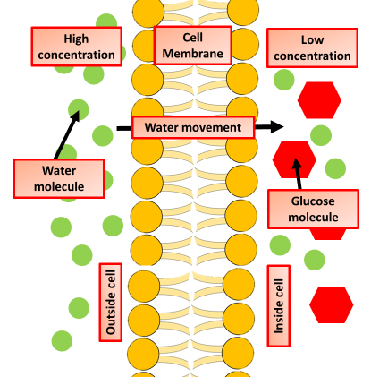
Explain diffusion over membranes
Explain active transport over membranes
Key information to include:
What diffusion is
How diffusion happens over a membrane
What effect temperature has on diffusion
What effect concentration has on diffusion
Key information to include:
What active transport is
How active transport happens over a membrane
What role carrier proteins play in active transport
Describe bulk transport
Describe what osmosis is
Key information to include:
What bulk transport is
What happens during exocytosis
What happens during endocytosis
Where in organisms we find bulk transport
Key information to include:
What osmosis is
How water moves across membranes
How concentration affects osmosis
Where osmosis is important in both plants and animals

Slide 3
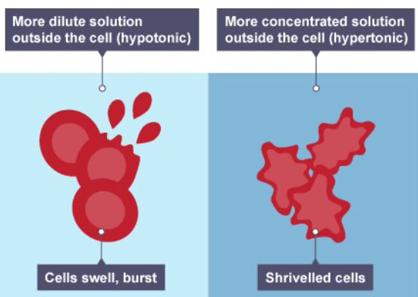
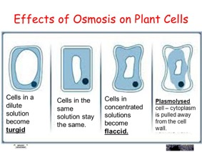
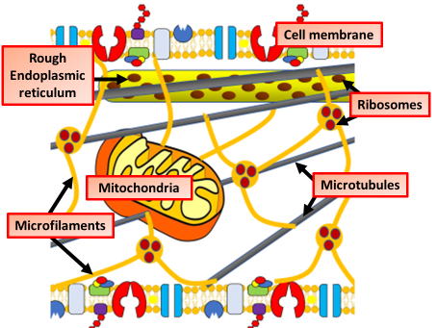
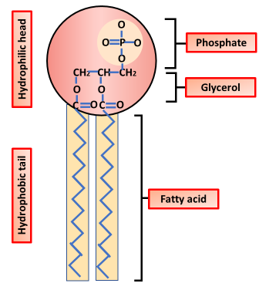
Describe the effect of osmosis in animal cells
Describe the effect of osmosis in plant cells
Key information to include:
What can change the water concentration in blood
What happens when it’s too high
What happens when it is too low
Key information to include:
How do cells become turgid
How do cells become flaccid
How do cells become plasmolysed
Explain the functions and structure of the cytoskeleton
Explain the structure & properties of phospholipids
Key information to include:
What is the cytoskeleton
What is it’s function
What are microfilamenta
What are microtubules
What are intermediate bibres
Key information to include:
What are phospholipids
What are the properties of the head
What are the properties of the tail
How do they make membranes

