Slide 1
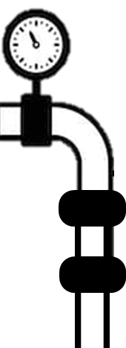

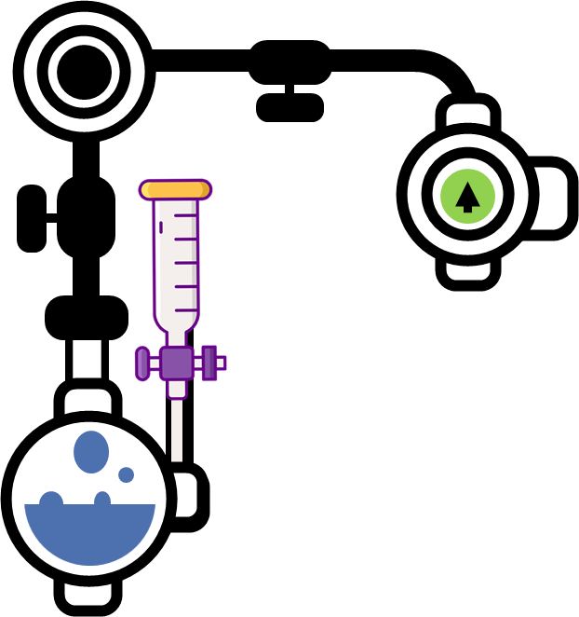

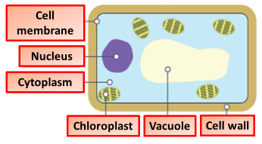

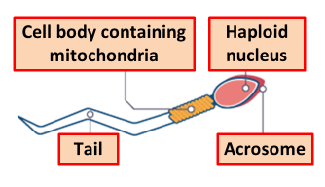
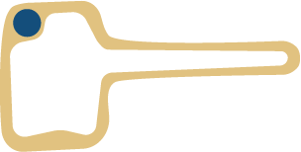
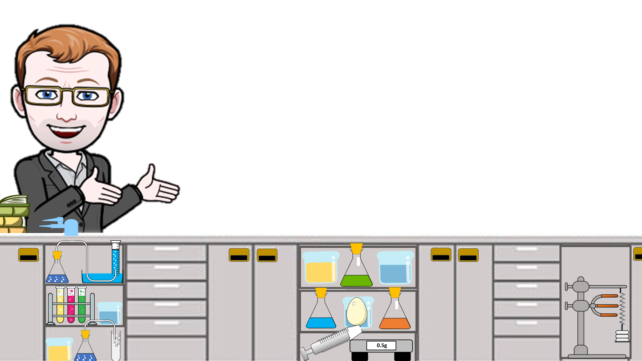

Cells Notes
Plant cells are the building block of plant life, and carry out all of the functions necessary for survival. Photosynthesis, the making of food from light energy, carbon dioxide, and water, occurs in the chloroplasts of the cell
.
Animal cells carry out all the processes of the body including producing and storing energy, making proteins, replicating the DNA, and transportation of molecules through the body.
Eukaryotes. Cells of animals, plants and fungi are called eukaryotic cells . They contain membrane bound organelles such as a nucleus and mitochondria.
Prokaryotes: Bacteria are amongst the simplest of organisms - they are made of single cells. These cells do not contain membrane bound organelles such as a nucleus and mitochondria. Bacterial cells are called prokaryotic cells .
Stem cells are cells that have not undergone differentiation. A cell which has not yet become specialised is called undifferentiated.
Cell membrane – this surrounds the cell and allows nutrients to enter and waste to leave it.
The acrosome in the head contains enzymes so that the sperm can penetrate an egg. The middle is packed with mitochondria to release energy needed to swim and fertilise the egg. The tail enables the sperm to swim.
Nucleus – this controls what happens in the cell. It contains DNA, the genetic information that cells need to grow and reproduce.
Cytoplasm – this is a jelly-like substance in which chemical reactions happen.
The root hair cell has a large surface area to provide contact with soil water. It has thin walls so as not to restrict the movement of water.
Mitochondria – these are the powerhouse of the cell. They are structures where respiration takes place.
Take a clean cotton swab and gently scrape the inside of your mouth.
Smear the cotton swab on the centre of the microscope slide for 2 to 3 seconds.
Add a drop of methylene blue solution and place a coverslip on top. Concentrated methylene blue is toxic if ingested.
Remove any excess solution by allowing a paper towel to touch one side of the coverslip.
Place the slide on the microscope, with 4 x or 10 x objective in position and find a cell. Then view at higher magnification.
Ribosome– this organelle uses mRNA from genes to produce protein
Cell wall - this is an outer structure that surrounds the cell and gives it support.
Vacuole - this is a space within the cytoplasm of plant cells that contains sap.
Making a slide
Chloroplasts - these contain chlorophyll and are the site of photosynthesis.

Slide 2
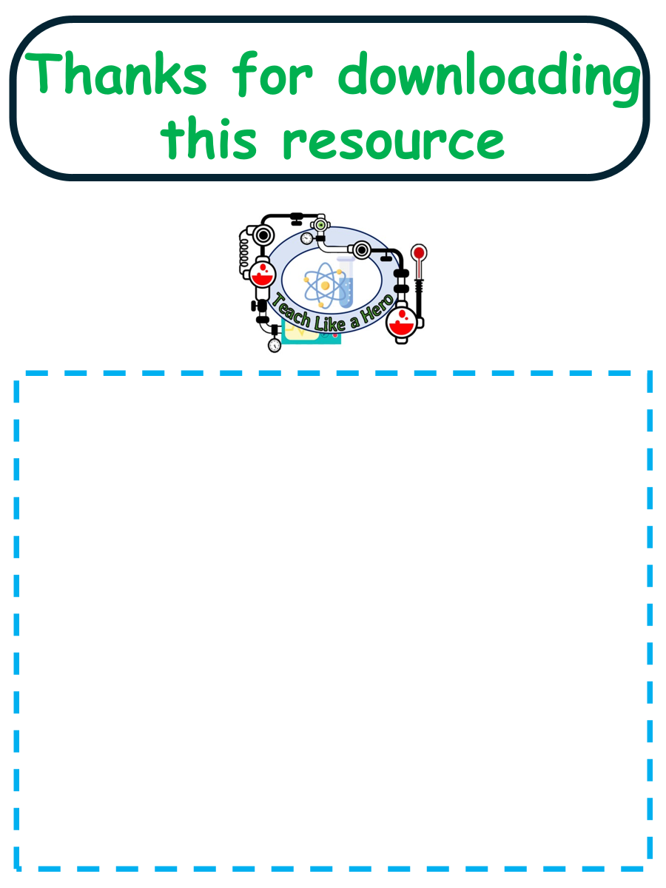
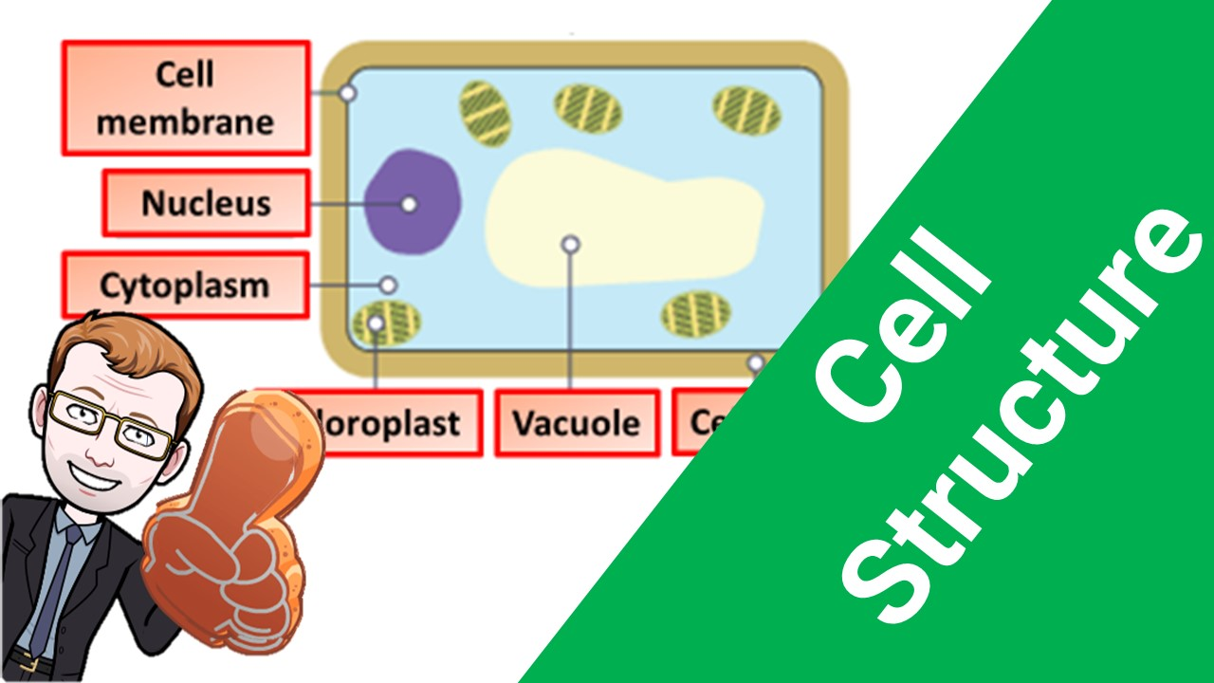


Click here to access my Cells youtube videos
Resources that this activity would work well with
Lessons on TES
Lessons on TPT
Follow me on social media to stay in touch
Keep up to date with my new content:

