Slide 1
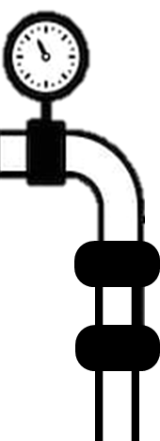
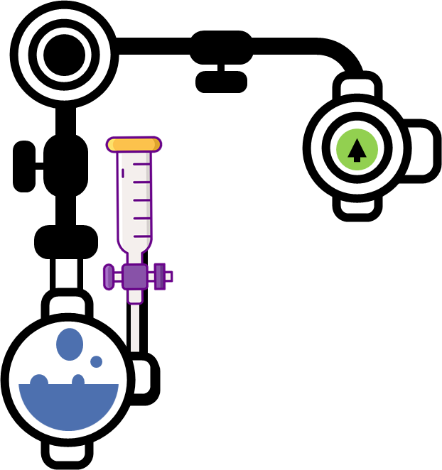
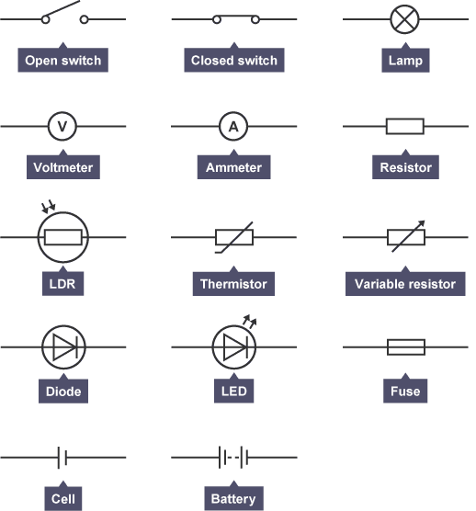
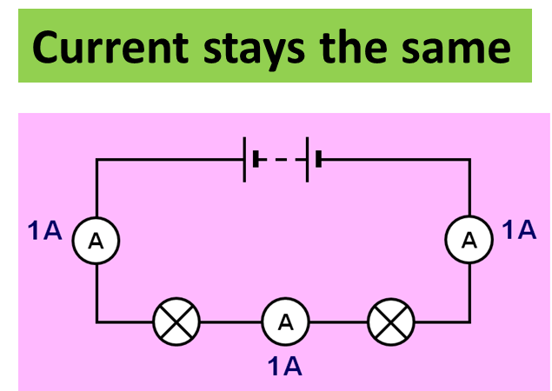
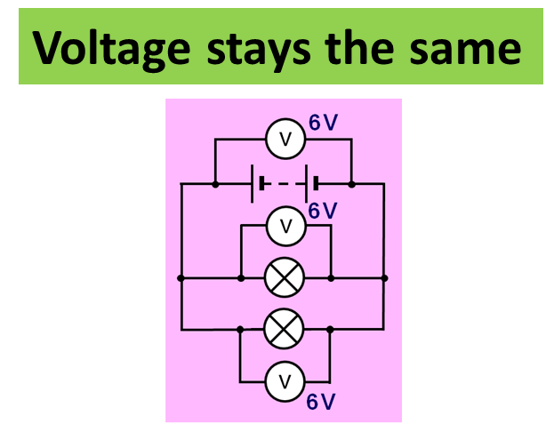
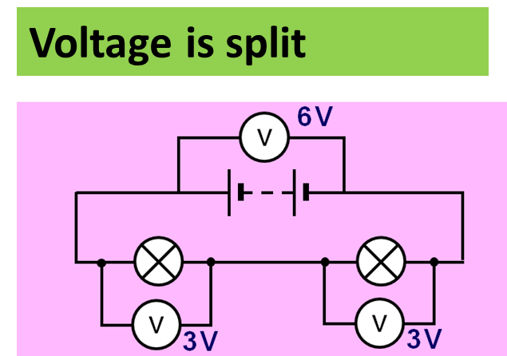
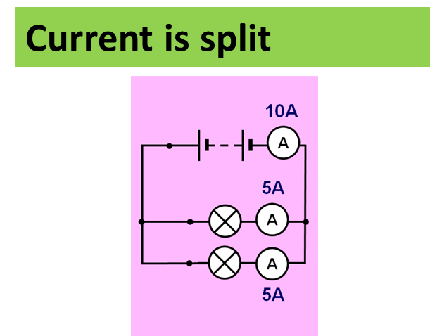
Circuits Notes
If the current flows in only one direction it is called direct current, or d.c. Batteries and cells supply d.c. electricity, with a typical battery supplying maybe 1.5V. The diagram shows an oscilloscope screen displaying the signal from a d.c. supply.
If the current constantly changes direction, it is called alternating current, or a.c.. Mains electricity is an a.c. supply, with the UK mains supply being about 230V. It has a frequency of 50Hz (50 hertz), which means it changes direction, and back again, 50 times a second. The diagram shows an oscilloscope screen displaying the signal from an a.c. supply
Some circuit symbols used in schematic diagrams are shown below. A straight line is used to represent a connecting wire between any two components of the circuit. An electrical device that offers resistance to the flow of charge is generically referred to as a resistor and is represented by a zigzag line.
Static electricity is an imbalance of electric charges within or on the surface of a material. The charge remains until it is able to move away by means of an electric current or electrical discharge.
There are two types of electric charge, POSITIVE and NEGATIVE
Negative charge is made up of electrons from the outside of atoms
Positive charge is made up from protons.
Protons are usually found in the nucleus of atoms.
Some materials become charged because friction cause electrons to be pulled off one material and transferred to another material.
Only electrons can move
Protons are “stuck” in the middle of atoms.
Materials that have a positive charge are usually things that have “lost” electrons (not gained protons).
Series Circuit
Parallel Circuit
A series circuit is a closed circuit in which the current follows one path, as opposed to a parallel circuit where the circuit is divided into two or more paths. In a series circuit, the current through each load is the same and the total voltage across the circuit is the sum of the voltages across each load.
A parallel circuit is a closed circuit in which the current divides into two or more paths before recombining to complete the circuit. Each load connected in a separate path receives the full circuit voltage, and the total circuit current is equal to the sum of the individual branch currents.

Slide 2
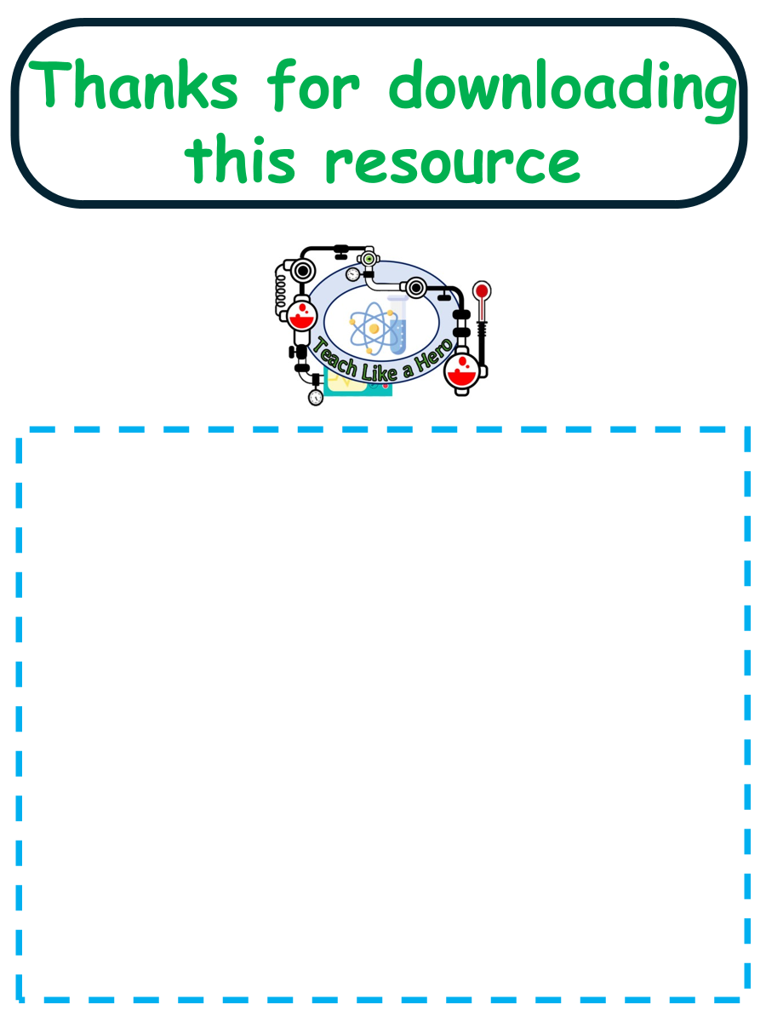
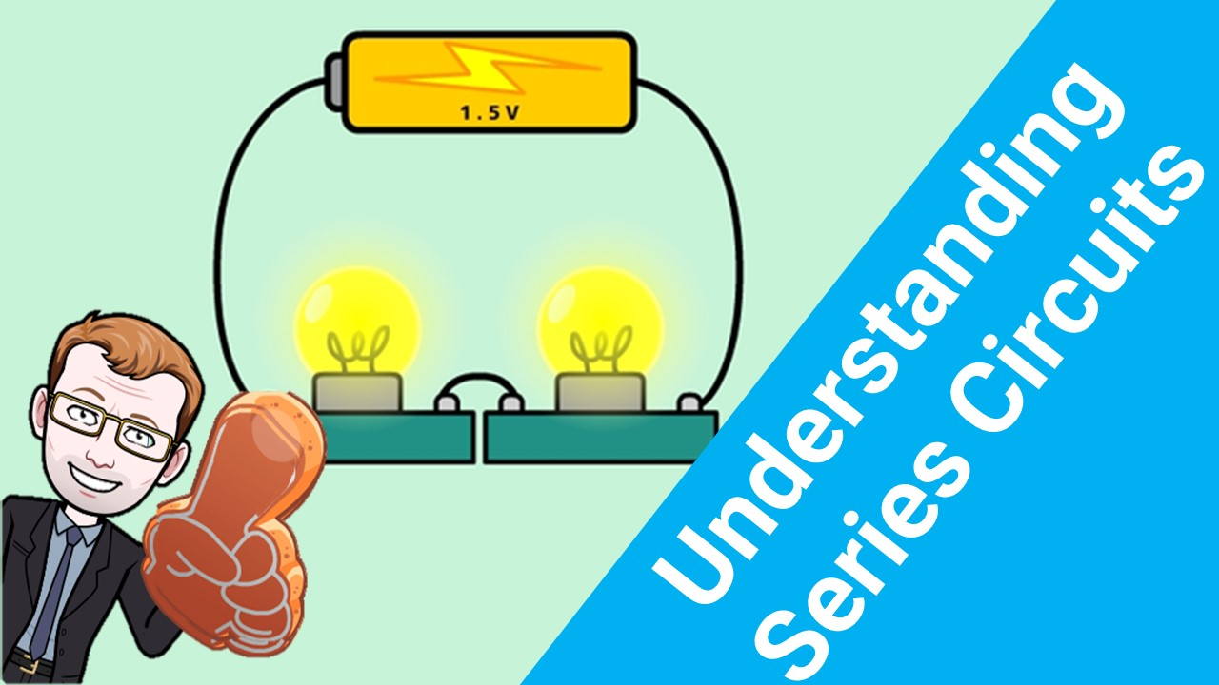
Click here to access my circuits youtube videos
Resources that this activity would work well with
Lessons on TES
Lessons on TPT
Follow me on social media to stay in touch
Keep up to date with my new content:

