Slide 1
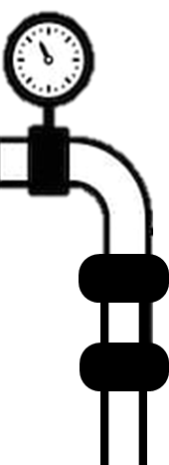
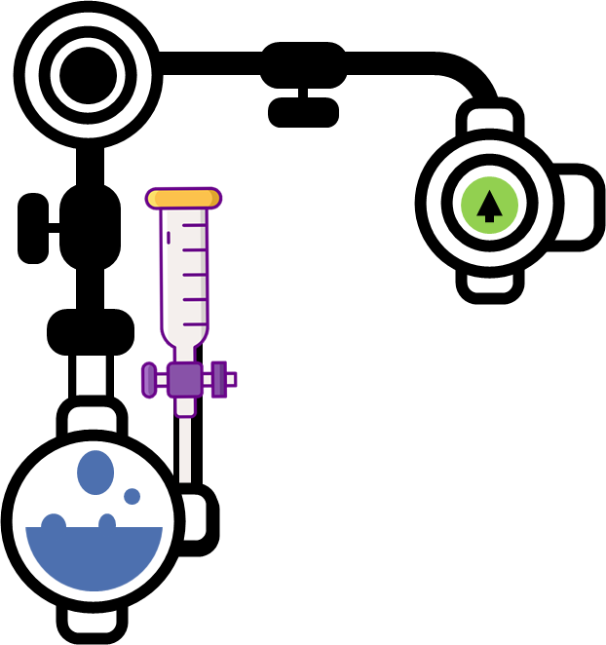
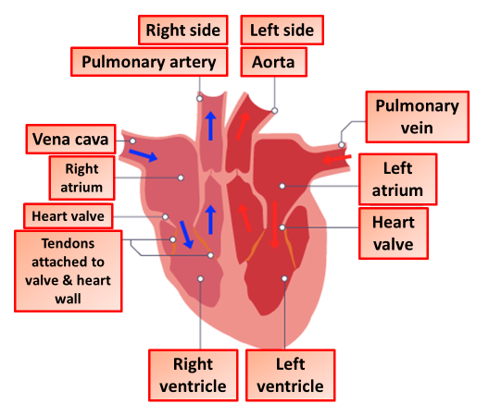
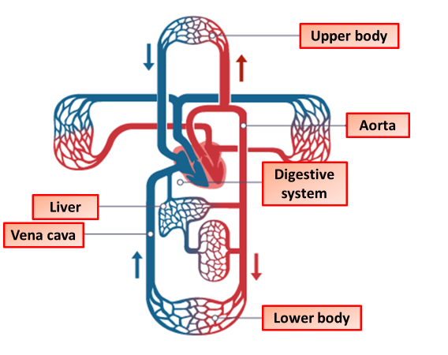
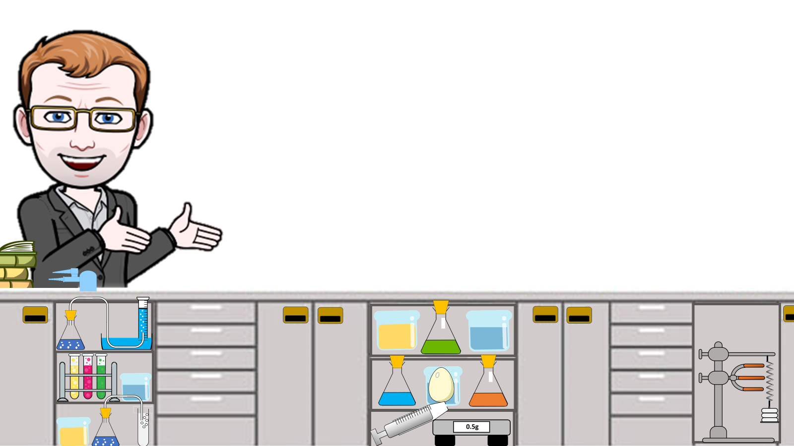
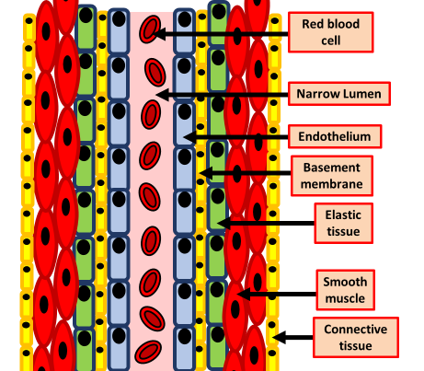
Circulation Notes
Systemic circulation is the portion of the cardiovascular system which transports oxygenated blood away from the heart through the aorta from the left ventricle where the blood has been previously deposited from pulmonary circulation, to the rest of the body, and returns oxygen-depleted blood back to the heart..
Blood is a body fluid in humans and other animals that delivers necessary substances such as nutrients and oxygen to the cells and transports metabolic waste products away from those same cells.
Plasma | Transporting carbon dioxide, digested food, urea, hormones
Red blood cells | Transporting oxygen
White blood cells | Ingesting pathogens and producing antibodies
Platelets | Involved in blood clotting
The heart is a four-chambered muscular pump which pumps blood round the circulatory system. The right side of the heart pumps de-oxygenated blood to the lungs to pick up oxygen. The left side of the heart pumps the oxygenated blood from the lungs around the rest of the body.
The blood capillaries are where the important functions of the circulation take place: the exchange of material between circulation and cells.
Arteries carry oxygenated blood away from the heart to the tissues, except for pulmonary arteries, which carry blood to the lungs for oxygenation (usually veins carry deoxygenated blood to the heart but the pulmonary veins carry oxygenated blood as well).
Veins are an important part of our circulatory system. They are responsible for returning deoxygenated blood back to the heart after arteries carry blood out. Veins have valves to stop backflow
Artery
Vein
Capillary

Slide 2
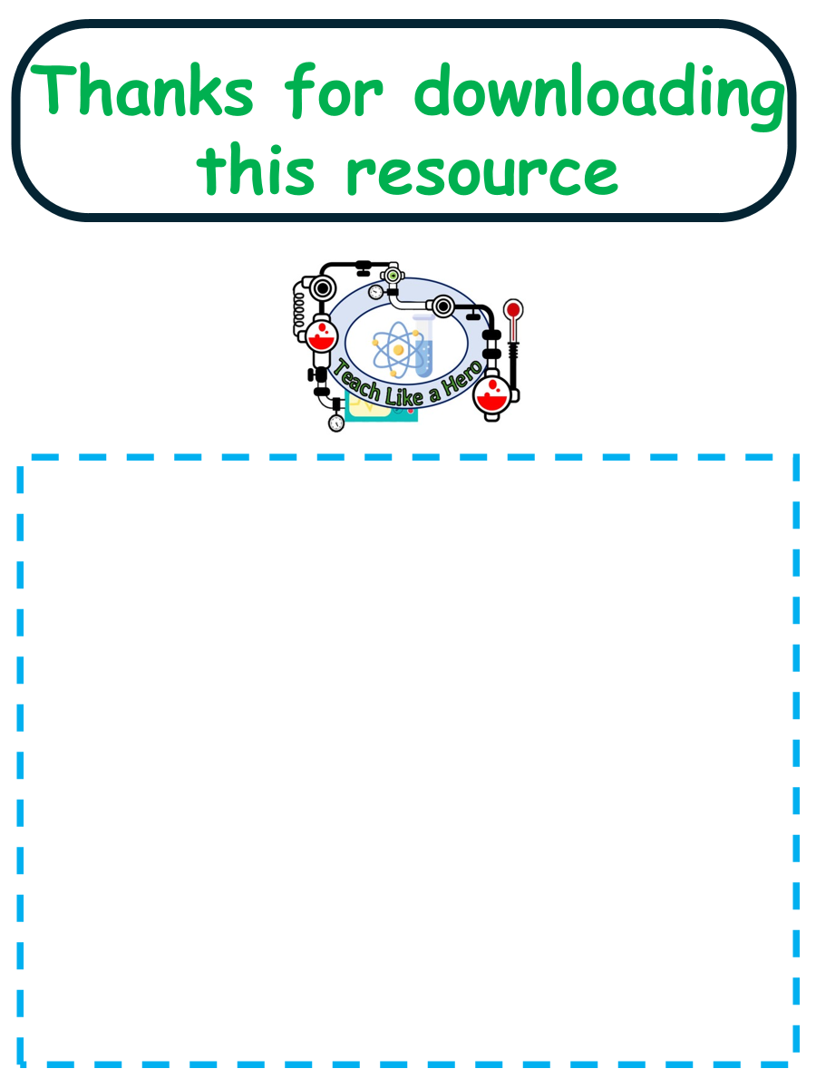
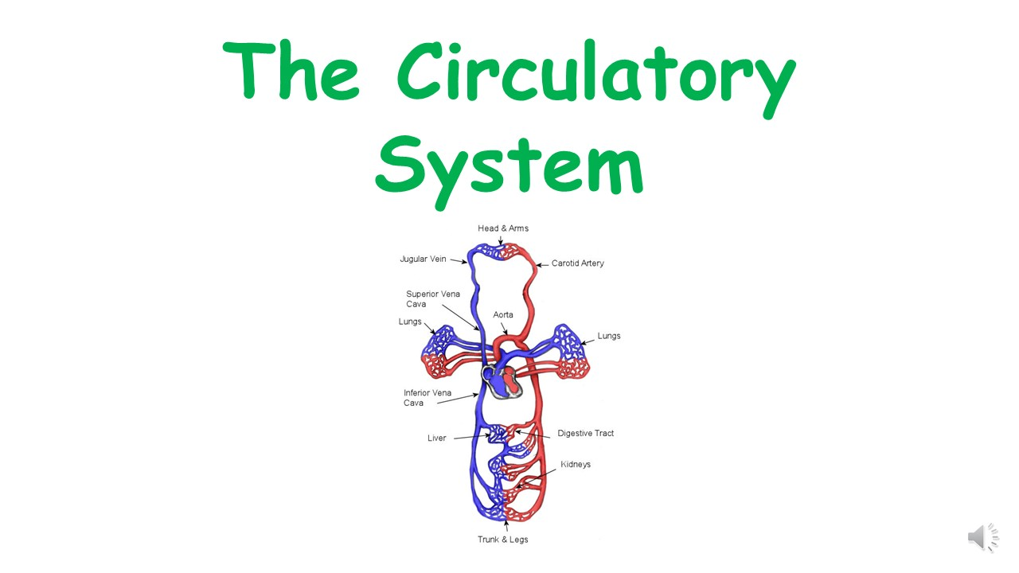
Click here to access my Cells youtube videos
Resources that this activity would work well with
Lessons on TES
Lessons on TPT
Follow me on social media to stay in touch
Keep up to date with my new content:

