Slide 1
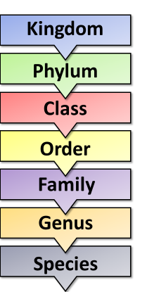
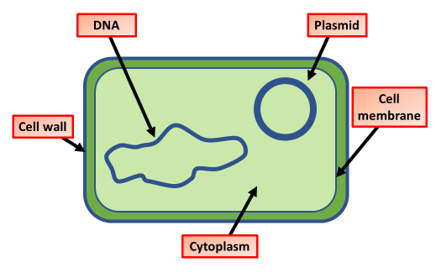
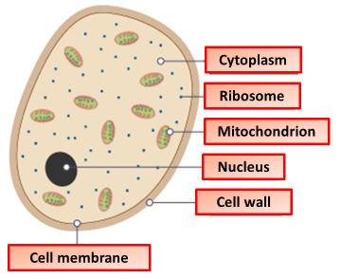
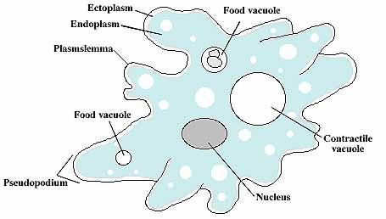
Describe how organisms are classified
Describe the features of prokaryotae
Key information to include:
What classification is
How has classification developed
What is the classification system
Key information to include:
What are their key features
How do they differ from other organisms
What does their DNA look like
Describe the features of protoctista
Describe the features of fungi
Key information to include:
What are their key features
How do they differ from other organisms
What does their DNA look like
Key information to include:
What are their key features
How do they differ from other organisms
What does their DNA look like

Slide 2
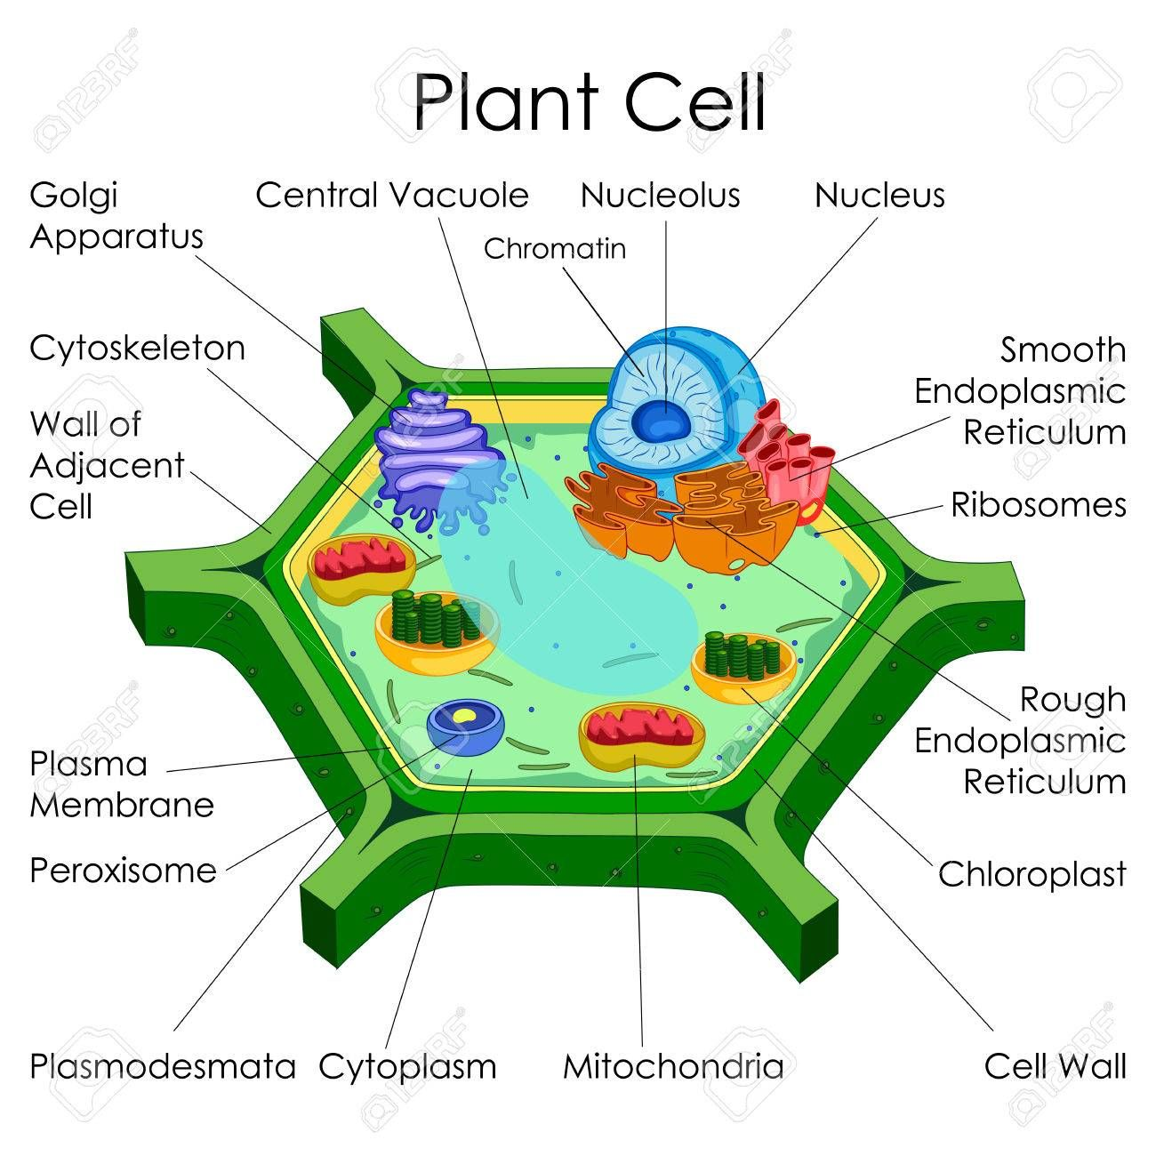
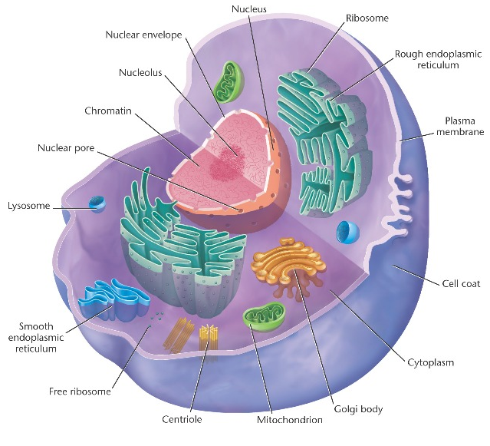
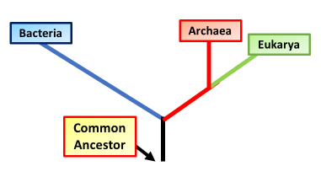
Describe the features of plantae
Describe the features of animalia
Key information to include:
What are their key features
How do they differ from other organisms
What does their DNA look like
Key information to include:
What are their key features
How do they differ from other organisms
What does their DNA look like
Describe the features of archaebacteria & eubacteria
Describe what phylogenetic classification is
Key information to include:
What it is
What phylogenetic trees are
What they show
What the advantages of phylogenetic classification
Key information to include:
What are their key features
How do they differ from other organisms
What does their DNA look like
Why were they split into 2 groups

Slide 3
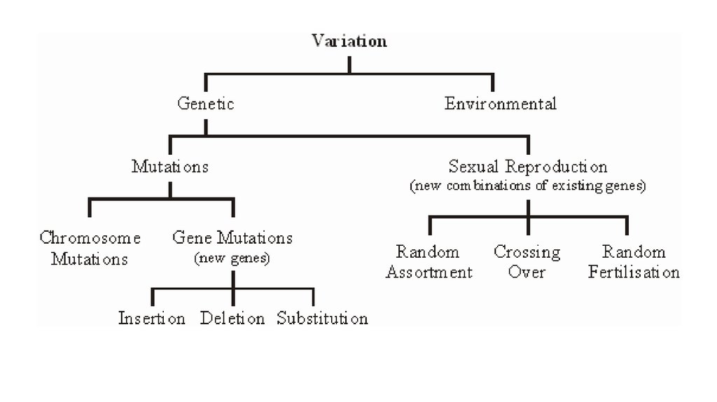
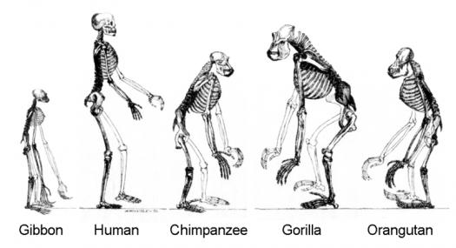
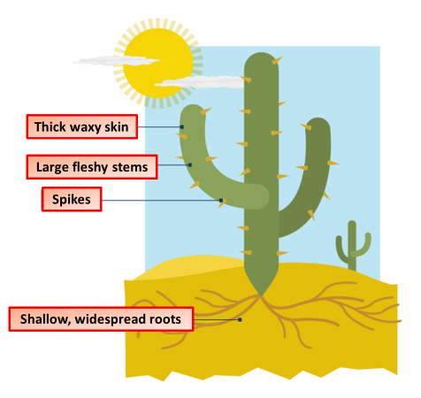
Describe other pieces of evidence of evolution
Describe the genetic causes of variation
Key information to include:
Fossils
Comparative anatomy
DNA
Observations
Biochemical processes
Key information to include:
Meiosis (crossing over)
Meiosis (independent assortment)
Mutations
Allele frequency
Describe the environmental causes of variation
Describe examples of anatomical adaptations
Key information to include:
Nutrients
Light
Water
Predators
Prey
Temperature
Limiting factors
Key information to include:
Body coverings
Camouflage
Teeth
Claws
Mimicry
Waxy cuticle
Stomata frequency
Hairs on leafs

Slide 4
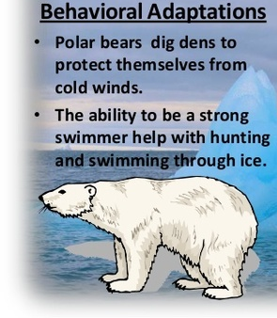
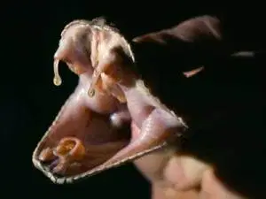
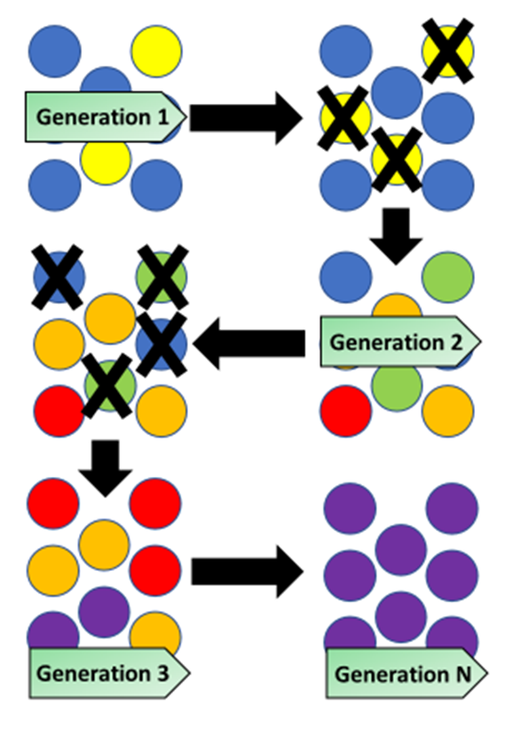
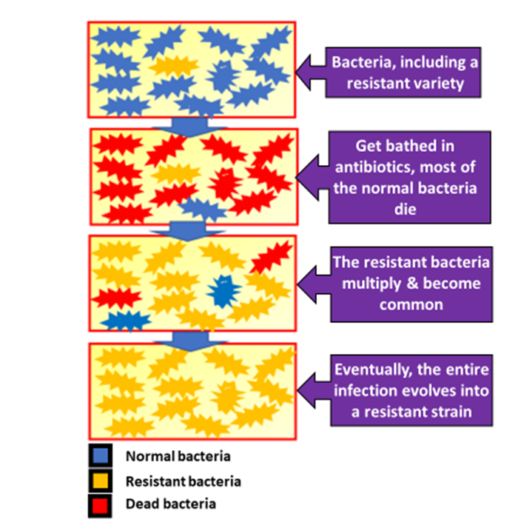
Describe examples of behavioral adaptations
Describe examples of physiological adaptations
Key information to include:
Survival behaviors
Courtship
Migration
Hibernation
Innate behavior
Learned behavior
Key information to include:
Poison production
Antibiotic production
Water holding
Describe natural selection
Give examples of natural selection
Key information to include:
A detailed description of how it happens
Mutations
Reproduction
Selective advantages
Key information to include:
Peppered moths
MRSA
Sheep blowflies
Flavobacterium

