Slide 1
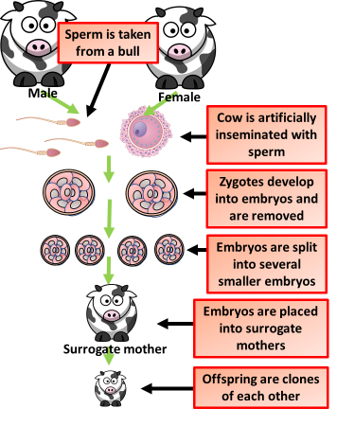
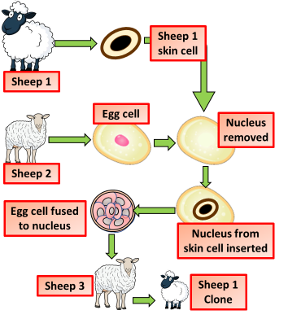
Cloning Animals
Specification Link:
Inheritance: 4.6.1.2
Highlight key words in the information below:
A developing embryo is removed from a pregnant animal at an early stage, before the embryo's cells have had time to become specialised. The cells are separated, grown for a while in a laboratory, and then transplanted into host mothers.
When the offspring are born, they are identical to each other. They are not identical to their host mothers, because they contain different genetic information (the offsprings' DNA comes from the original pregnant animal and the father).
Using the diagram explain how embryo cloning is carried out
______________________________________________________________________________________________________________________________________________________________________________________________________________________________________________________________________________
Fusion cell cloning involves replacing the nucleus of an unfertilised egg with the nucleus from a different cell. The replacement nucleus can come from an embryo, but if it comes from an adult cell, it is called adult cell cloning.
Using the diagram explain how fusion cloning is carried out
________________________________________________________________________________________________________________________________________________________________________________________________________________________________________________________________________________________________________________________________________________________________________________________________________
Discuss the benefits and drawbacks in cloning
____________________________________________________________________________________________________________________________________________________________________________________________________________________________________________________________________________________________________________
Ethics of Cloning
Serious ethical concerns have been raised by the future possibility of harvesting organs from clones. Advocates of human therapeutic cloning believe the practice could provide genetically identical cells for regenerative medicine, and tissues and organs for transplantation.
Therapeutic cloning could produce stem cells with the same genetic make-up as the patient. The technique involves the transfer of the nucleus from a cell of the patient, to an egg cell whose nucleus has been removed. Stem cells produced in this way could be transferred to the patient.

