Slide 1
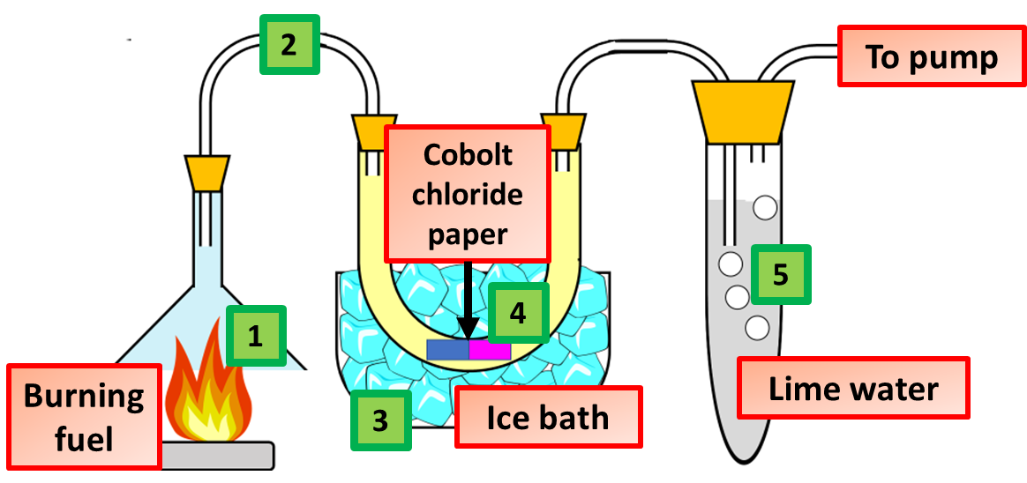
Combustion Practice Question
This apparatus was used to study the combustion of a hydrocarbon fuel. Describe what happens when fuel burns stating how the products from combustion can be identified using the equipment above.
Key things to include:
What reaction takes place
How us water detected
How is carbon dioxide detected
Answer
_____________________________________________________________________________________________________________________________________________________________________________________________________________________________________________________________________________________________________________________________________
Link to video

Slide 2
Combustion Practice Question

Slide 3
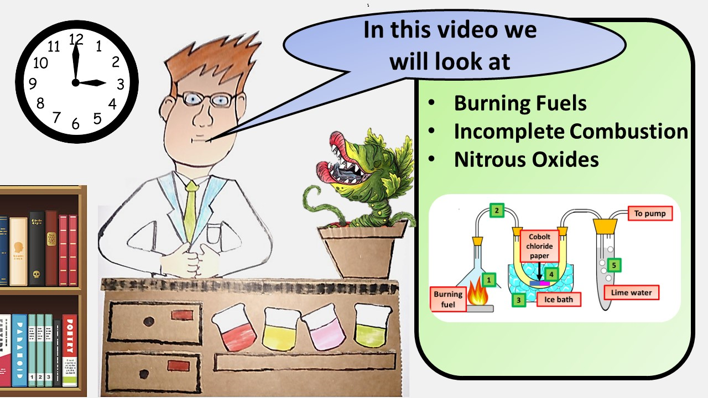
Click here to access my youtube videos
Resources that this activity would work well with
Lesson on TES
Lesson on TPT
Follow me on social media to stay in touch
Keep up to date with my new content:

