Slide 1
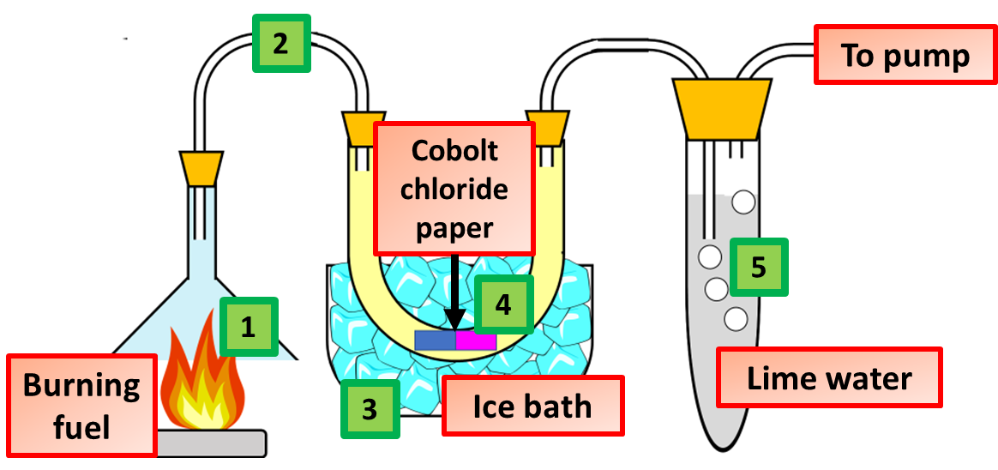
Combustion Practice Question
This apparatus was used to study the combustion of a hydrocarbon fuel. Describe what happens when fuel burns stating how the products from combustion can be identified using the equipment above.
Hydrocarbon + oxygen
Makes carbon dioxide + water
This is caller combustion
The water vapour is condensed in the u tube
Answer
Which causes the anhydrous copper sulphate to change colour
The lime water is used to detect carbon dioxide
Which turns the lime water white
A pump is used to help pull the gases through

Slide 2
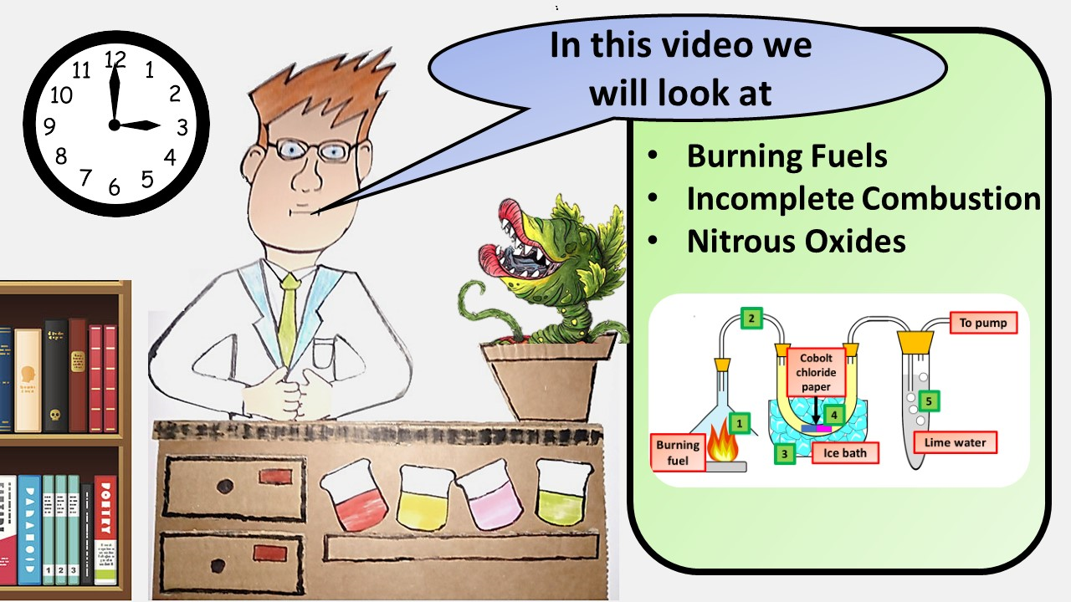
Click here to access my youtube videos
Resources that this activity would work well with
Lesson on TES
Lesson on TPT
Follow me on social media to stay in touch
Keep up to date with my new content:

