Slide 1
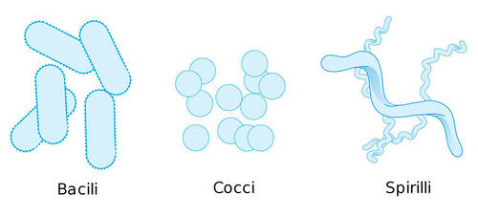
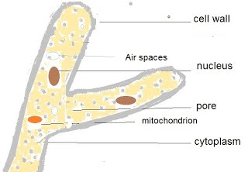
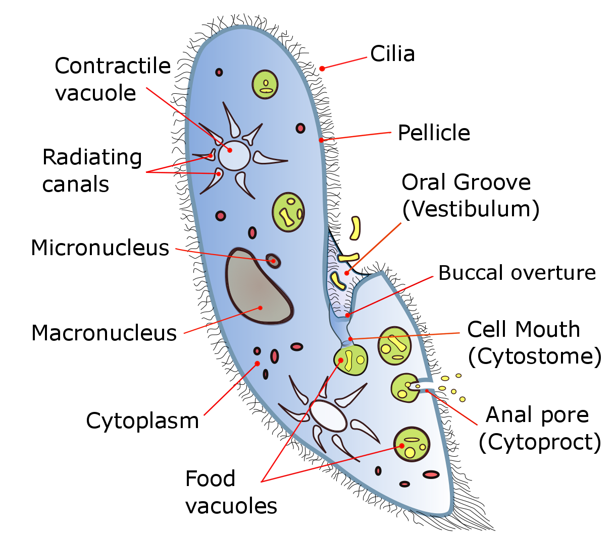
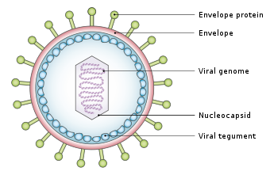
What are bacteria
What are fungi
Key information to include:
A general overview
Bacilli
Cocci
Spirilli
Gram positive bacteria
Gram negative bacteria
Key information to include:
A general overview
How they are spread
A comparison of size to other pathogens
The effect they have on plants
What are viruses
What are protoctista
Key information to include:
A general overview
HIV
Herpes Simplex
TMV
Bacteriaphage
How viruses infect cells
The relative size
Why they are hard to treat
Key information to include:
A general overview
How they differ from other pathogens
Malaria
How they infect people
How they can be spread

Slide 2
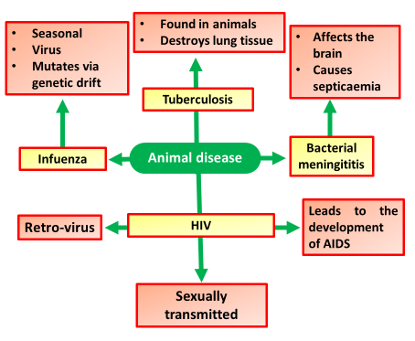
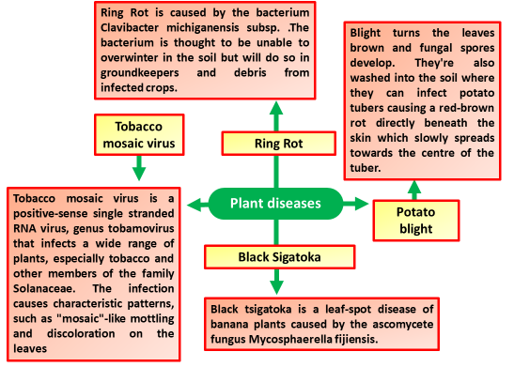
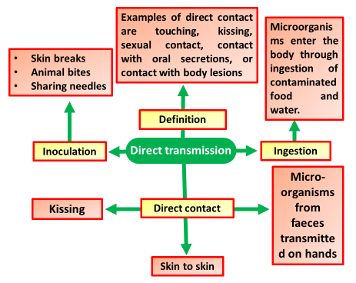
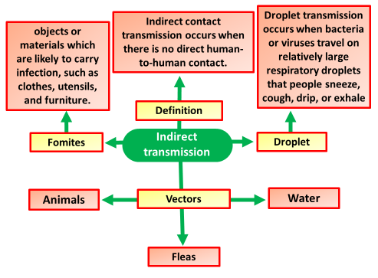
Examples of plant diseases
Examples of animal diseases
Key information to include:
Black Sigatoka
Tobacco mosaic virus
Potato blight
Ring Rot
Key information to include:
Infuenza
Tuberculosis
HIV
Bacterial meningititis
Explain how diseases are spread through direct transmission
Explain how diseases are spread through indirect transmission
Key information to include:
Direct contact
Inoculation
Ingestion
Key information to include:
Fomites
Vectors
Droplet

Slide 3
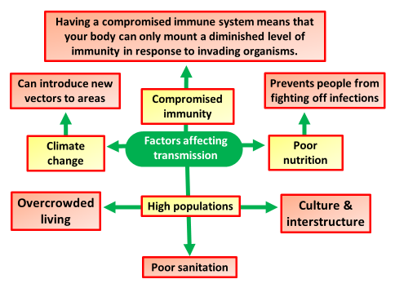
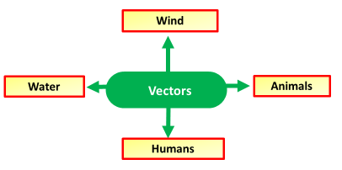
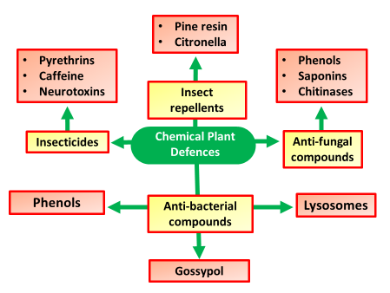
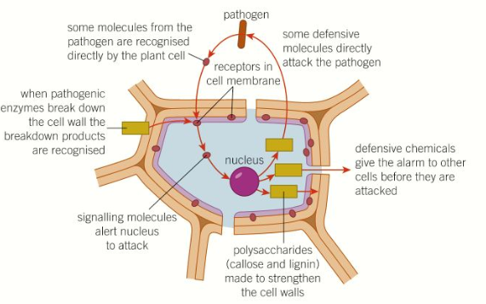
Summaries the factors that affect disease transmission
Explain how vectors transmit disease
Key information to include:
Overcrowding
Poor nutrition
Compromised immunity
Climate change
Culture
Key information to include:
Wind
Water
Animals
Humans
Explain physical defenses in plants
Explain chemical defenses in plants
Key information to include:
What are physical defences
Callose
Cell walls
Lignin
Plasmodesmata
Key information to include:
Insecticides
Anti-fungal
Anii-bacterial
Insect repellents
General toxins

Slide 4
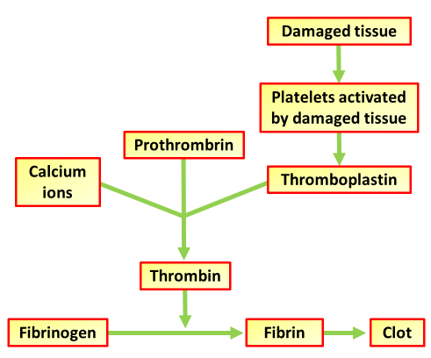
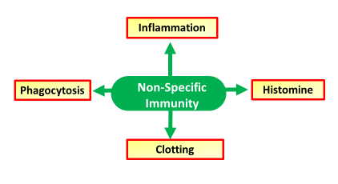
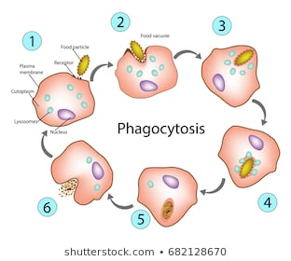
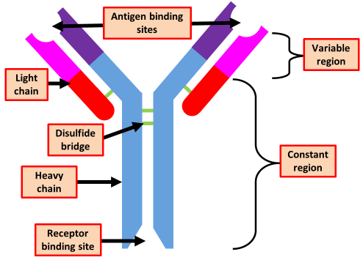
Describe how blood clots
Describe other non specific immune responses
Key information to include:
Platelets
Prothrombrin
Calcium ions
Thromboplastin
Thrombin
Fibrinogen
Fibrin
Key information to include:
Phagocytosis
Inflammation
Clotting
Histamine
Describe phagocytosis
Describe the structure of antibodies
Key information to include:
Antigen binding sites
Light chain
Disulfide bridge
Heavy chain
Receptor binding site
Variable region
Constant region
Key information to include:
Pathogens
Endocytosis
Exocytosis
Phagosome
Lysosome
Phagolysosome
Digestive enzymes

Slide 5
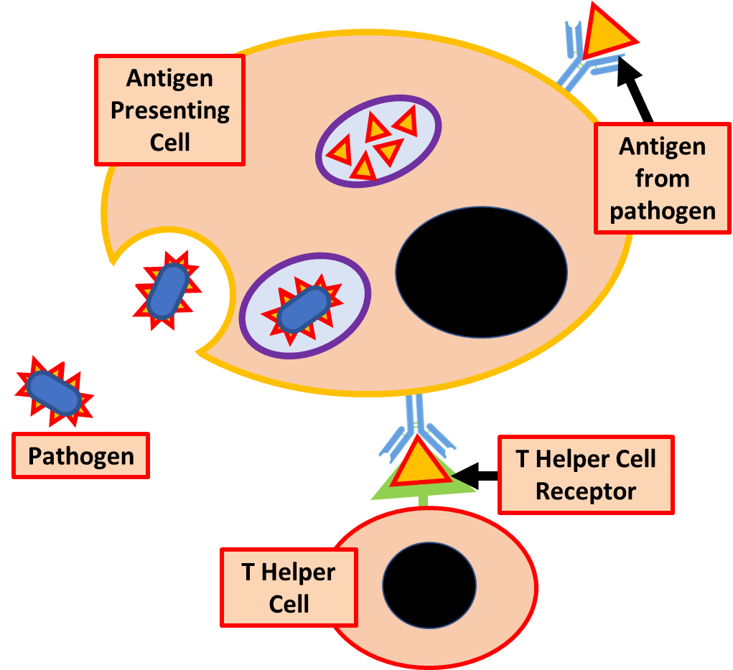
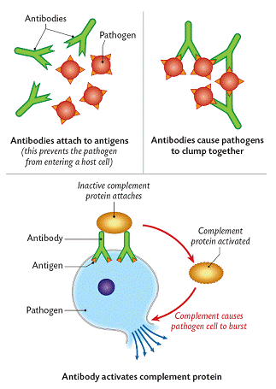
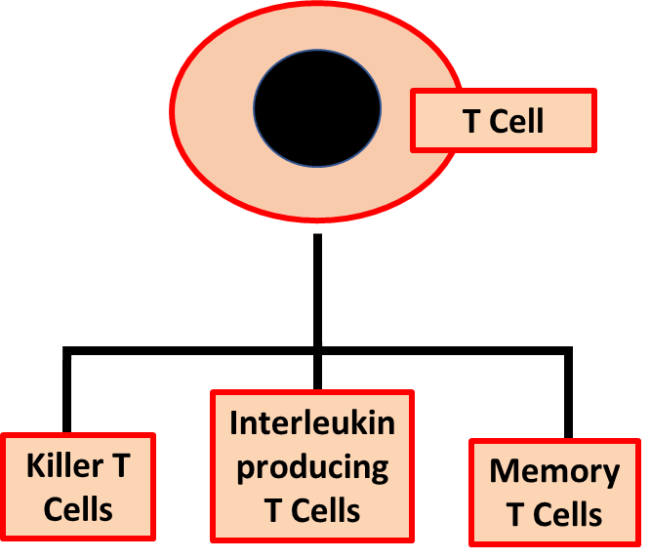
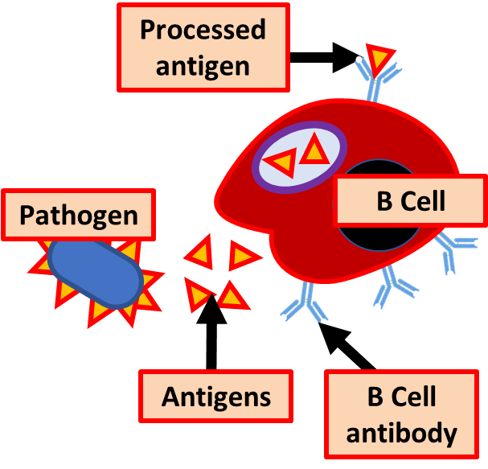
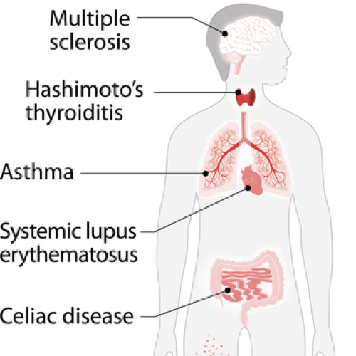
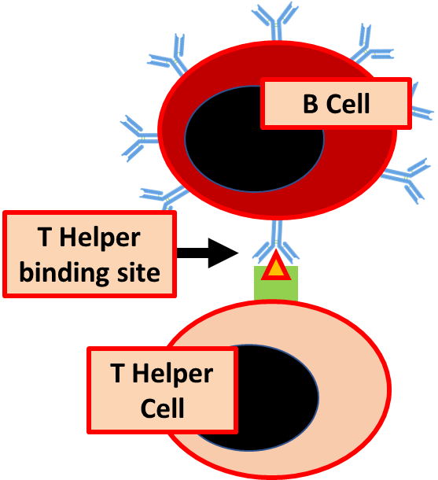
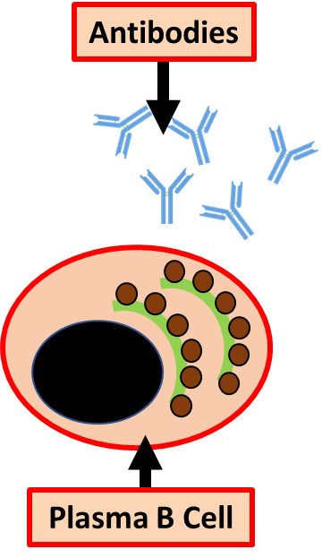
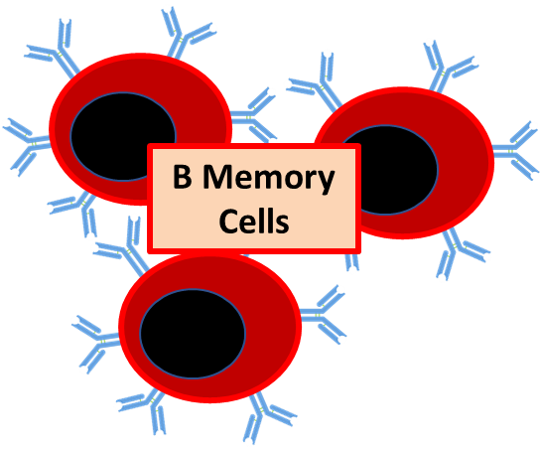
Describe how antibodies defend the body
Describe cell mediated immunity
Key information to include:
Antigen Presenting Cell
Pathogen
Antigen from pathogen
T Helper Cell Receptor
T Helper Cell
Killer T Cells
Interleukin producing T Cells
Memory T Cells
Key information to include:
Antibody complexes
Complementary shapes
Agglutinins
Anti-toxins
Describe humoral immunity
Describe autoimmune diseases
Key information to include:
Pathogen
Antigens
B Cell antibody
B Cell
T Helper binding site
T Helper Cell
B Memory Cells
Plasma B Cell
Key information to include:
General overview
How they are caused
Define autoimmunity
Give some examples

Slide 6
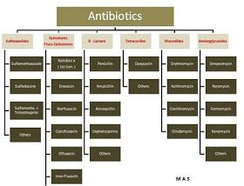
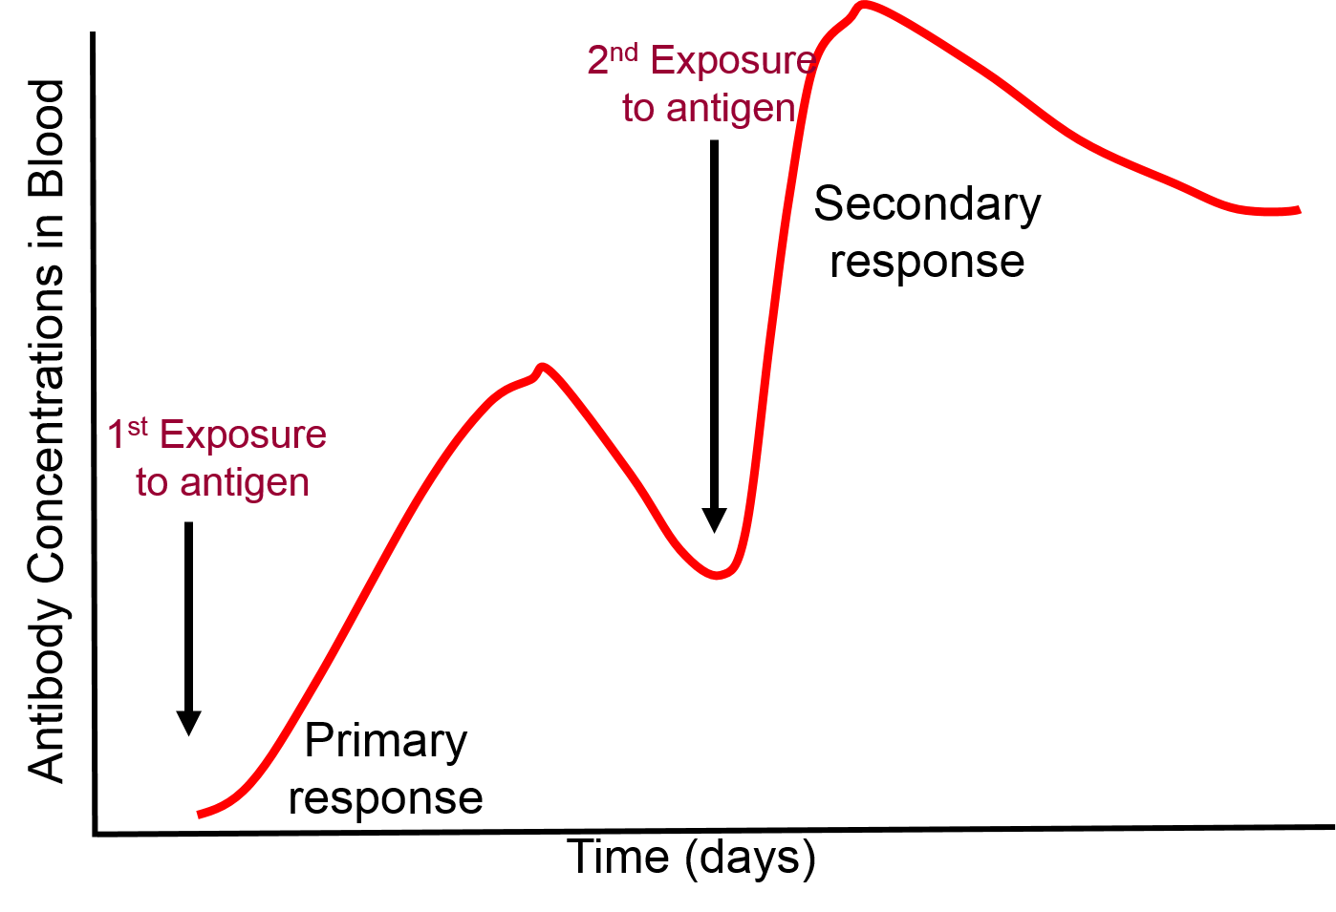
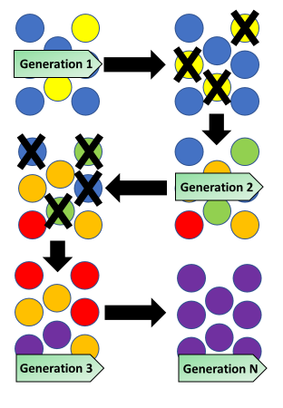
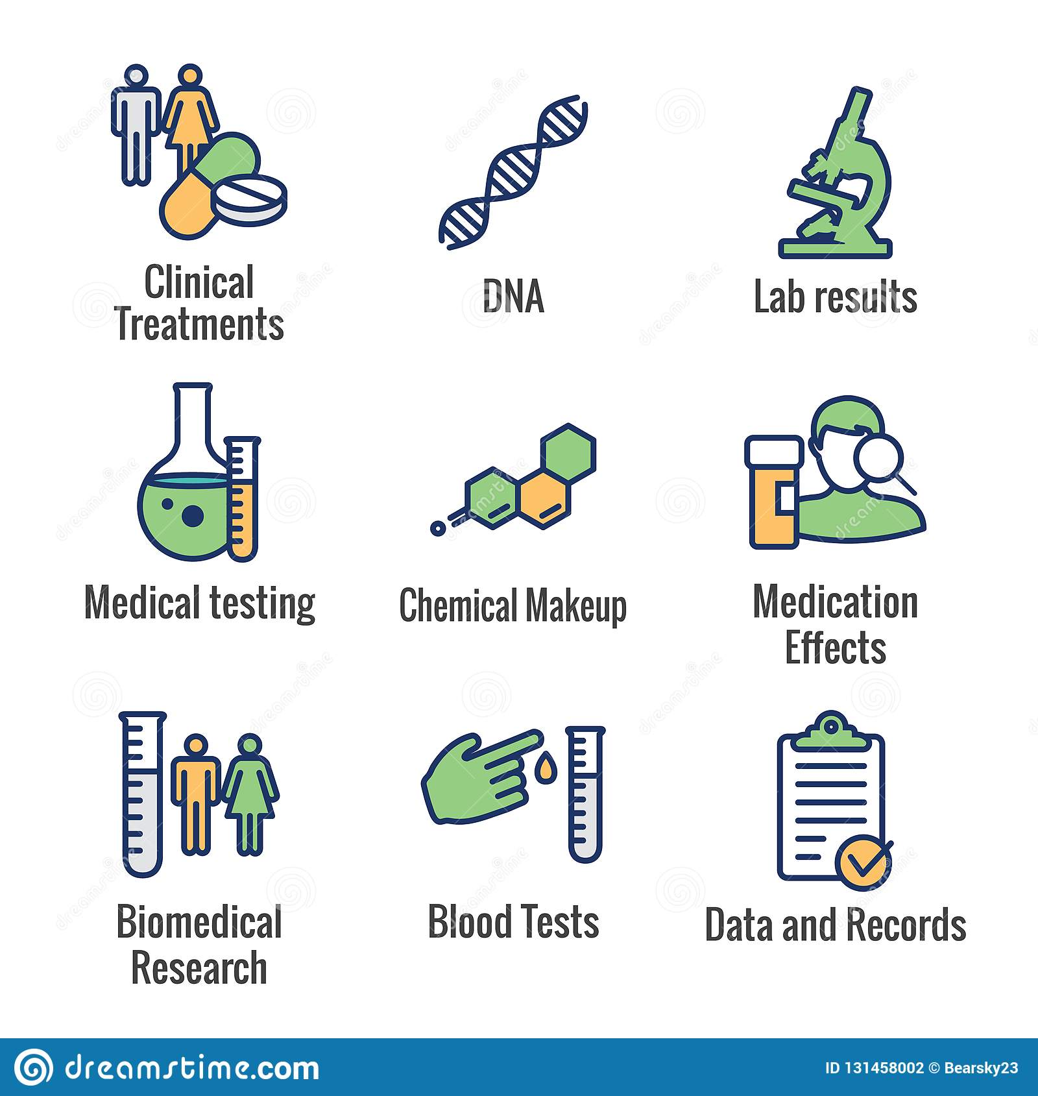
Describe vaccines
Describe what antibiotics are
Key information to include:
What antibiotics do
How new antibiotics work
How they were discovered
Key information to include:
How vaccines work
How vaccines are made
How vaccine prevent disease
Describe the development of antibiotic resistance
Describe what medicines are and where they come from
Key information to include:
What antibiotic resistance is
How antibiotic resistant bacteria develop
Why antibiotic resistant bacteria are a problem
Key information to include:
Penicillin
Docetaxel
Aspirin
Prialt
Vancomycin
Digoxin

