Slide 1
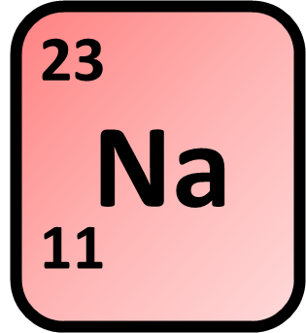
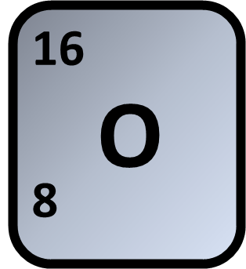
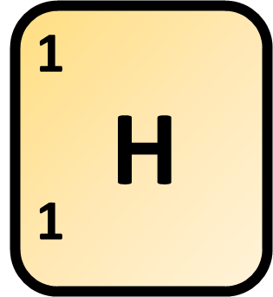


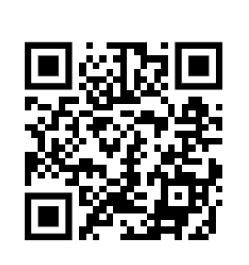
Concentration Calculation
Sodium hydroxide is a solid at room temperature.
Calculate the mass of sodium hydroxide (NaOH) needed to make 500 cm³ of a solution with concentration 0.0750 mol/dm³
1: What id the RFM of sodium hydroxide
2: How many moles sodium hydroxide
Answer
3: Calculate the mass of sodium hydroxide
Link to answer video

