Slide 1
Control of Blood Glucose
Specification Link:
Homeostasis: 4.5.2.4
Highlight key words in the question below:
Reading the question activity:
What do you know about hormones?
____________________________________________________________________________________________________________________________________________________
How do hormones travel around the body?
__________________________________________________________________________
Give some examples of where hormones are released from:
_______________________________________________________________________________________________________________
Many functions of the human body are controlled by chemicals called hormones.
What is a hormone?
Answer:
_____________________________________________________________________________________________________________________________________________________________________________________________________________________________________________________________________________________________________________
Reading the question activity:
What hormones control blood glucose?
_______________________________________________________________________________________________________________
Why does blood glucose need regulating?
__________________________________________________________________________
What are the roles of the hormones in the regulation of glucose?
____________________________________________________________________________________________________________________________________________________
Highlight key words in the question below:
Name the two hormones that control blood glucose concentration and explain what they do within the body
Answer:
_____________________________________________________________________________________________________________________________________________________________________________________________________________________________________________________________________________________________________________
Highlight key words in the question below:
Reading the question activity:
What is negative feedback?
____________________________________________________________________________________________________________________________________________________
_____________________________________
What happens to blood glucose after a meal?
__________________________________________________________________________
Why does blood glucose drop?
______________________________________________________________________
Explain how negative feedback controls the blood glucose concentration during the first one and a half hours after the meal.
Answer:
________________________________________________________________________________________________________________________________________________________________________________________________________________________________________________________________________________________________________________________________________________________

Slide 2
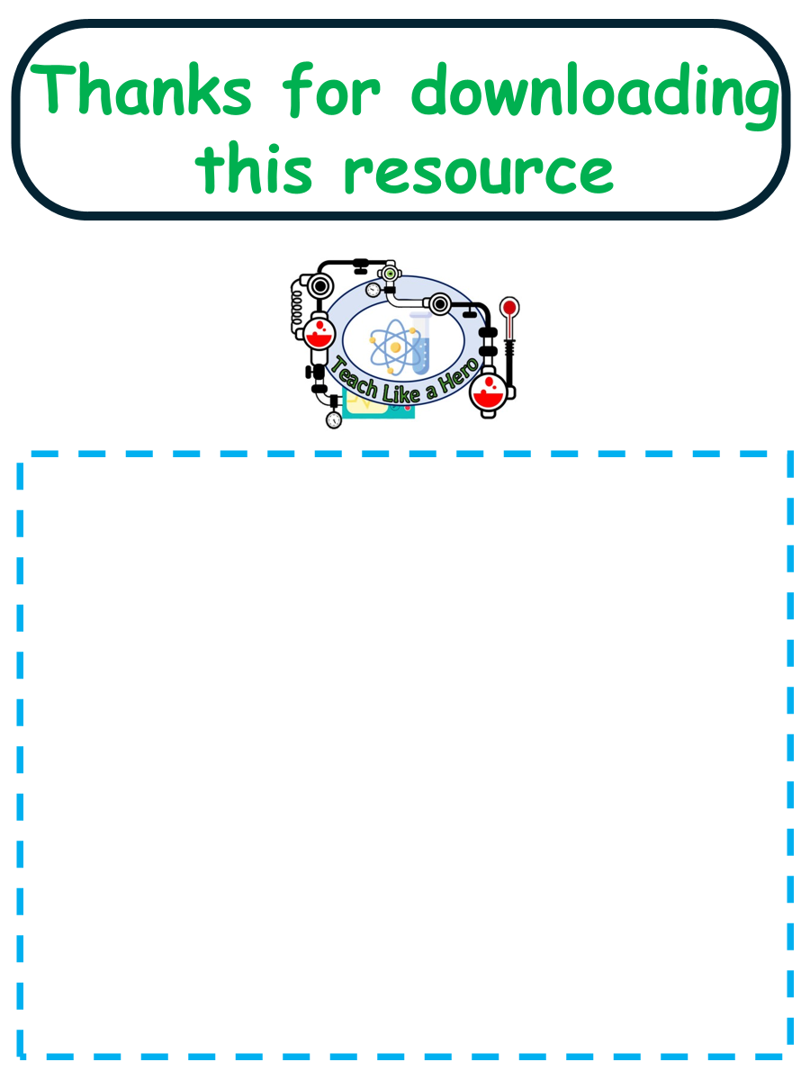
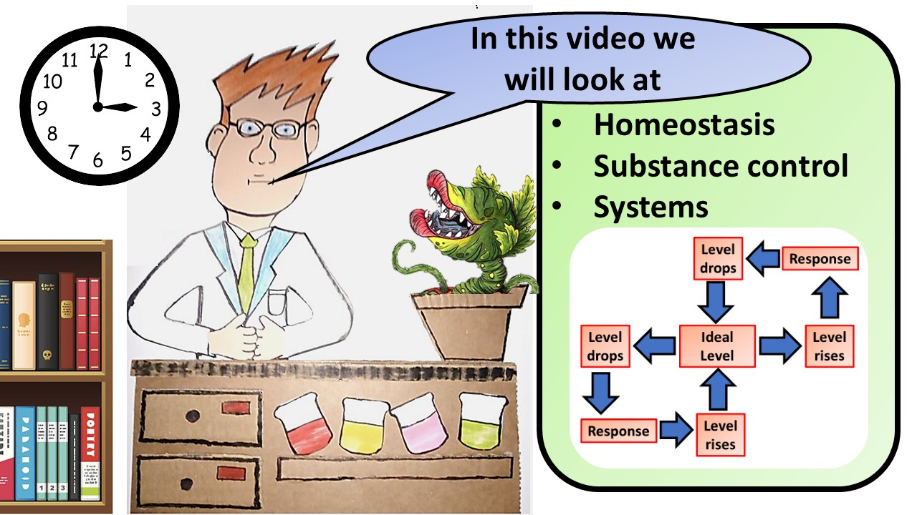
Click here to access my youtube videos
Resources that this activity would work well with
Lesson on TES
Lesson on TPT
Follow me on social media to stay in touch
Keep up to date with my new content:

