Slide 1
Controlling Blood Glucose Question
It is important to keep the blood glucose concentration within narrow limits. A person eats a meal containing a lot of carbohydrate. This causes an increase in the person’s blood glucose concentration.
Explain how the hormones insulin and glucagon control the person’s blood glucose concentration after the meal.
(glucose increases after meal causing) insulin secretion
insulin causes glucose to enter cells / liver / muscles
Answer
(insulin causes) glucose conversion to glycogen
(so) blood glucose decreases causing glucagon secretion
glucagon causes glycogen to be converted to glucose

Slide 2
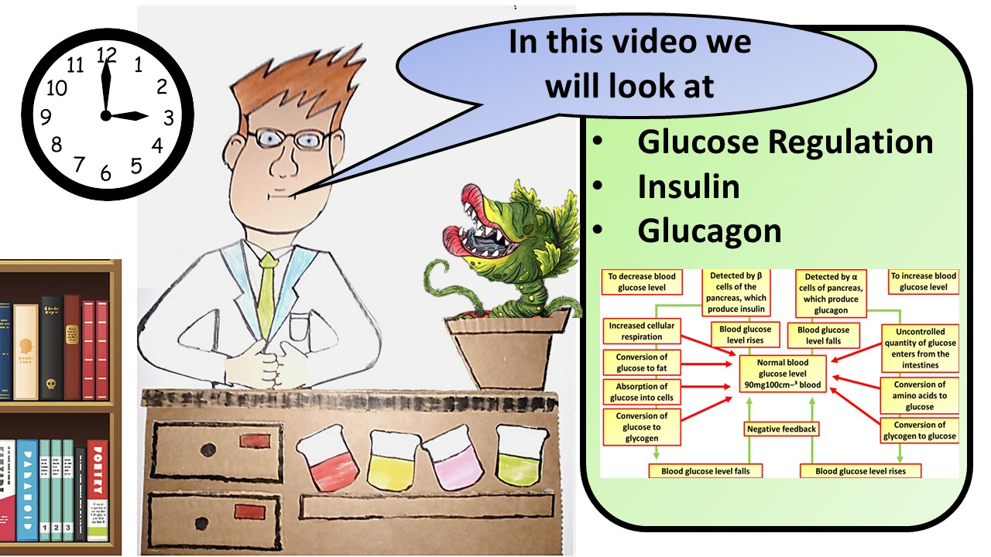
Click here to access my youtube videos
Resources that this activity would work well with
Lesson on TES
Lesson on TPT
Follow me on social media to stay in touch
Keep up to date with my new content:

