Slide 1
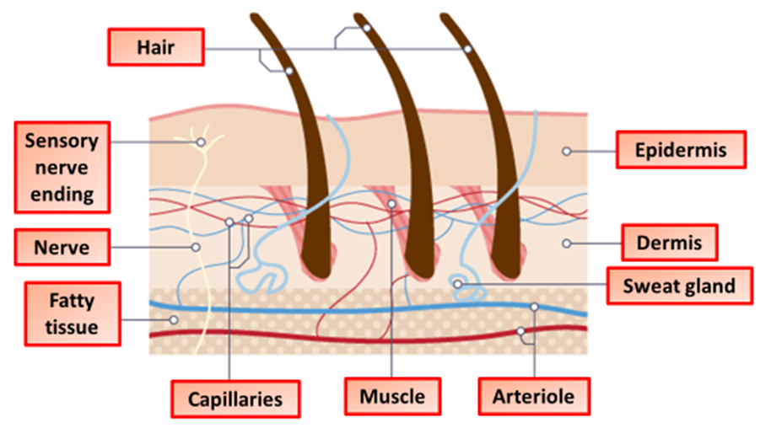
Controlling Body Temperature Question
Humans keep their internal conditions almost constant. Body temperature is kept within a narrow range.
When the core body temperature is too low, this is detected by the thermoregulatory centre in the brain. Describe how the body responds when a decrease in core body temperature is detected.
blood vessels supplying skin constrict
less blood flow (to / through capillaries / to skin)
Answer
so less energy is lost (to the surroundings)
‘shivering’ by muscle (contraction)
releasing energy or respiring (more)
ignore hair erection

Slide 2

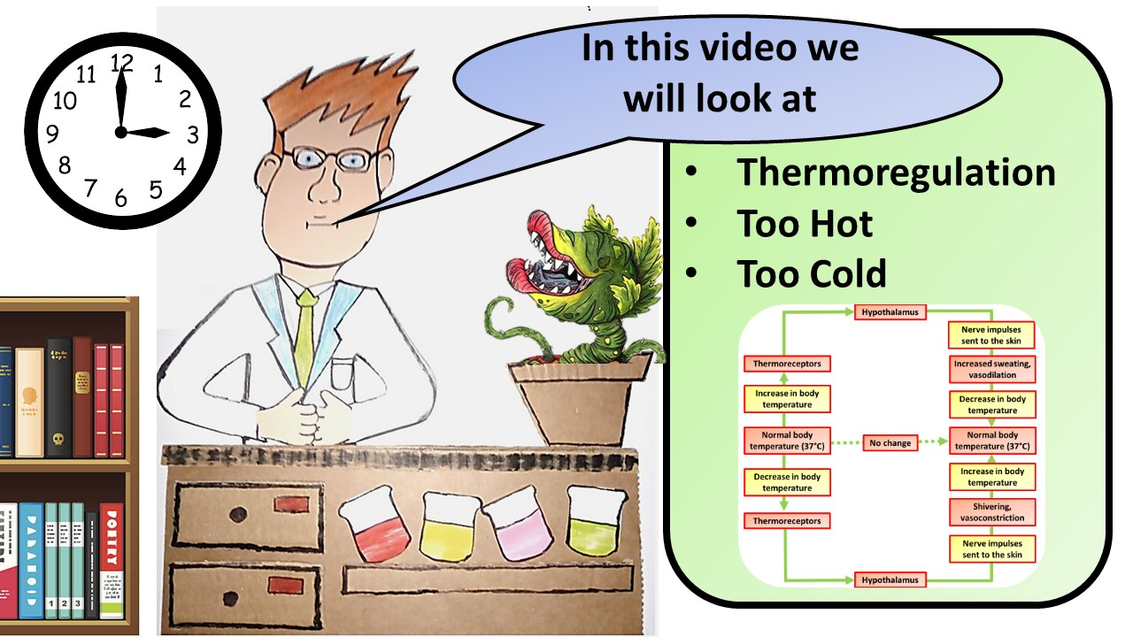


Click here to access my youtube videos
Resources that this activity would work well with
Lesson on TES
Lesson on TPT
Follow me on social media to stay in touch
Keep up to date with my new content:

