Slide 1
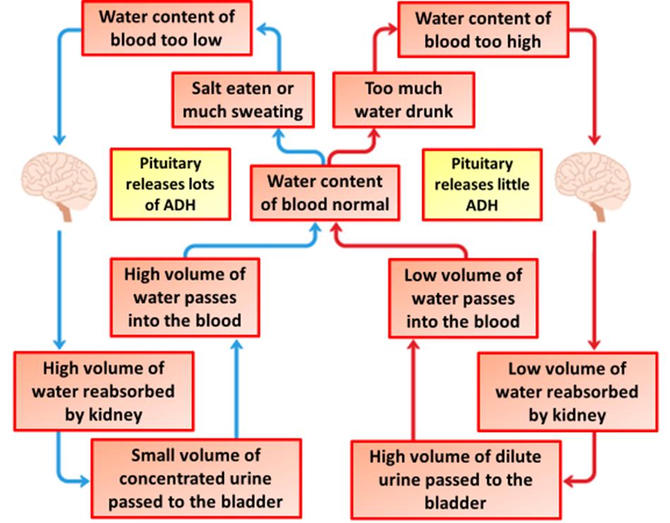
Controlling Body Water Question
Homeostasis keeps conditions in the body relatively constant. The amount of water in the body is controlled by homeostasis.
Kidney function is controlled by a gland in the brain
Describe how the water content of the blood is controlled.
if water content too low, ADH released
from pituitary gland
into the blood
Answer
(causing) kidney reabsorbs more water
more concentrated / small volume urine produced
if water content too high, ADH lowered / not produced
less water reabsorbed by kidney
more dilute / larger volume urine produced

Slide 2

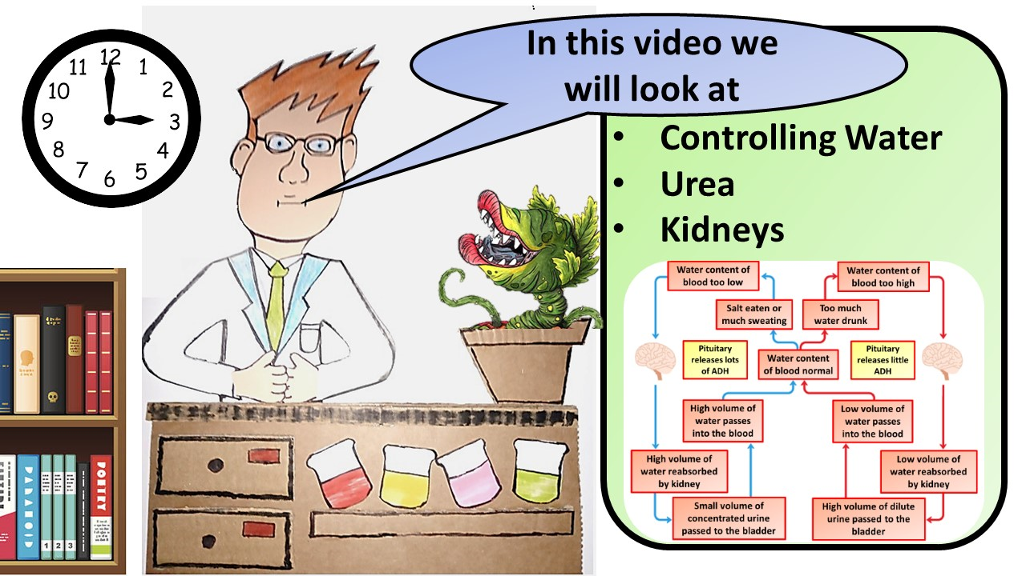


Click here to access my youtube videos
Resources that this activity would work well with
Lesson on TES
Lesson on TPT
Follow me on social media to stay in touch
Keep up to date with my new content:

