Slide 1
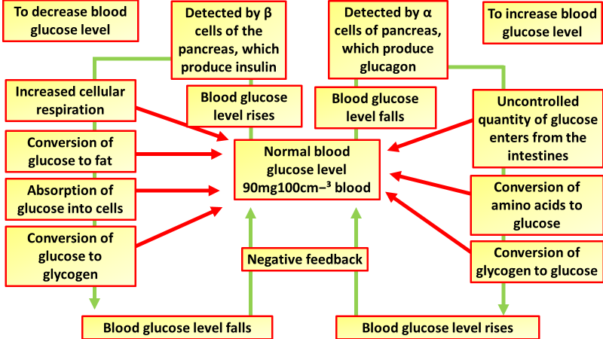
Control of Blood Glucose Question
Specification Link:
Hormonal Communication
Highlight key words in the information below:
Insulin and glucagon are hormones secreted by islet cells within the pancreas. They are both secreted in response to blood sugar levels, but in opposite fashion! Insulin is normally secreted by the beta cells (a type of islet cell) of the pancreas
What is the role of insulin?
_______________________________________________________________________________________
What is the role of glucagon?
_______________________________________________________________________________________
Describe the difference between the roles of insulin and glucagon
______________________________________________________________________________________________________________________________________________________
Why does blood glucose need to be controlled?
_______________________________________________________________________________________
Insulin can't be taken orally to lower blood sugar because stomach enzymes will break down the insulin, preventing its action. You'll need to receive it either through injections or an insulin pump. Injections. You can use a fine needle and syringe or an insulin pen to inject insulin under your skin. Treatment of Type 2 diabetes. Treatment typically includes diet control, exercise, home blood glucose testing, and in some cases, oral medication and/or insulin. Approximately 40% of people with type 2 diabetes require insulin injections
What is normal blood glucose concentration?
__________________________________________________________
What are the differences between treatments for type 1 & type 2 diabetes?
________________________________________________________________________________________________________________________________________________________________________________________________________________________________________________________________________________________________________________________________________________
Stem cells use in islet cell transplants. To cure type 1 diabetes, stem cell replacement needs to be more than simply a case of swapping insulin-producing cells from a healthy pancreas with those destroyed by diabetes in a diabetic patient. Numerous complications preclude this as a simple treatment.
A potential treatment for type 1 diabetes is the use of stem cells. State an advantage of this form of treatment compared to treatment using insulin.
____________________________________________________________________________________________________________________________________________________________________________________________________________________________________________________________________________________________________________

Slide 2

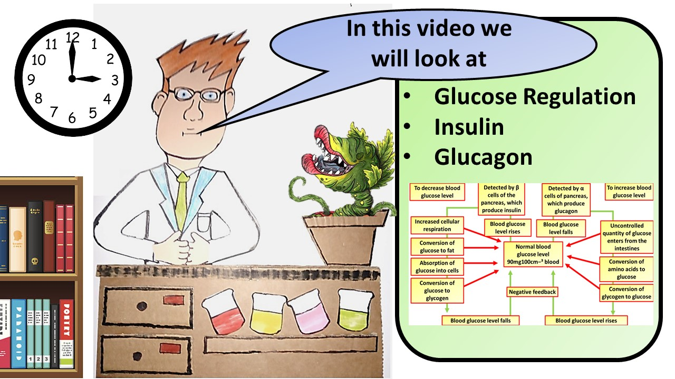


Click here to access my percentage composition youtube videos
Resources that this activity would work well with
Lesson on TES
Lesson on TPT
Follow me on social media to stay in touch
Keep up to date with my new content:

