Slide 1
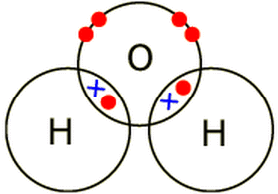
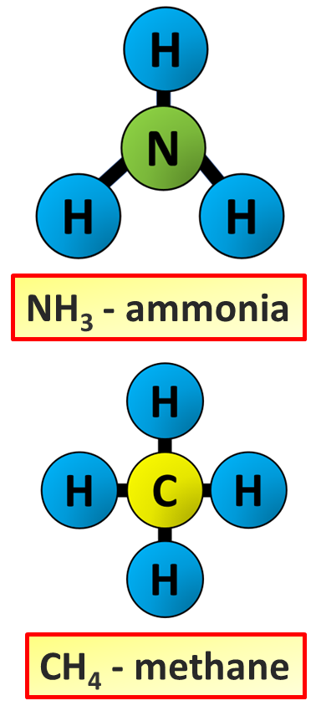
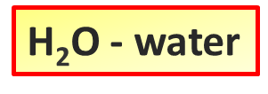
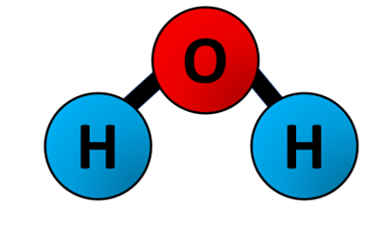
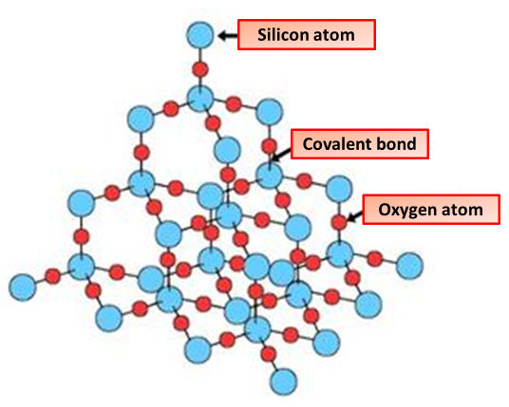
Covalent Bonding
Specification Link:
Bonding
Highlight key words in the information below:
A covalent bond, also called a molecular bond, is a chemical bond that involves the sharing of electron pairs between atoms. These electron pairs are known as shared pairs or bonding pairs, and the stable balance of attractive and repulsive forces between atoms, when they share electrons, is known as covalent bonding
How many electrons does an atom want in it’s outer shell?
___________________________________________
Covalent bonds form between non-metal atoms. Each bond consists of a shared pair of electrons, and is very strong. Simple molecular substances and giant covalent structures have different properties.
If an atom has 4 electrons how many electrons does it need to share?
___________________________________________
Describe the properties of simple covalent molecules
________________________________________________________________________________________________________________________________________________________________________________________________________________________________________________________________________________________________
Describe how the structure of water affects it’s properties
_________________________________________________________________________________________________________________________________________________________________________________________________________________________________
Giant covalent structures contain very many atoms , each joined to adjacent atoms by covalent bonds . The atoms are usually arranged into giant regular lattices - extremely strong structures because of the many bonds involved.
Describe the bonding in giant covalent molecules & how this effects their properties
_______________________________________________________________________________________________________________________________________________________________________________________________________________________________________________________________________________________________________________________________________________________________________________________________________________________________________________________________________________________________________________

Slide 2
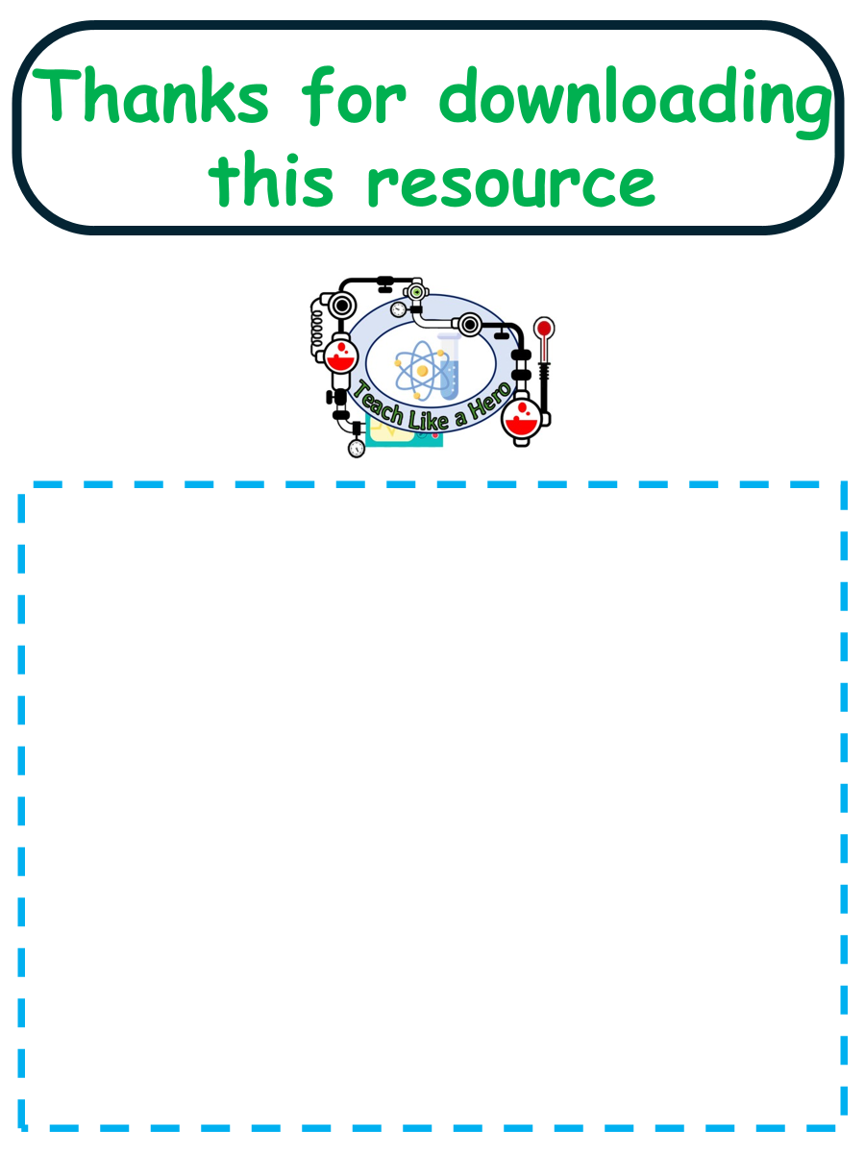
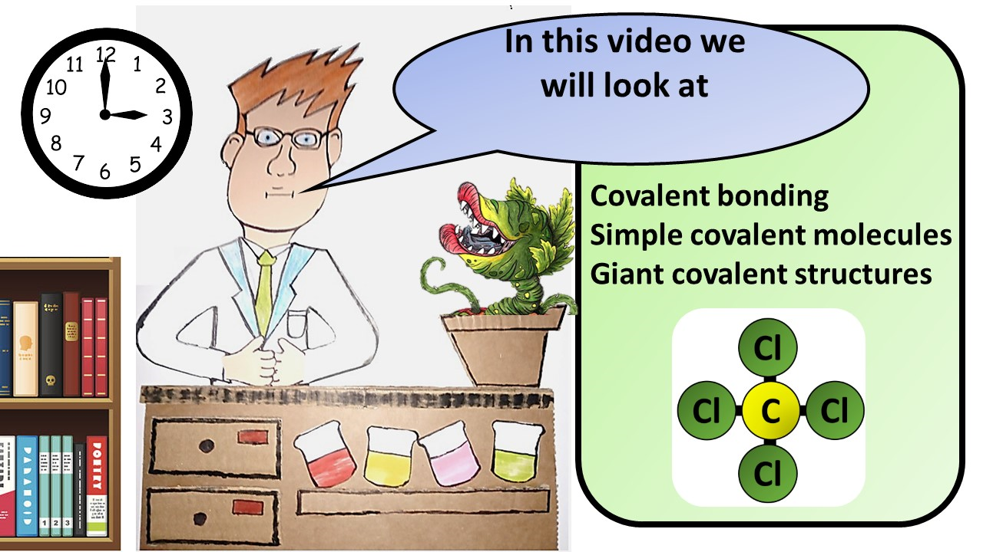
Click here to access my youtube videos
Resources that this activity would work well with
Lesson on TES
Lesson on TPT
Follow me on social media to stay in touch
Keep up to date with my new content:

