Slide 1
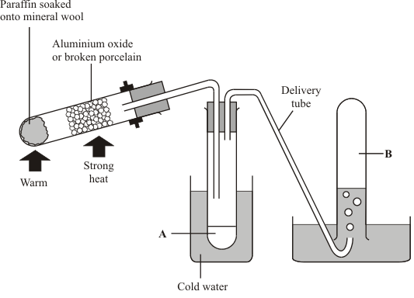
Cracking Practice Question
The diagram shows an apparatus that can be used to carry out cracking reactions in a laboratory.
The oil industry uses a similar technique to crack long chain hydrocarbons into short ones. Explain, as fully as you can why cracking is used in the oil industry and how they carry it out.
Key things to include:
What temperature is it carried out at
Why is a catalyst added
How are the short chain hydrocarbons separated
_____________________________________________________________________________________________________________________________________________________________________________________________________________________________________________________________________________________________________________________________________________________________________________________________________________________________________________________________________________________________________________________________________
Answer
Link to video

Slide 2
Cracking Practice Question

Slide 3
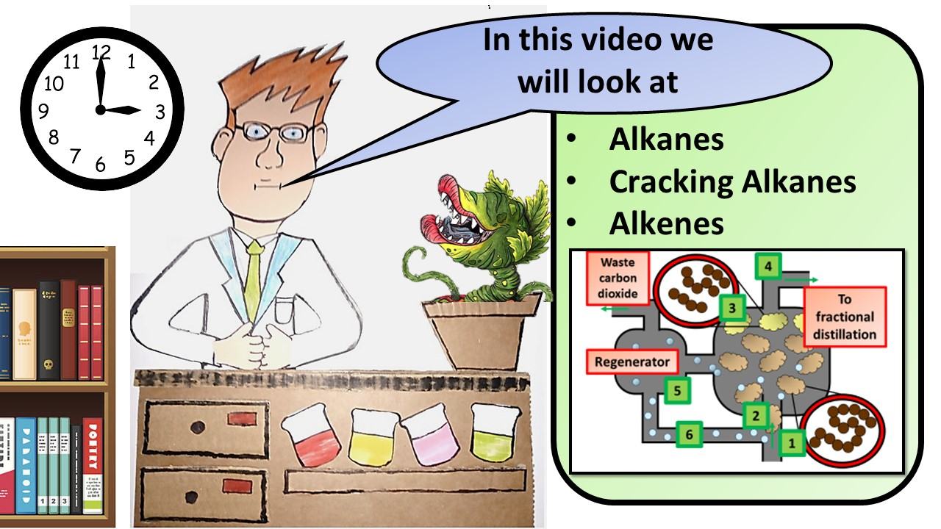
Click here to access my youtube videos
Resources that this activity would work well with
Lesson on TES
Lesson on TPT
Follow me on social media to stay in touch
Keep up to date with my new content:

