Slide 1
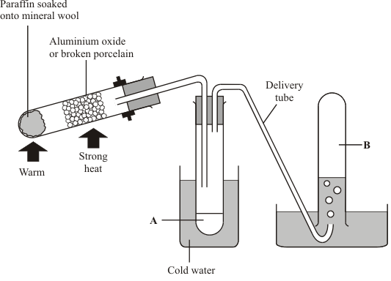
Cracking Practice Question
The diagram shows an apparatus that can be used to carry out cracking reactions in a laboratory.
The oil industry uses a similar technique to crack long chain hydrocarbons into short ones. Explain, as fully as you can why cracking is used in the oil industry and how they carry it out.
Long chain hydrocarbons are heated until they turn into a vapour
A catalyst of zeolite crystals is added
The long chain hydrocarbon molecules are broken down into smaller ones
The cracked hydrocarbons can have double bonds
Answer
The mixture of cracked molecules is pumped into a fractional distillation column where they are separated
During the reaction the catalyst becomes coated with carbon so is pumped into a regenerator where it is burnt off
The cleaned catalyst flows back into the reaction vessel to be reused

Slide 2
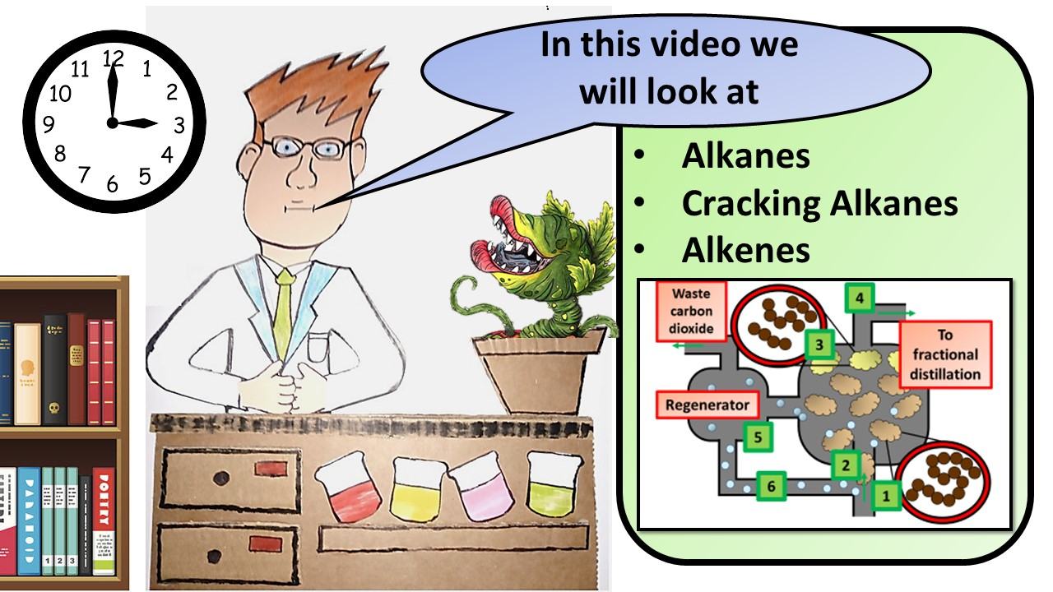
Click here to access my youtube videos
Resources that this activity would work well with
Lesson on TES
Lesson on TPT
Follow me on social media to stay in touch
Keep up to date with my new content:

