Slide 1
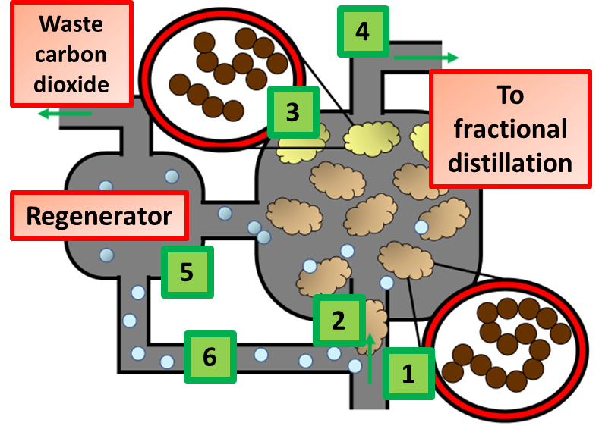
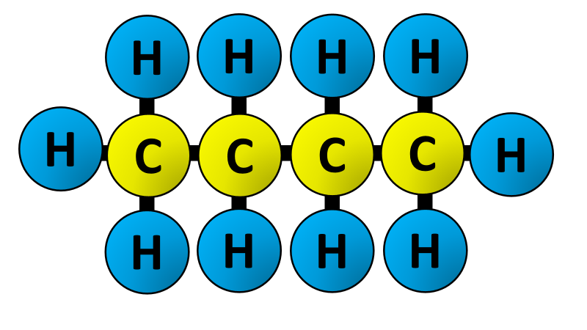
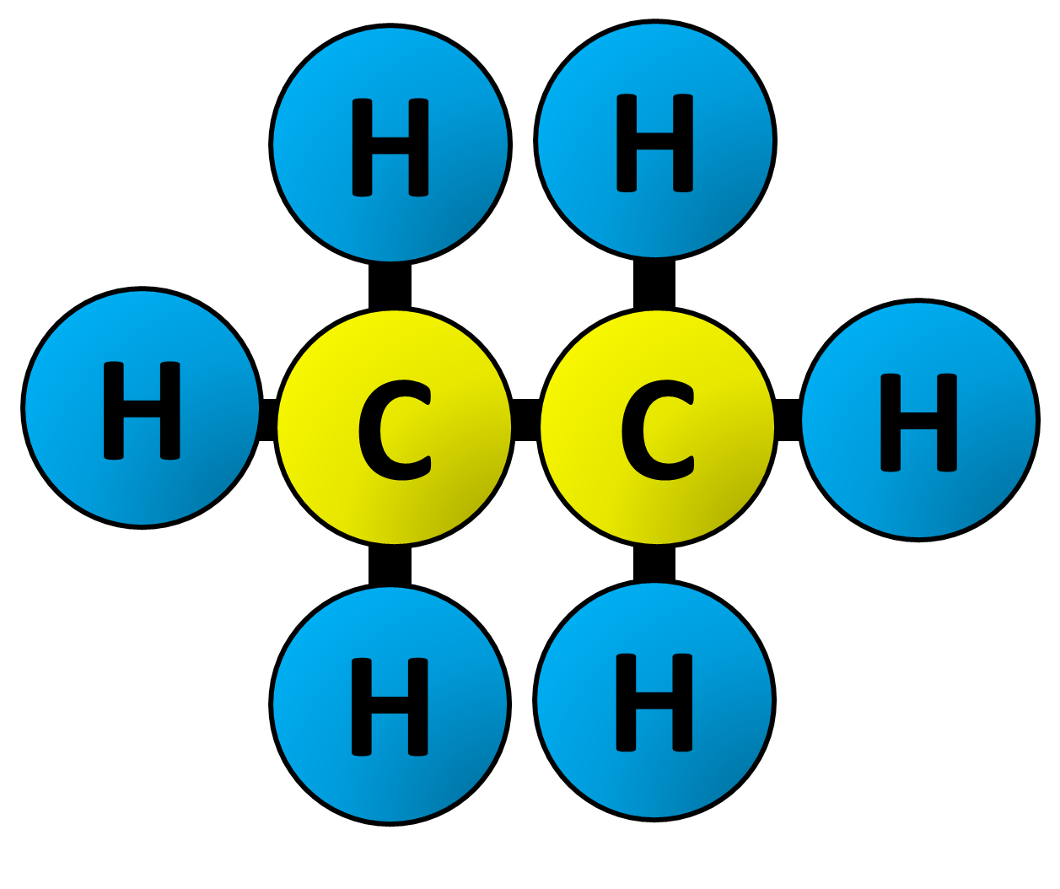
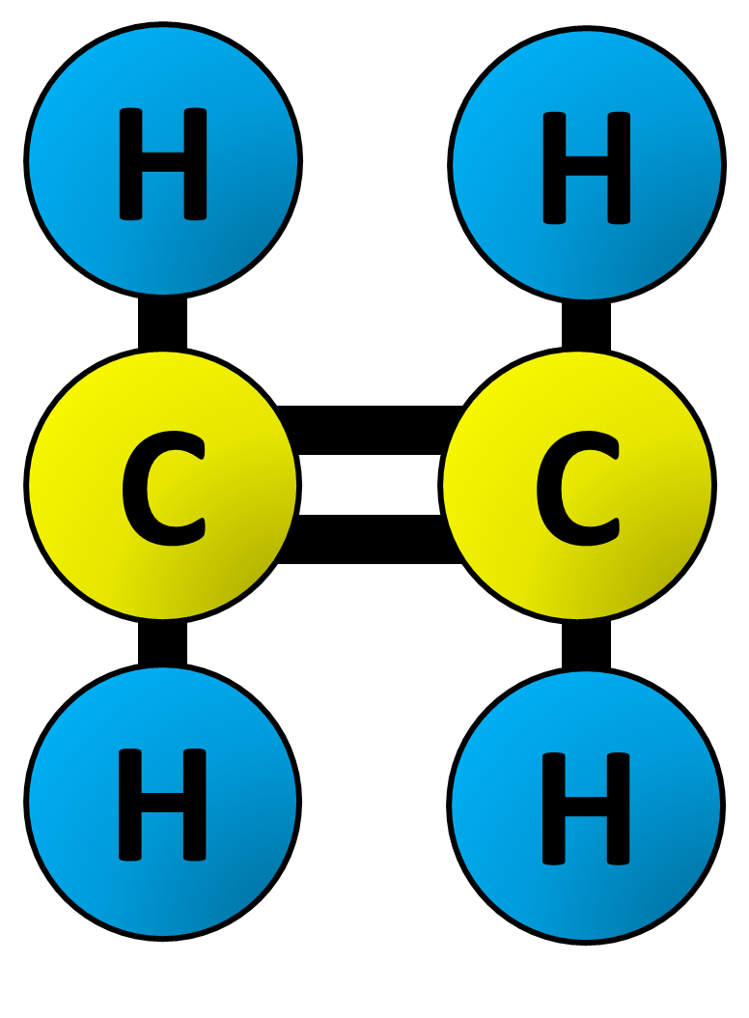
Cracking Hydrocarbons Question
Specification Link:
Organic Chemistry
Highlight key words or phrases
Cracking is the breakdown of a large alkane into smaller, more useful alkenes. Simply put, hydrocarbon cracking is the process of breaking a long-chain of hydrocarbons into short ones. This process requires high temperatures and high pressure.
The diagram shows how large hydrocarbons can be cracked into smaller ones. Describe this process in 6 stages:
________________________________________________________________________________________________________________________________________________________________________________________________________________________________________________________________________________________________________________________________________________________
What length hydrocarbons are cracked?
______________________________________
What length hydrocarbons are cracked?
______________________________________
What catalyst is used?
______________________________________
How is the catalyst regenerated?
____________________________________________________________________________
Why do the cracked hydrocarbons need to go back to the fractional distillation column?
____________________________________________________________________________
The diagram above shows what happens to a molecule during cracking. Explain what has happened to the large molecule and the differences between the 2 smaller molecules made:
_____________________________________________________________________________________________________________________________________________________________________________________________________________________________________________________________________________________________________________
Highlight key words or phrases
Alkenes are a class of hydrocarbons (e.g, containing only carbon and hydrogen) unsaturated compounds with at least one carbon-to-carbon double bond. Another term used to describe alkenes is olefins. Alkenes are more reactive than alkanes due to the presence of the double bond.
Describe how the equipment to the left could be used to measure the rate of photosynthesis:
_______________________________________________________________________________________________________________________________________________________________________________________________________________________________________________________________

