Slide 1
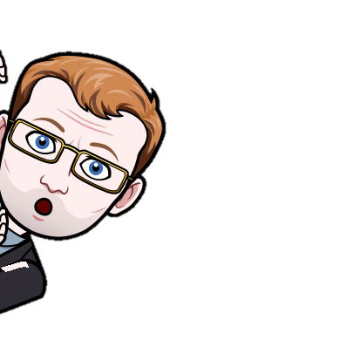

What is online bullying and how can we deal with it

Slide 2
What is online bullying and how can we deal with it
What is Cyberbullying?
Cyberbullying is bullying with the use of digital technologies. It can take place on social media, messaging platforms, gaming platforms and mobile phones. It is repeated behaviour, aimed at scaring, angering or shaming those who are targeted. Examples include:
spreading lies about or posting embarrassing photos of someone on social media
sending hurtful messages or threats via messaging platforms
impersonating someone and sending mean messages to others on their behalf.

Slide 3
What is online bullying and how can we deal with it
What is Cyberbullying?
The most common places where cyberbullying occurs are:
Social Media, such as Facebook, Instagram, Snapchat, and Tik Tok
Text messaging and messaging apps on mobile or tablet devices
Instant messaging, direct messaging, and online chatting over the internet
Online forums, chat rooms, and message boards, such as Reddit
Email
Online gaming communities

Slide 4
What is online bullying and how can we deal with it
What are the effects of cyberbullying?
When bullying happens online it can feel as if you’re being attacked everywhere, even inside your own home. It can seem like there’s no escape. The effects can last a long time and affect a person in many ways:
Mentally — feeling upset, embarrassed, stupid, even angry
Emotionally — feeling ashamed or losing interest in the things you love
Physically — tired (loss of sleep), or experiencing symptoms like stomach aches and headaches
The feeling of being laughed at or harassed by others, can prevent people from speaking up or trying to deal with the problem. In extreme cases, cyberbullying can even lead to people taking their own lives.

Slide 5
What is online bullying and how can we deal with it
Cyber Bullying Podcast
Your Task
In groups you will need to plan and present a podcast giving advice on online bullying. You will need to include:
What cyber bullying is
What people can do to try and stop it
You will need to prepare at least 2 mins worth of content that you will be presenting to another group

